Slide 1
Mizan: Optimizing Graph Mining in Large Parallel Systems
Panos Kalnis
King Abdullah University of Science and Technology (KAUST)
H. Jamjoom (IBM Watson) and Z. Khayyat, K. Awara (KAUST)

Slide 2
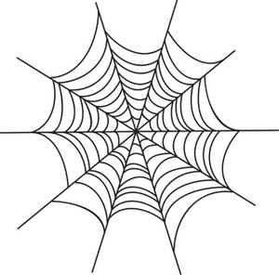
Graphs: Are they Important?
Graphs are everywhere
  Internet Web graph
  Social networks
  Biological networks
Processing graphs
  Find patterns, rules, anomalies
  Rank web pages
  ‘Viral' or 'word-of-mouth' marketing
  Identify interactions among proteins
  Computer security: anomalies in email traffic

Slide 3
Graph Research in InfoCloud
Panos
isA
FD³: RDF query engine
  Distributed
  On-the-fly placement and indexing
GraMi: Graph mining
  E.g., find frequent subgraphs
Mizan
  Framework for executing graph algorithms
  Distributed, large-scale
GOAL: Graph DBMS
professor
works
studies
KAUST
Yasser
isA
student

Slide 4
Existing Graph-processing Frameworks
Map-Reduce based
  HADI, Pegasus
Message passing
  Pregel
Specialized graph engines
  Parallel Boost Graph Library (pBGL)

Slide 5
PageRank with Map-Reduce
2
Write on
HDFS
Write on
HDFS
5
Reduce-1
Reduce-1
3
4
2 | 3
2 | v₂
3 | v₂
1 | v₂
2 | v₂
2 | v₂
1
2 | 1
Map-1
1 | v₂
1 | v₁ v₂ v₃ v₄ v₅
2 | 3
3 | 1
2 | 1
5 | 1
4 | 1
2 | v₂
1 | v₁ v₃
Map-1
1 | v₁
1 | v₁
Reduce-2
1 | v₄ v₅
Map-2
3 | 1
3 | v₃
1 | v₃
4 | 1
Reduce-2
Map-2
3 | v₂
3 | v₂ v₃
2 | v₂
3 | v₃
1 | v₁
5 | v₅
4 | v₄
3 | v₃
4 | v₄
1 | v₄
3 | v₃
4 | v₄
4 | v₄
4 | v₄
Reduce-3
Map-3
Map-3
5 | 1
5 | v₅
1 | v₅
Reduce-3
5 | v₅
5 | v₅
5 | v₅

Slide 6
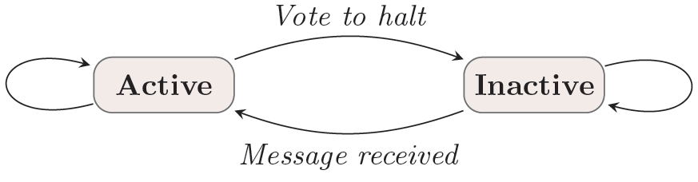
Pregel^{[1]}
Bulk Synchronous Parallel model
Statefull model: long-lived processes compute, communicate, and modify local state
  vs. data-flow model: process computes solely on input data and produces output data
[1] G. Malewich et al., Pregel: a system for large scale graph processing, SIGMOD, 2010

Slide 7
Pregel Example: MAX
3
6
6
6
2
1
2
6
6
6
6
6
6
6
6
6
Example from [Malewich et al., SIGMOD, 2010]

Slide 8
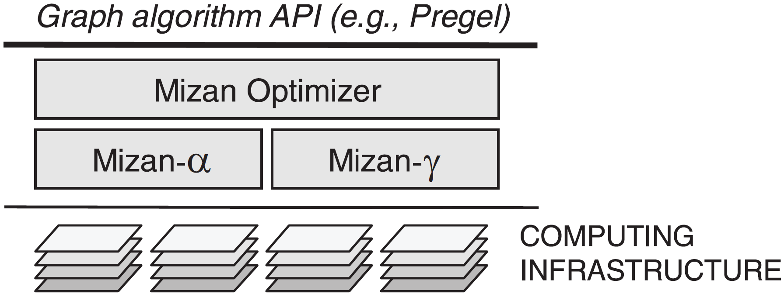
Mizan - Overview
Min-cut partitioning of input graph
Point-to-point message passing
Good for power-law graphs
Random partitioning of input
Ring overlay message passing
Good for non-power-law graphs

Slide 9
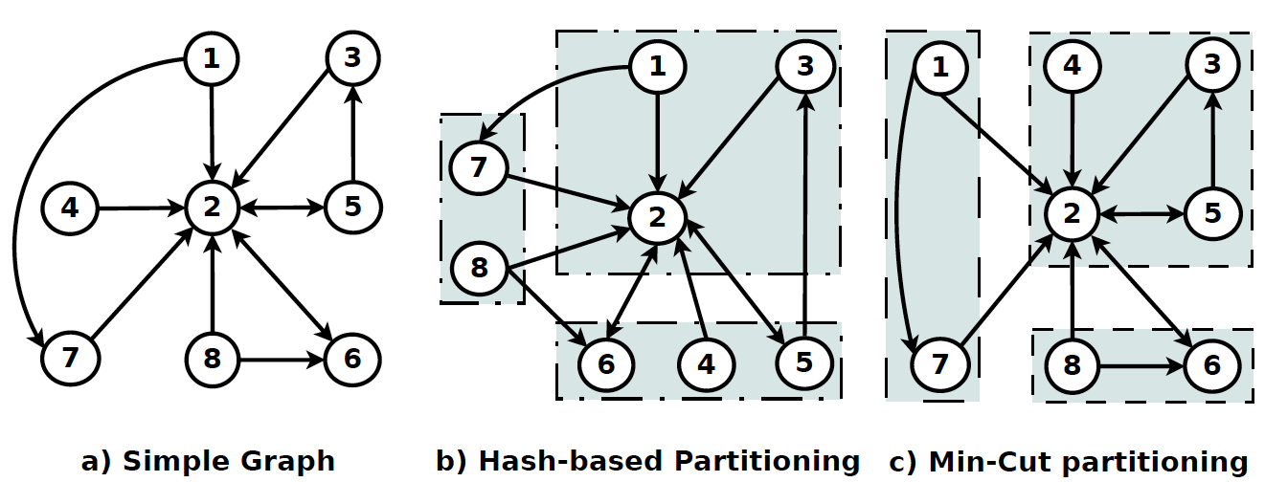
α – Minimum-Cut Partitioning

Slide 10
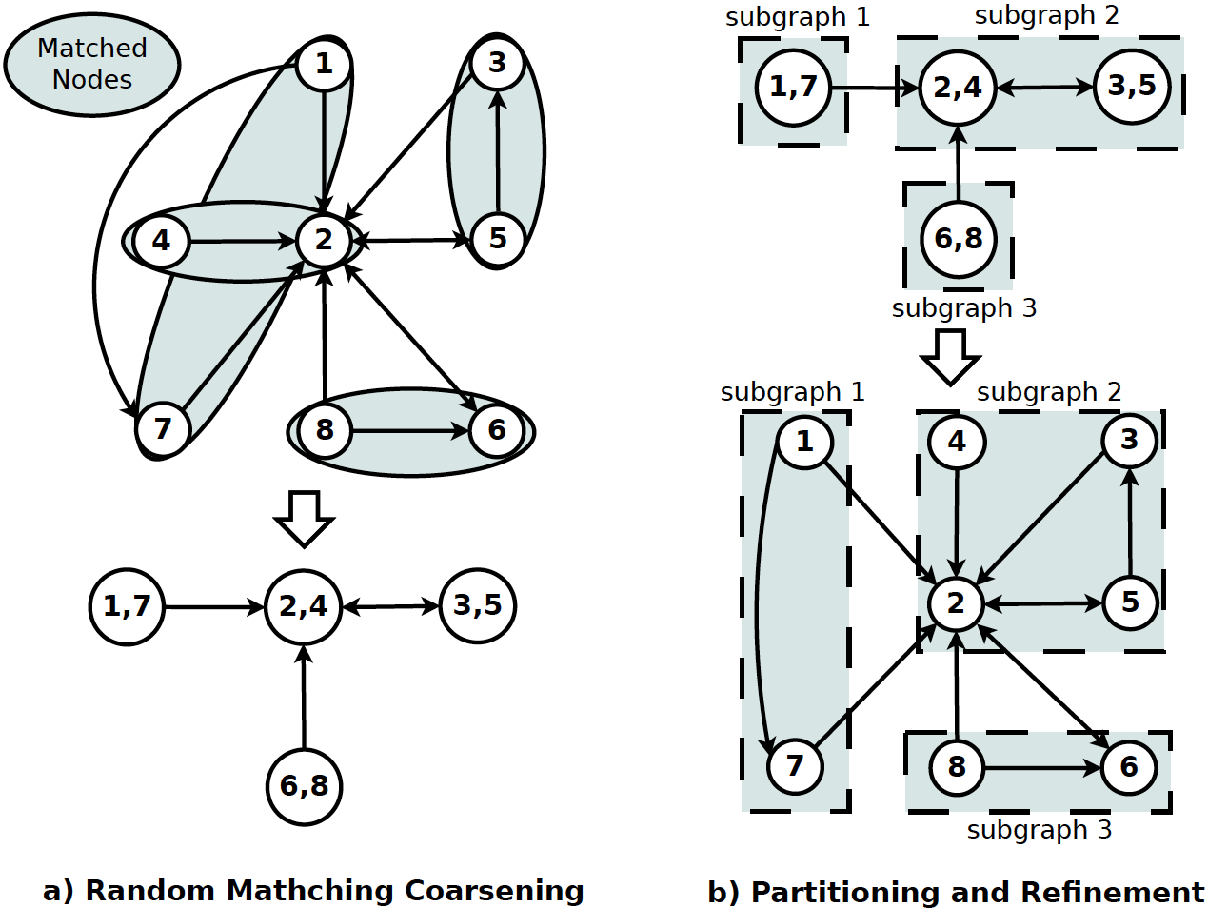
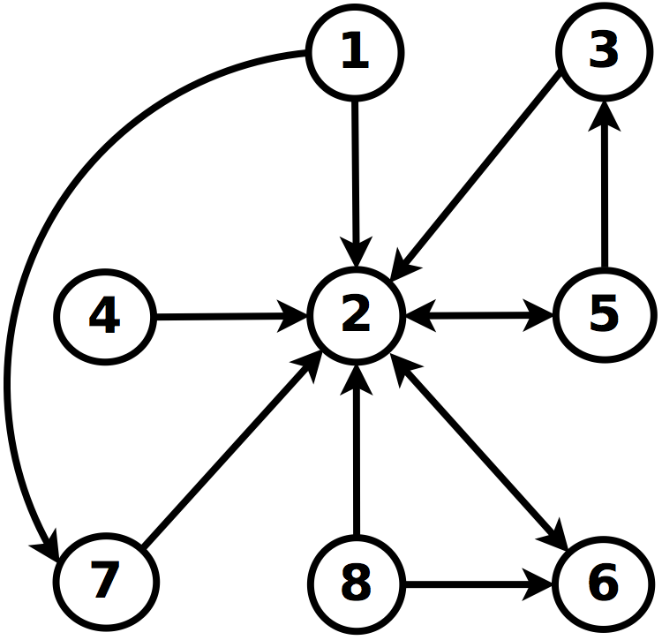
METIS ^{[2]}
[2] Karypis and Kumar, “Multilevel k-way Partitioning Scheme for Irregular Graphs”, JPDC, 1998
Notes:
Multilevel coarsening; visit all nodes of the graph and choose randomly one of the neighbors to combine. Sum the weights of edges and nodes. The results is Gm
k-way partitioning of Gm is computed using a multilevel bisection algorithm. Why don’t use coarsening down to k? Even if we are able to coarsen the graph down to only k vertices, the weights of these vertices are likely to be quite different, making the initial partitioning highly unbalanced.
Un-coarsening: Note that, even if the partitioning of Gi is at a local minima, 4 the projected partitioning of Gi−1 may not be at a local minima. Since Gi−1 is finer, it has more degrees of freedom that can be used to further improve the partitioning and thus decrease the edge-cut. Hence, it may still be possible to improve the projected partitioning of Gi−1 by local refinement heuristics.

Slide 11
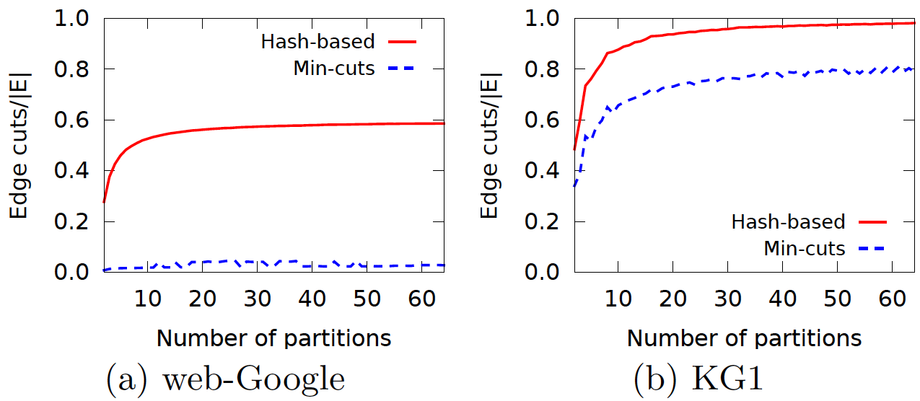
α – Percentage of Edge Cuts with Minimum-Cut Partitioning
Power-law
Non-Power-law

Slide 12
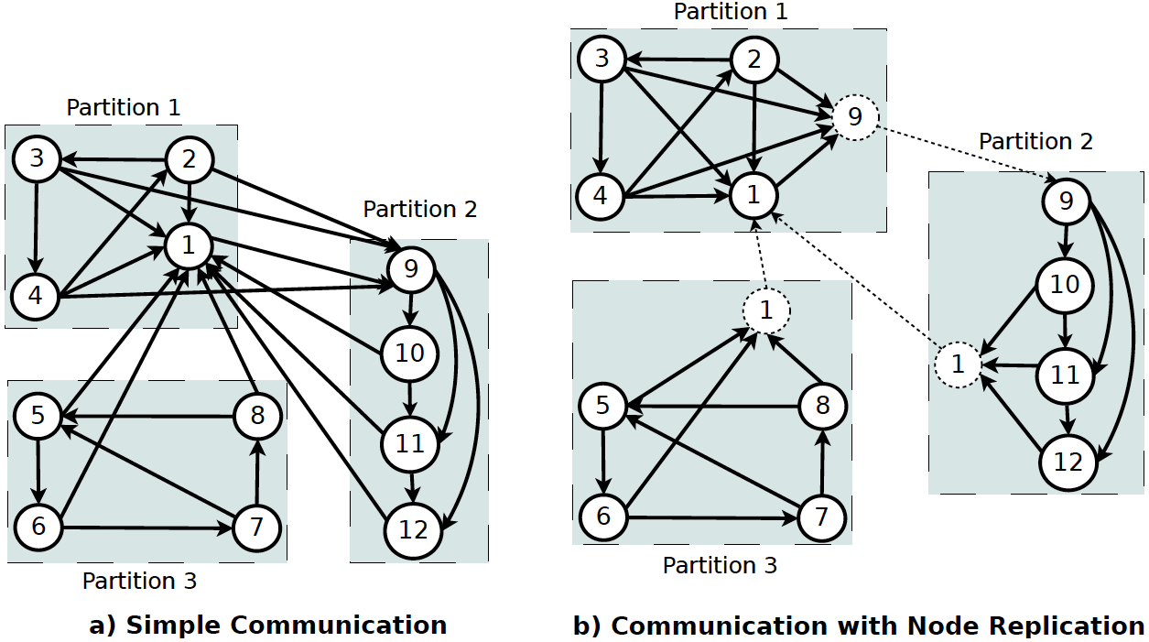
α – Node Replication
Notes:
combiners should only be enabled for
commutative and associative operations

Slide 13
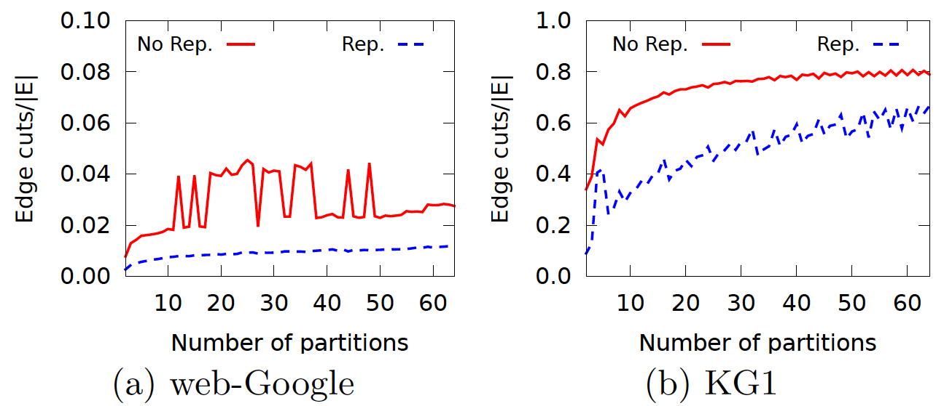
α – Percentage of Edge Cuts with Node Replication
Power-law
Non-Power-law

Slide 14
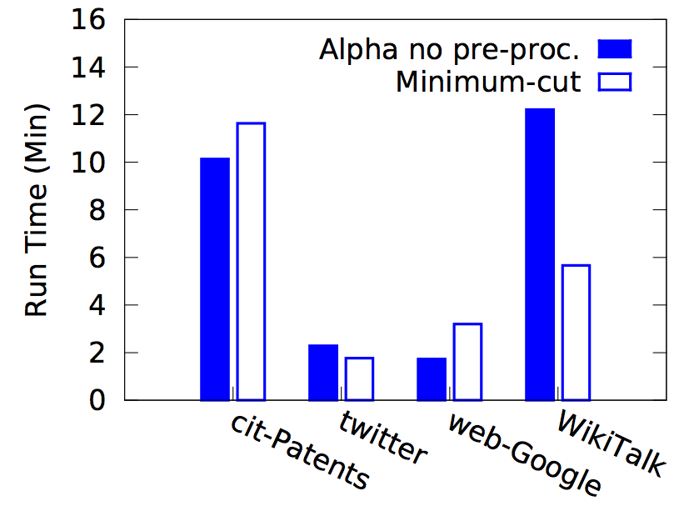
Cost of Min-Cut Partitioning
Partition
User’s code

Slide 15
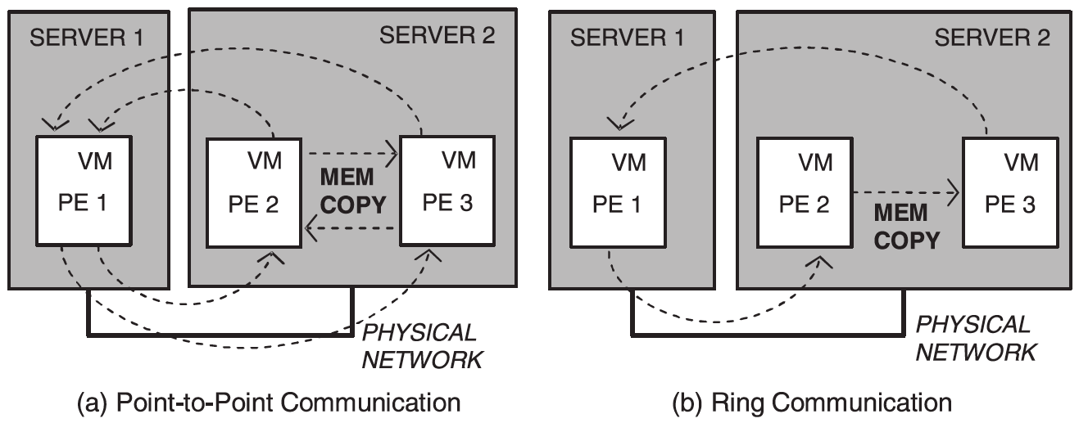
γ – Message-passing in a Ring
2
1
1
2
Point-to-Point communication
Ring-based communication
Mizan-γ

Slide 16
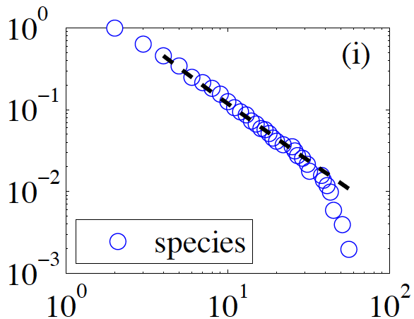
Optimizer
α → Partitioning cost (min-cut)
  Pays off for power-law graphs
γ → Latency due to the ring
  Each message must be needed by many nodes
  Good for non-power law graphs
Is the input power-law?
  Take a random sample
  Use [2] to compare with theoretical
  power-law distribution
  Compute pValue
  0.1 ≤ pValue < 0.9 ➔Power-law
[2] A. Clauset et al., Power-Law Distributions in Empirical Data. SIAM Review, 51(4), 2009.

Slide 17
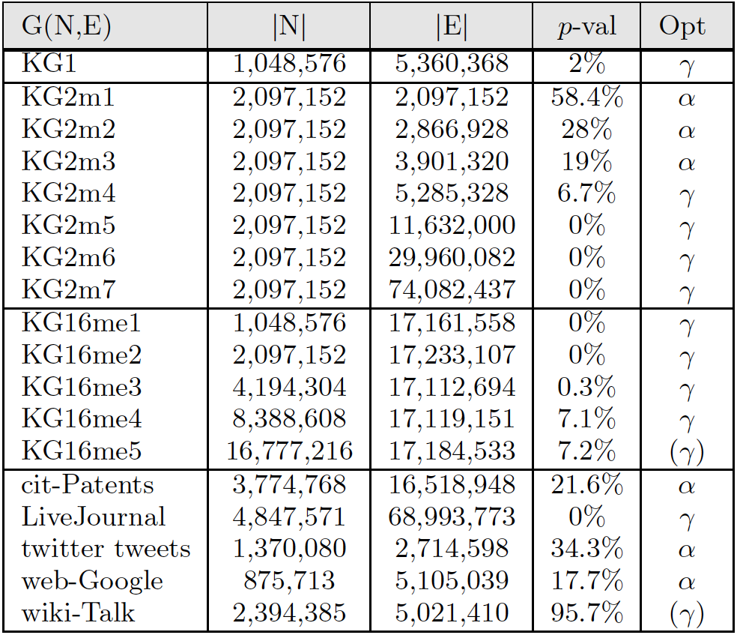
Datasets & Optimizer’s Decisions
Synthetic
Real

Slide 18
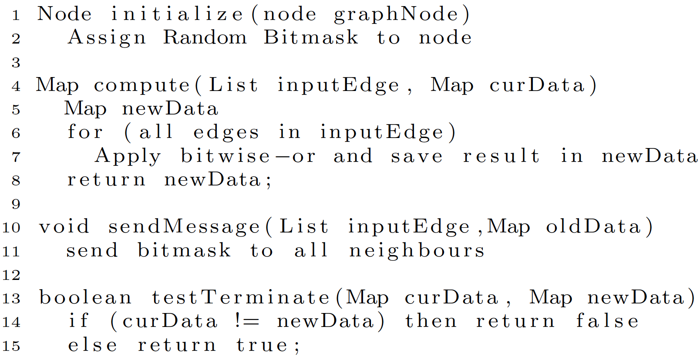
Example: Diameter Estimation

Slide 19
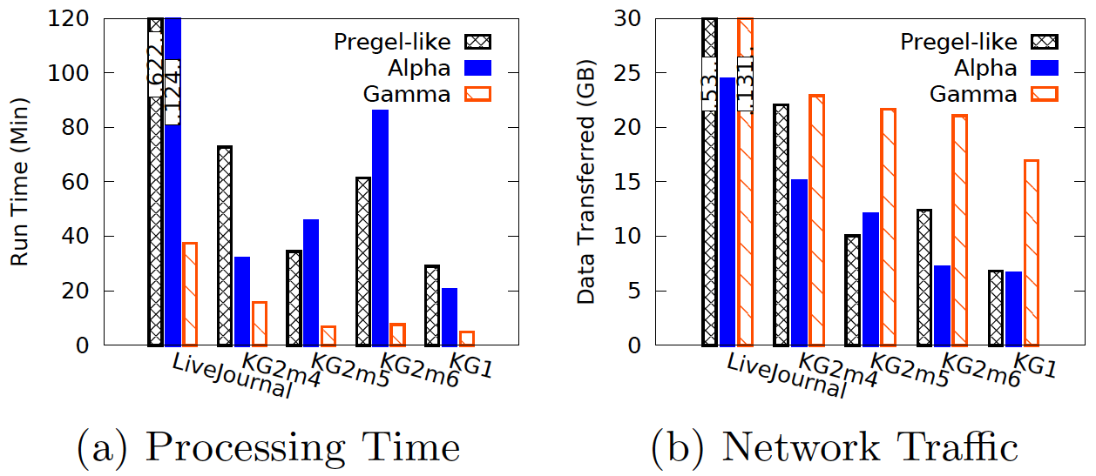
Non-Power-law
8 EC2 instances, Diameter estimation

Slide 20
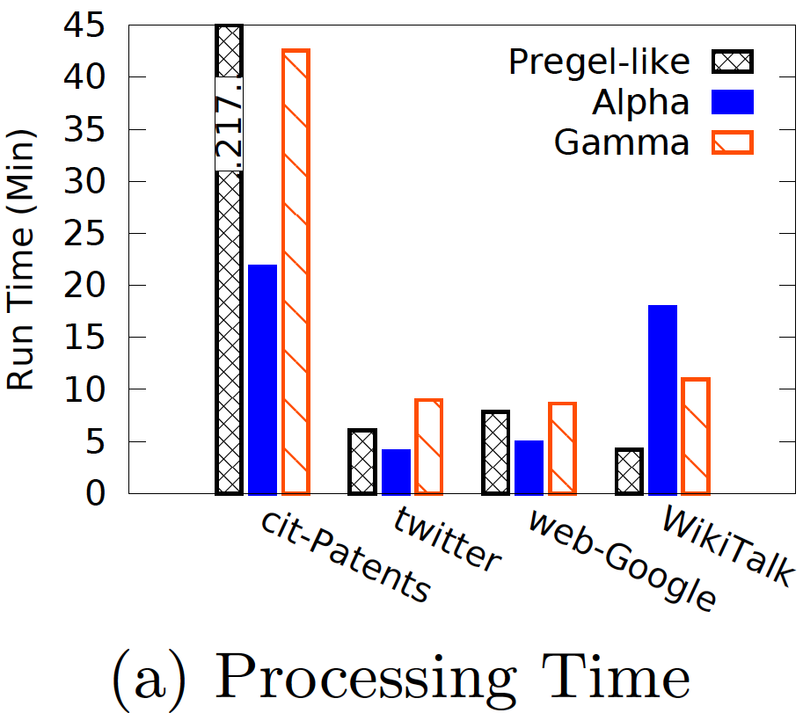
Power-law
8 EC2 instances, Diameter estimation

Slide 21
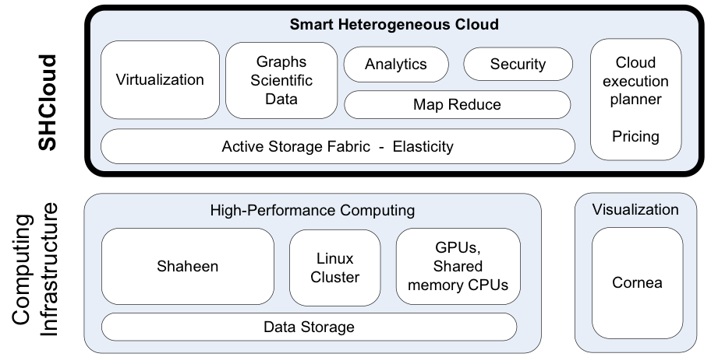







Cloud Computing in KAUST
Scientific & commercial Applications

Slide 22
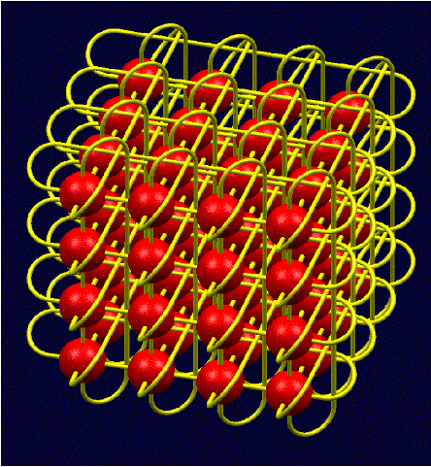
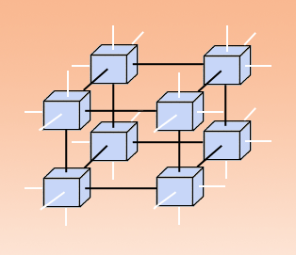
IBM BlueGene/P – 3D Torus Network

Slide 23
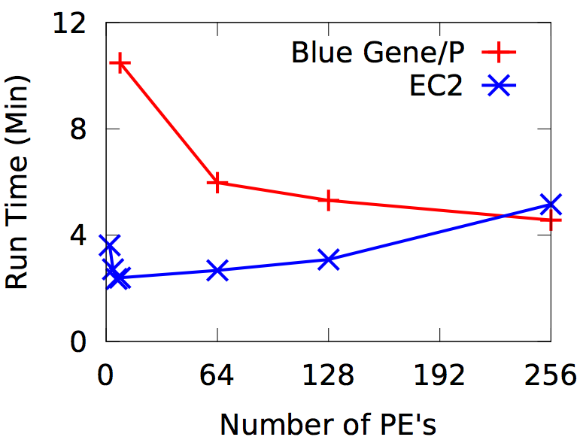
IBM-BlueGene/P vs. Amazon EC2
IBM/P: 850MHz
EC2: 2.4GHz
Notes:
After 64 Pes, the size of the input per processor becomes too small, so performance drops. Common problem in HPC. Must check weak scalability.

Slide 24
Points to remember
Mizan: Framework for graph algorithms in large scale computing infrastructures
  α: Power-law graphs
  γ: Non-power-law graphs
  Runs on cloud and on supercomputers
To do list:
  Dynamic graph placement
  Hybrid (alpha and gamma)
  Better optimizer

Slide 25


Questions?
CL UD
KAUST
http://cloud.kaust.edu.sa

