Slide 1
Crowdsourcing using Mechanical Turk:
Quality Management and Scalability
Panos Ipeirotis
Stern School of Business
New York University
Twitter: @ipeirotis
“A Computer Scientist in a Business School”
http://behind-the-enemy-lines.com
Joint work with: Jing Wang, Foster Provost, Josh Attenberg, and Victor Sheng; Special thanks to AdSafe Media
Notes:
Micro-outsourcing systems (like AMT, RentaCoder, oDesk, and many more) have changed the cost/benefit landscape for data analytics. Certain sorts of data can be acquired much more cheaply—but the data quality may be suspect.

Slide 2
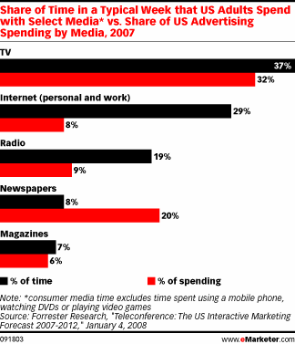
Brand advertising not embraced Internet advertising yet…
Afraid of improper brand placement
Notes:
total media ad spending is about $300B
laments about poor “performance” of ads on social networking sites are criticisms of direct marketing-style advertising, as well as click-based evaluations.

Slide 3
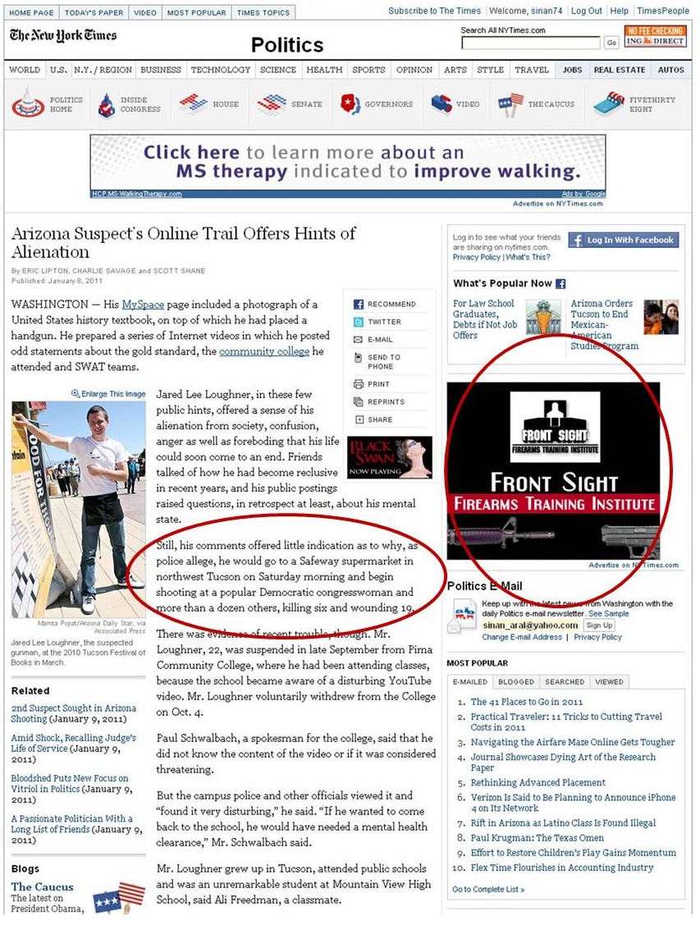
Gabrielle Giffords Shooting, Tucson, AZ, Jan 2011

Slide 4
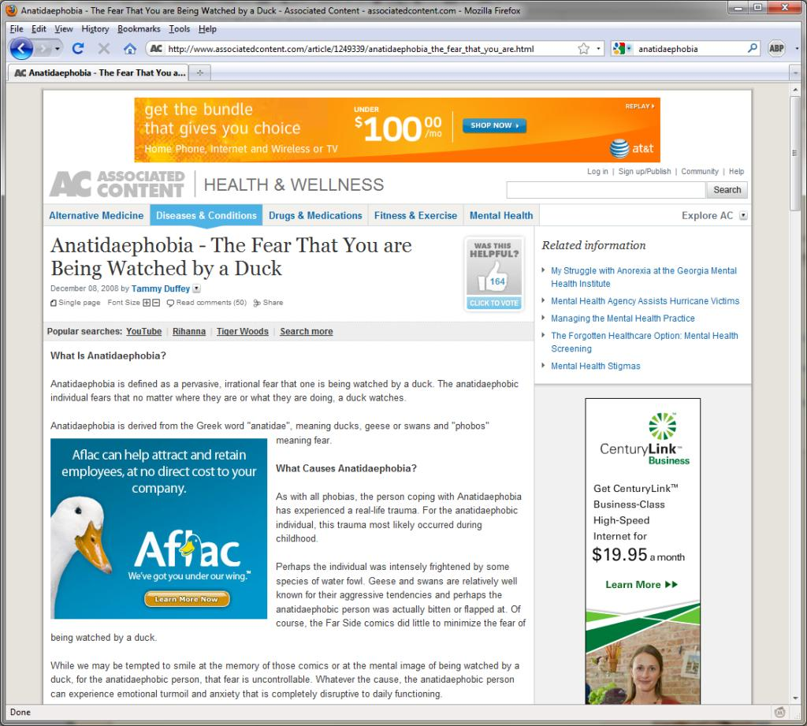

Slide 5
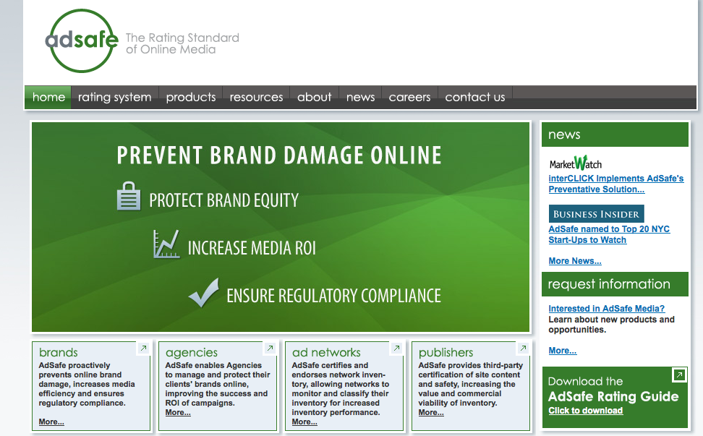

Slide 6
Model needed within days
Pharmaceutical firm does not want ads to appear:
  In pages that discuss swine flu (FDA prohibited pharmaceutical company to display drug ad in pages about swine flu)
Big fast-food chain does not want ads to appear:
  In pages that discuss the brand (99% negative sentiment)
  In pages discussing obesity, diabetes, cholesterol, etc
Airline company does not want ads to appear:
  In pages with crashes, accidents, …
  In pages with discussions of terrorist plots against airlines

Slide 7
Need to build models fast
Traditionally, modeling teams have invested substantial internal resources in data collection, extraction, cleaning, and other preprocessing
    No time for such things…
However, now, we can outsource preprocessing tasks, such as labeling, feature extraction, verifying information extraction, etc.
  using Mechanical Turk, oDesk, etc.
  quality may be lower than expert labeling (much?)
  but low costs can allow massive scale
7
Notes:
pay for expert labeling?
alternative setting to active learning – where labeling is very costly
7

Slide 8

Example: Build an “Adult Web Site” Classifier
Need a large number of hand-labeled sites
Get people to look at sites and classify them as:
G (general audience) PG (parental guidance) R (restricted) X (porn)
Cost/Speed Statistics
Undergrad intern: 200 websites/hr, cost: $15/hr
Mechanical Turk: 2500 websites/hr, cost: $12/hr

Slide 9
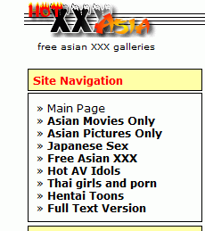

Bad news: Spammers!
Worker ATAMRO447HWJQ
labeled X (porn) sites as G (general audience)

Slide 10
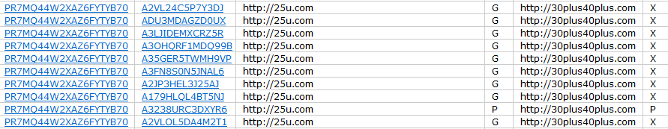
Redundant votes, infer quality
Look at our spammer friend ATAMRO447HWJQ together with other 9 workers
Using redundancy, we can compute error rates for each worker

Slide 11
Algorithm of (Dawid & Skene, 1979)
[and many recent variations on the same theme]
Iterative process to estimate worker error rates
Initialize“correct” label for each object (e.g., use majority vote)
Estimate error rates for workers (using “correct” labels)
Estimate “correct” labels (using error rates, weight worker votes according to quality)
Go to Step 2 and iterate until convergence
Error rates for ATAMRO447HWJQ
P[G → G]=99.947% P[G → X]=0.053%
P[X → G]=99.153% P[X → X]=0.847%
Our friend ATAMRO447HWJQ
marked almost all sites as G.
Seems like a spammer…

Slide 12
Challenge: From Confusion Matrixes to Quality Scores
Confusion Matrix for ATAMRO447HWJQ
P[X → X]=0.847% P[X → G]=99.153%
P[G → X]=0.053% P[G → G]=99.947%
How to check if a worker is a spammer
using the confusion matrix?
(hint: error rate not enough)

Slide 13
Challenge 1:
Spammers are lazy and smart!
Confusion matrix for spammer
P[X → X]=0% P[X → G]=100%
P[G → X]=0% P[G → G]=100%
Confusion matrix for good worker
P[X → X]=80% P[X → G]=20%
P[G → X]=20% P[G → G]=80%
Spammers figure out how to fly under the radar…
In reality, we have 85% G sites and 15% X sites
Error rate of spammer = 0% * 85% + 100% * 15% = 15%
Error rate of good worker = 85% * 20% + 85% * 20% = 20%
False negatives: Spam workers pass as legitimate

Slide 14
Challenge 2:
Humans are biased!
Error rates for CEO of AdSafe
  P[G → G]=20.0% P[G → P]=80.0% P[G → R]=0.0% P[G → X]=0.0%
  P[P → G]=0.0% P[P → P]=0.0% P[P → R]=100.0% P[P → X]=0.0%
  P[R → G]=0.0% P[R → P]=0.0% P[R → R]=100.0% P[R → X]=0.0%
  P[X → G]=0.0% P[X → P]=0.0% P[X → R]=0.0% P[X → X]=100.0%
We have 85% G sites, 5% P sites, 5% R sites, 5% X sites
Error rate of spammer (all G) = 0% * 85% + 100% * 15% = 15%
Error rate of biased worker = 80% * 85% + 100% * 5% = 73%
False positives: Legitimate workers appear to be spammers
(important note: bias is not just a matter of “ordered” classes)

Slide 15
Solution: Reverse errors first, compute error rate afterwards
Error Rates for CEO of AdSafe
  P[G → G]=20.0% P[G → P]=80.0% P[G → R]=0.0% P[G → X]=0.0%
  P[P → G]=0.0% P[P → P]=0.0% P[P → R]=100.0% P[P → X]=0.0%
  P[R → G]=0.0% P[R → P]=0.0% P[R → R]=100.0% P[R → X]=0.0%
  P[X → G]=0.0% P[X → P]=0.0% P[X → R]=0.0% P[X → X]=100.0%
When biased worker says G, it is 100% G
When biased worker says P, it is 100% G
When biased worker says R, it is 50% P, 50% R
When biased worker says X, it is 100% X
Small ambiguity for “R-rated” votes but other than that, fine!

Slide 16
Solution: Reverse errors first, compute error rate afterwards
Error Rates for spammer: ATAMRO447HWJQ
  P[G → G]=100.0% P[G → P]=0.0% P[G → R]=0.0% P[G → X]=0.0%
  P[P → G]=100.0% P[P → P]=0.0% P[P → R]=0.0% P[P → X]=0.0%
  P[R → G]=100.0% P[R → P]=0.0% P[R → R]=0.0% P[R → X]=0.0%
  P[X → G]=100.0% P[X → P]=0.0% P[X → R]=0.0% P[X → X]=0.0%
When spammer says G, it is 25% G, 25% P, 25% R, 25% X
When spammer says P, it is 25% G, 25% P, 25% R, 25% X
When spammer says R, it is 25% G, 25% P, 25% R, 25% X
When spammer says X, it is 25% G, 25% P, 25% R, 25% X
[note: assume equal priors]
The results are highly ambiguous. No information provided!

Slide 17
Expected Misclassification Cost
High cost: probability spread across classes
Low cost: “probability mass concentrated in one class
Assigned Label | Corresponding “Soft” Label | Expected Label Cost
Spammer: G | <G: 25%, P: 25%, R: 25%, X: 25%> | 0.75
Good worker: G | <G: 99%, P: 1%, R: 0%, X: 0%> | 0.0198
[***Assume misclassification cost equal to 1, solution generalizes]

Slide 18
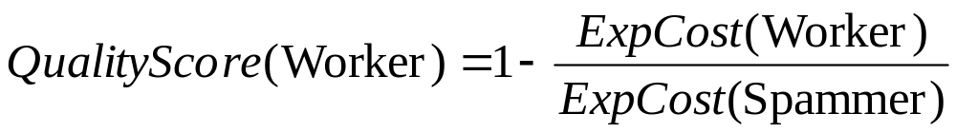
Quality Score
Quality Score: A scalar measure of quality
A spammer is a worker who always assigns labels randomly, regardless of what the true class is.
Scalar score, useful for the purpose of ranking workers
HCOMP 2010

Slide 19
Instead of blocking: Quality-sensitive Payment
Threshold-ing rewards gives wrong incentives:
  Good workers have no incentive to give full quality (need to just be above threshold for payment),
  Decent, but useful, workers get fired
Instead: estimate payment level based on quality
  Pay full price for workers with quality above specs
  Estimate reduced payment based on how many workers with given confusion matrix I need to reach specs

Slide 20
Too much theory?
Open source implementation available at:
http://code.google.com/p/get-another-label/
Input:
  Labels from Mechanical Turk
  [Optional] Some “gold” labels from trusted labelers
  Cost of incorrect classifications (e.g., X→G costlier than G→X)
Output:
  Corrected labels
  Worker error rates
  Ranking of workers according to their quality
  [Coming soon] Quality-sensitive payment
  [Coming soon] Risk-adjusted quality-sensitive payment

Slide 21
Example: Build an “Adult Web Site” Classifier
Get people to look at sites and classify them as:
G (general audience) PG (parental guidance) R (restricted) X (porn)
But we are not going to label the whole Internet…
Expensive
Slow

Slide 22
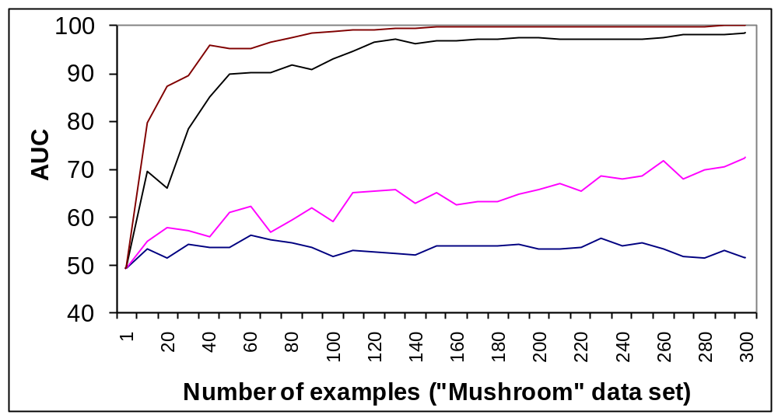
Quality and Classification Performance
Noisy labels lead to degraded task performance
Labeling quality increases  classification quality increases
Quality = 100%
Quality = 80%
Quality = 60%
Quality = 50%
Single-labeler quality (probability of assigning correctly a binary label)

Slide 23
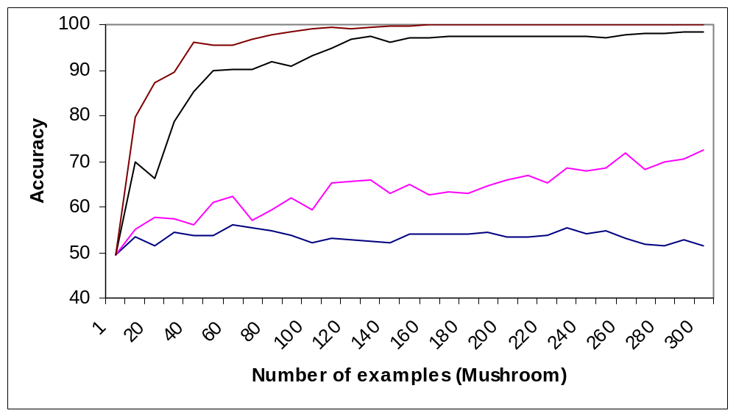
Tradeoffs: More data or better data?
Get more examples  Improve classification
Get more labels  Improve label quality  Improve classification
Quality = 100%
Quality = 80 %
Quality = 60%
Quality = 50%
KDD 2008, Best paper runner-up
23
Notes:
key: gradient in accuracy over example X quality space
complicated for various reasons, one of which is: labeling different examples will have different benefits
23

Slide 24
(Very) Basic Results
We want to follow the direction that has the highest “learning gradient”
  Estimate improvement with more data (cross-validation)
  Estimate sensitivity to data quality (introduce noise)
Rule-of-thumb results:
With high quality labelers (85% and above):
Get more data (One worker per example)
With low quality labelers (~60-70%):
Improve quality (Multiple workers per example)

Slide 25
Selective Repeated-Labeling
We do not need to label everything the same way
Key observation: we have additional information to guide selection of data for repeated labeling
  the current multiset of labels
  the current model built from the data
Example: {+,-,+,-,-,+} vs. {+,+,+,+,+,+}
  Will skip details in the talk, see “Repeated Labeling” paper
Notes:
if we’re getting a certain number of labels, how best to choose?

Slide 26
Improving worker participation
With just labeling, workers are passively labeling the data that we give them
Why not asking them to search themselves and find training data

Slide 27
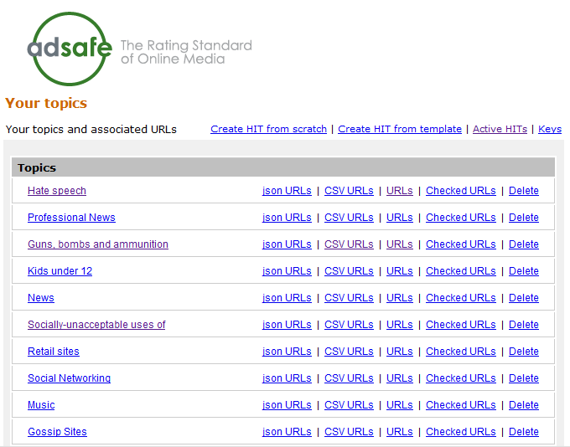
Guided Learning
Ask workers to find example web pages (great for “sparse” content)
After collecting enough examples, easy to build and test web page classifier
http://url-collector.appspot.com/allTopics.jsp
KDD 2009

Slide 28
Limits of Guided Learning
No incentives for workers to find “new” content
After a while, submitted web pages similar to already submitted ones
No improvement for classifier
28
Notes:
pay for expert labeling?
alternative setting to active learning – where labeling is very costly
28

Slide 29




The result? Blissful ignorance…
Classifier seems great: Cross-validation tests show excellent performance
Alas, classifier fails: The “unknown unknowns” ™
No similar training data in training set
“Unknown unknowns” = classifier
fails with high confidence
29
Notes:
pay for expert labeling?
alternative setting to active learning – where labeling is very costly
29

Slide 30
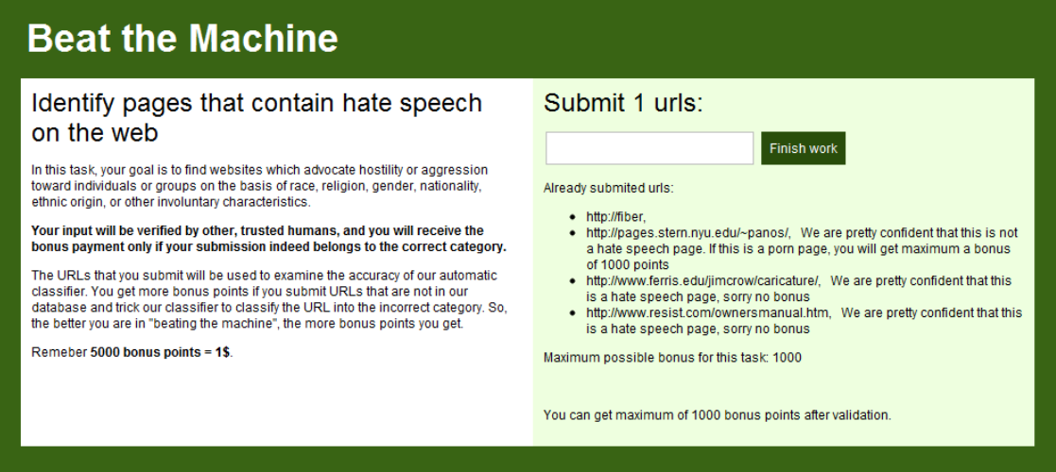
Beat the Machine!
Ask humans to find URLs that
the classifier will classify incorrectly
another human will classify correctly
http://adsafe-beatthemachine.appspot.com/
30
Example:
Find hate speech pages that the machine will classify as benign
Notes:
30

Slide 31
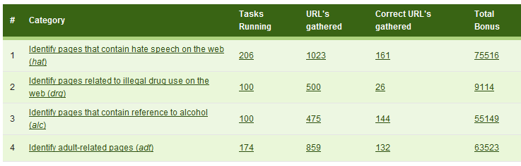
Probes
Successes
Error rate for probes significantly higher
than error rate on (stratified) random data
(10x to 100x higher than base error rate)

Slide 32
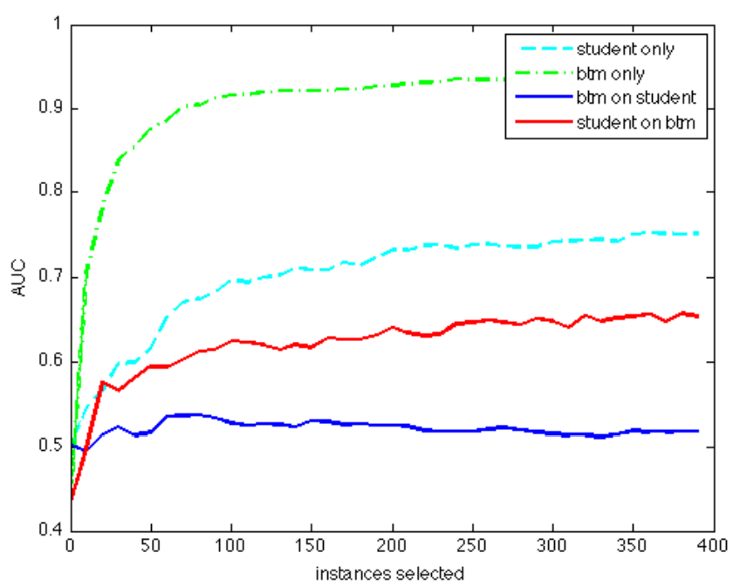
Structure of Successful Probes
Now, we identify errors much faster (and proactively)
Errors not random outliers: We can “learn” the errors
Could not, however, incorporate errors into existing classifier without degrading performance
32
Notes:
pay for expert labeling?
alternative setting to active learning – where labeling is very costly
32

Slide 33
Unknown unknowns → Known unknowns
Once humans find the holes, they keep probing (e.g., multilingual porn ☺ )
However, we can learn what we do not know (“unknown unknowns” → “known unknowns”)
We now know the areas where we are likely to be wrong
33
Notes:
pay for expert labeling?
alternative setting to active learning – where labeling is very costly
33

Slide 34
Reward Structure for Humans
High reward higher when:
  Classifier confident (but wrong) and
  We do not know it will be an error
Medium reward when:
  Classifier confident (but wrong) and
  We do know it will be an error
Low reward when:
  Classifier already uncertain about outcome
34
Notes:
pay for expert labeling?
alternative setting to active learning – where labeling is very costly
34

Slide 35
Current Directions
Learn how to best incorporate knowledge to improve classifier
Measure prevalence of newly identified errors on the web (“query by document”)
  Increase rewards for errors prevalent in the “generalized” case
35
Notes:
pay for expert labeling?
alternative setting to active learning – where labeling is very costly
35

Slide 36
Workers reacting to bad rewards/scores
Score-based feedback leads to strange interactions:
The “angry, has-been-burnt-too-many-times” worker:
“F*** YOU! I am doing everything correctly and you know it! Stop trying to reject me with your stupid ‘scores’!”
The overachiever worker:
“What am I doing wrong?? My score is 92% and I want to have 100%”

Slide 37
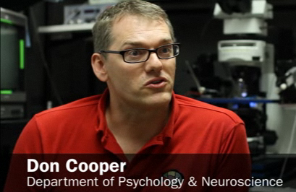
An unexpected connection at the
NAS “Frontiers of Science” conf.
Your bad workers behave like my mice!

Slide 38
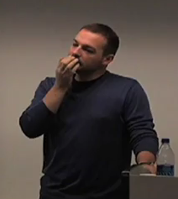
An unexpected connection at the
NAS “Frontiers of Science” conf.
Your bad workers behave like my mice!
Eh?

Slide 39
An unexpected connection at the
NAS “Frontiers of Science” conf.
Your bad workers want to engage their brain only for motor skills, not for cognitive skills
Yeah, makes sense…

Slide 40
An unexpected connection at the
NAS “Frontiers of Science” conf.
And here is how I train my mice to behave…

Slide 41
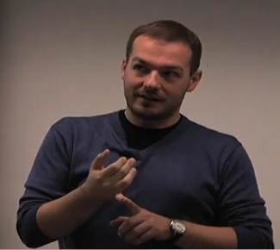
An unexpected connection at the
NAS “Frontiers of Science” conf.
Confuse motor skills!
Reward cognition!
I should try this the moment that I get back to my room

Slide 42
Implicit Feedback using Frustration
Punish bad answers with frustration of motor skills (e.g., add delays between tasks)
  “Loading image, please wait…”
  “Image did not load, press here to reload”
  “404 error. Return the HIT and accept again”
Reward good answers by rewarding the cognitive part of the brain (e.g, introduce variety/novelty, return results fast)
→Make this probabilistic to keep feedback implicit

Slide 43
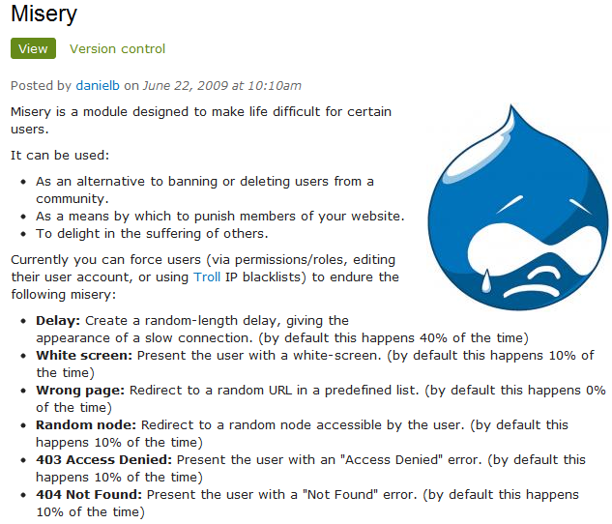

Slide 44
First result
Spammer workers quickly abandon
Good workers keep labeling
Bad: Spammer bots unaffected
How to frustrate a bot?
  Give it a CAPTHCA ☺

Slide 45
Second result (more impressive)
Remember, scheme was for training the mice…
15% of the spammers start submitting good work!
Putting cognitive effort is more beneficial (?)
Key trick: Learn to test workers on-the-fly

Slide 46
Thanks!
Q & A?

Slide 47
Overflow Slides

Slide 48
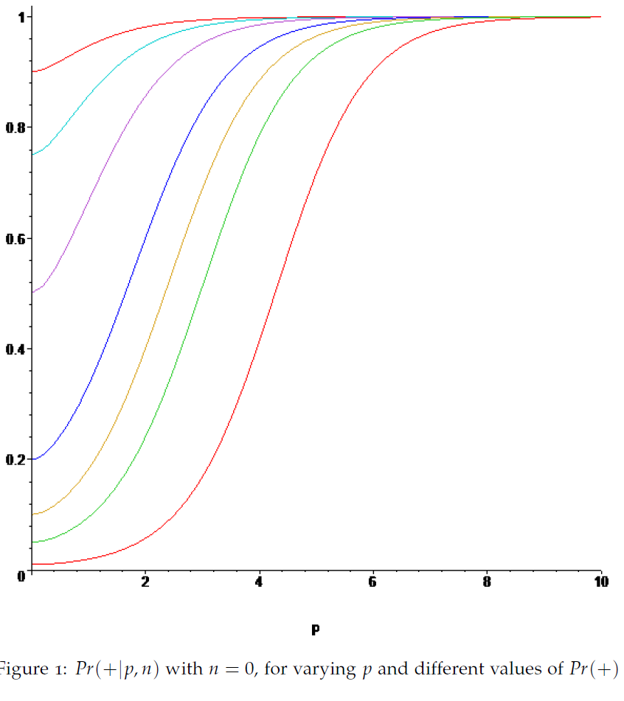

Slide 49
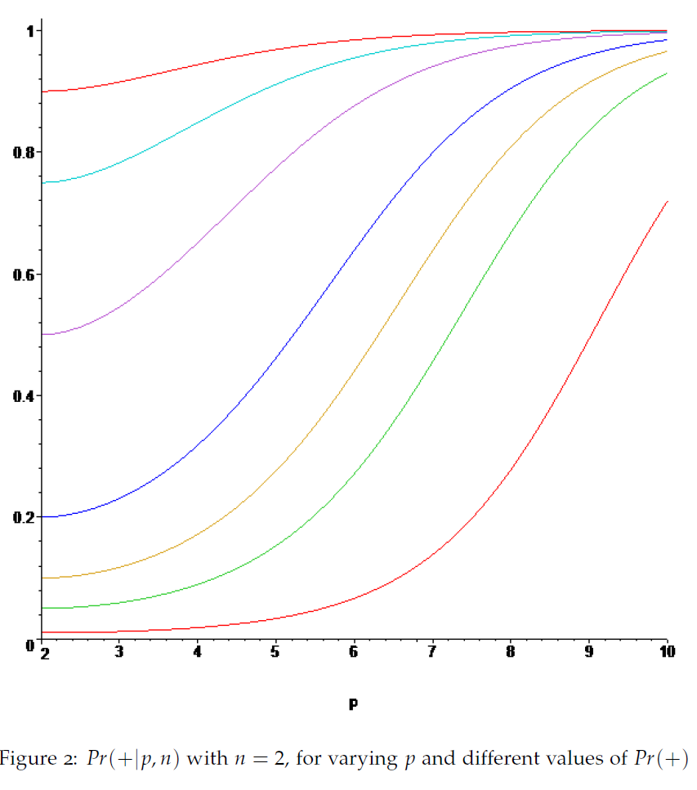

Slide 50
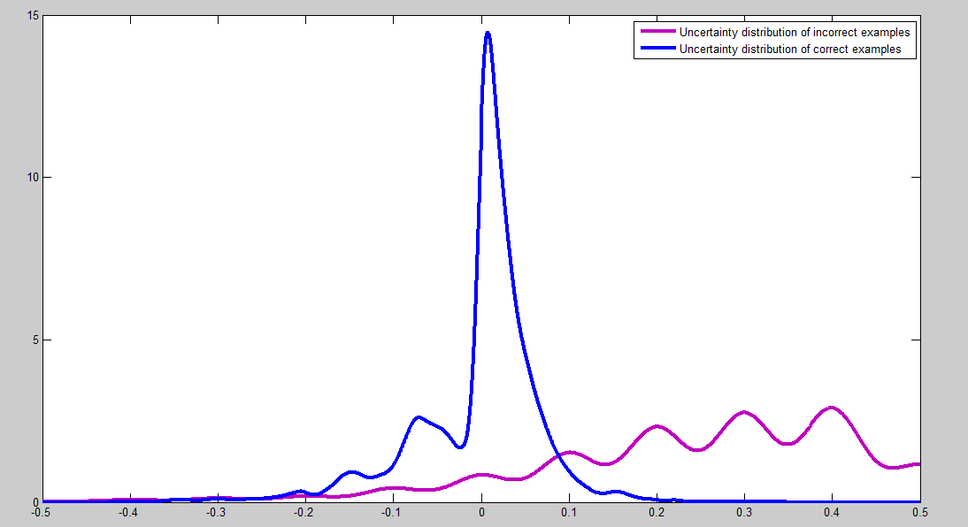
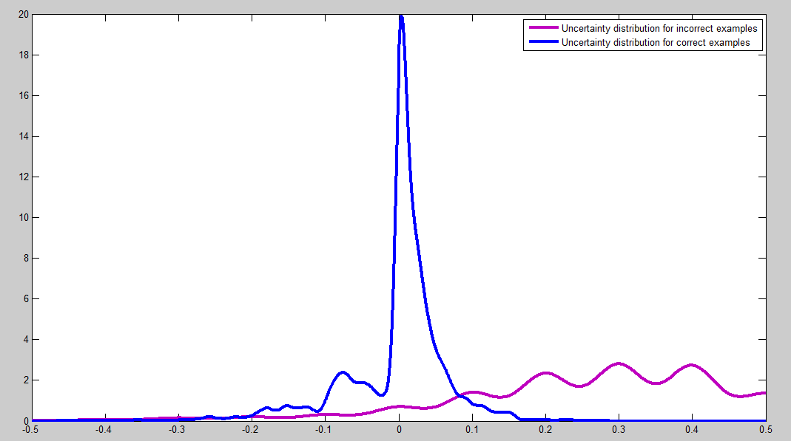
Why does
Model Uncertainty (MU) work?
+ +
- - - -
+ +
+ +
- - - -
- - - -
- - - -
+ +
+ +
+
+ +
+ +
- - - -
- - - -
+ +
- - - -
+ +
- - - -
+ +
MU score distributions for
correctly labeled (blue) and
incorrectly labeled (purple) cases

Slide 51
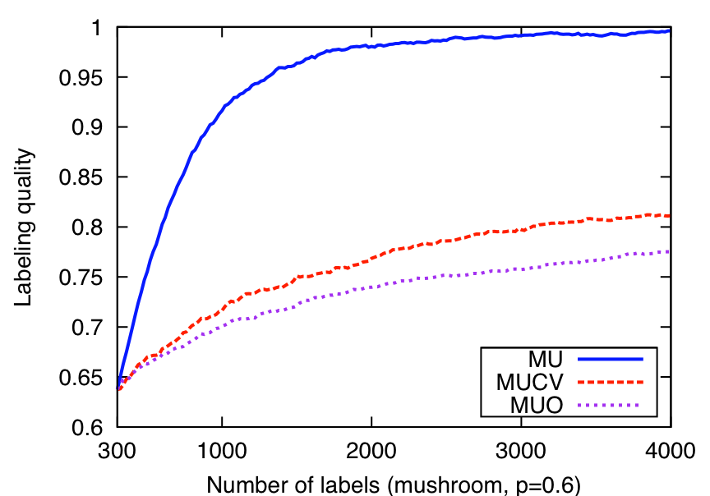
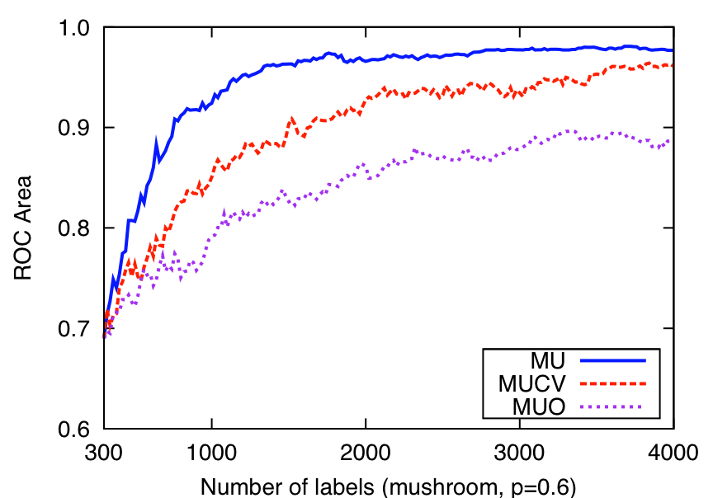
Why does
Model Uncertainty (MU) work?
+ +
- - - -
+ +
+ +
- - - -
+ +
+ +
- - - -
- - - -
+
+ +
+ +
- - - -
- - - -
+ +
- - - -
+ +
- - - -
+ +
Self-healing process
Examples
Self-healing MU
Models
“active learning” MU

Slide 52
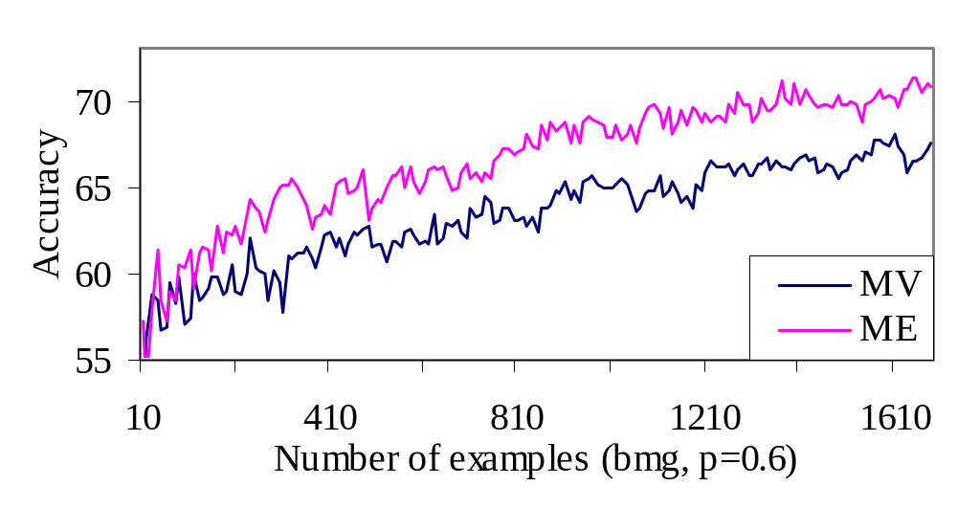
Soft Labeling vs. Majority Voting
MV: majority voting
ME: soft labeling

Slide 53
Related topic
Estimating (and using) the labeler quality
  for multilabeled data: Dawid & Skene 1979; Raykar et al. JMLR 2010; Donmez et al. KDD09
  for single-labeled data with variable-noise labelers: Donmez & Carbonell 2008; Dekel & Shamir 2009a,b
  to eliminate/down-weight poor labelers: Dekel & Shamir, Donmez et al.; Raykar et al. (implicitly)
  and correct labeler biases: Ipeirotis et al. HCOMP-10
  Example-conditional labeler performance
    Yan et al. 2010a,b
Using learned model to find bad labelers/labels: Brodley & Friedl 1999; Dekel & Shamir, Us (I’ll discuss)

Slide 54
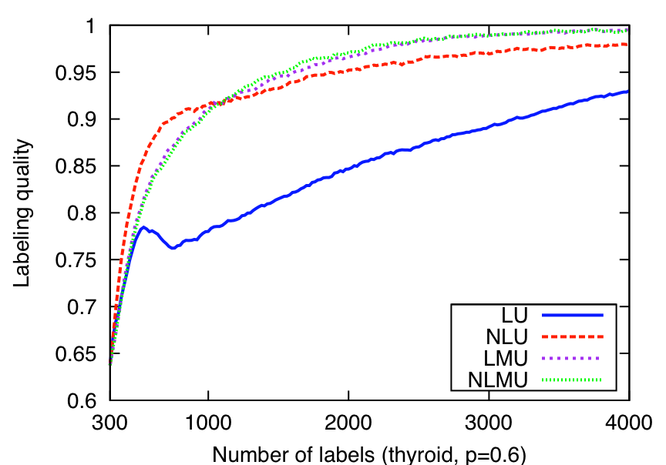
More sophisticated LU improves labeling quality under class imbalance and fixes some pesky LU learning curve glitches
Both techniques
perform essentially optimally with balanced classes
Notes:
Other experiments show LU and NLU perform almost identically under balanced class distributions, and indeed are just about “optimal” –in the sense that they separate the positive and negative examples almost as well as knowing the actual uncertainty (the best uncertainty metric possible when we are only taking into account the information in the label multiset).

Slide 55
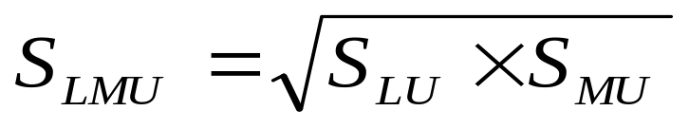
Yet another strategy:
Label & Model Uncertainty (LMU)
Label and model uncertainty (LMU): avoid examples where either strategy is certain

Slide 56
Another strategy:
Model Uncertainty (MU)
+ +
- - - -
+ +
+ +
- - - -
+ +
- - - -
- - - -
+ +
+
+ +
+ +
- - - -
- - - -
+ +
- - - -
+ +
- - - -
+ +
Learning models of the data provides an alternative source of information about label certainty
Model uncertainty: get more labels for instances that cause model uncertainty
Intuition?
  for modeling: why improve training data quality if model already is certain there?
  for data quality, low-certainty “regions” may be due to incorrect labeling of corresponding instances
Examples
Models
Self-healing process
KDD 2008

Slide 57
Label Quality
Label + Model Uncertainty
Label Uncertainty
Model Uncertainty alone also improves quality
1
0.95
0.9
0.85
0.8
Labeling quality
Uniform, round robin
0.75
0.7
UNF
MU
0.65
LU
LMU
0.6
0
400
800
1200
1600
2000
Number of labels (waveform, p=0.6)

Slide 58
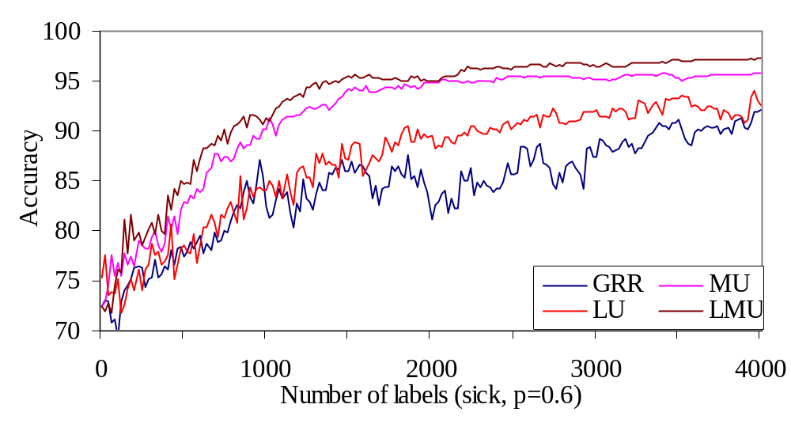
Model Quality
Across 12 domains, LMU is always better
than GRR. LMU is statistically significantly
better than LU and MU.
Label & Model Uncertainty
58
Notes:
58

Slide 59
What about Gold testing?
Naturally integrated into the latent class model
Initialize by aggregating labels for each object (e.g., use majority vote)
Estimate error rates for workers (using aggregate labels)
Estimate aggregate labels (using error rates, weight worker votes according to quality)
  Keep labels for “gold data” unchanged
Go to Step 2 and iterate until convergence

Slide 60
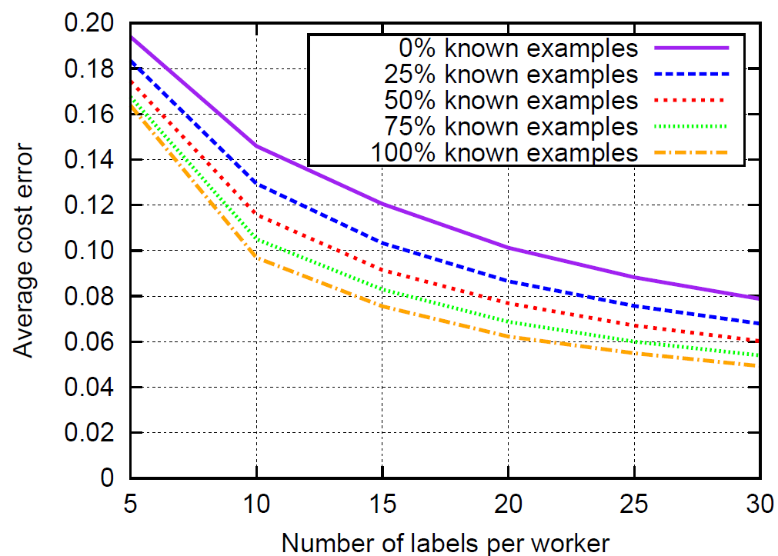
Gold Testing?
3 labels per example
2 categories, 50/50
Quality range: 0.55:0.05:1.0
200 labelers

Slide 61
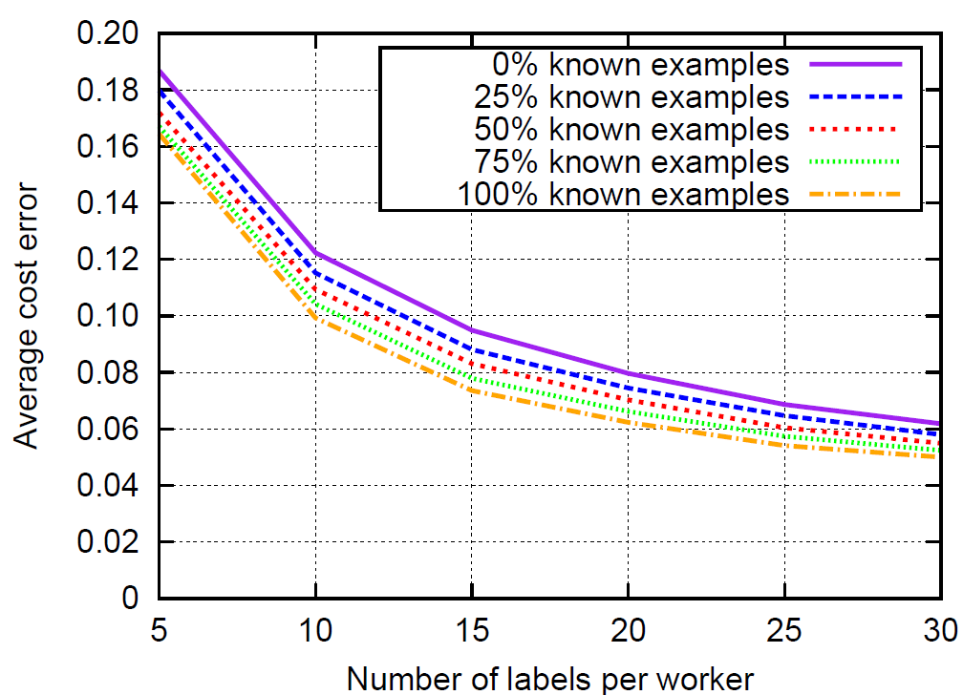
Gold Testing?
5 labels per example
2 categories, 50/50
Quality range: 0.55:0.05:1.0
200 labelers

Slide 62
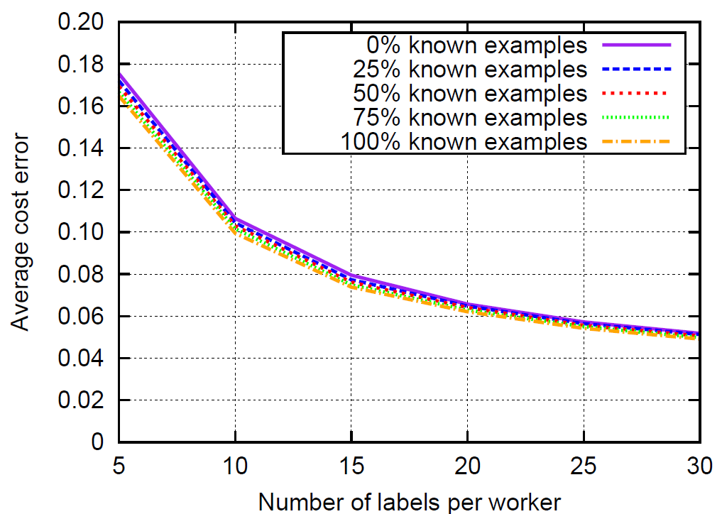
Gold Testing?
10 labels per example
2 categories, 50/50
Quality range: 0.55:0.05:1.0
200 labelers

Slide 63
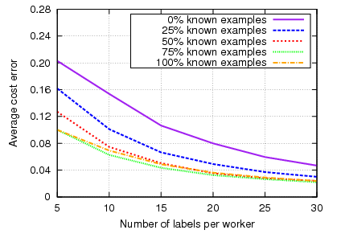
Gold Testing
10 labels per example
2 categories, 90/10
Quality range: 0.55:0.1.0
200 labelers
Advantage under imbalanced datasets

Slide 64
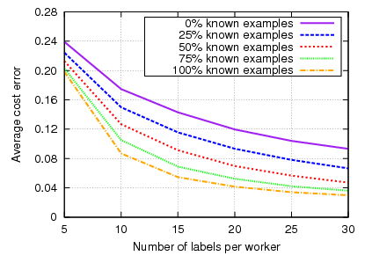
Gold Testing
5 labels per example
2 categories, 50/50
Quality range: 0.55:0.65
200 labelers
Advantage with bad worker quality

Slide 65
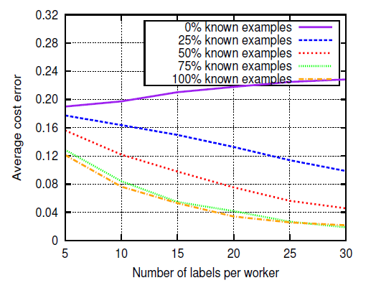
Gold Testing?
10 labels per example
2 categories, 90/10
Quality range: 0.55:0.65
200 labelers
Significant advantage under “bad conditions”
(imbalanced datasets, bad worker quality)

