Slide 1
When You Have Too Much Data, “Good Enough” Is Good Enough
Pat Helland
Unemployed Software Architect

Slide 2
Outline
Introduction
Watering Down the ACID
Schema! We Don’t Need No Stinking Schema!
Contortion and Distortion
Dreaming of Streaming
Swimming While Syncing
Serendipity When You Least Expect It…
Heisenberg Was an Optimist…
Conclusion: My Karma Ran Over Your Dogma

Slide 3
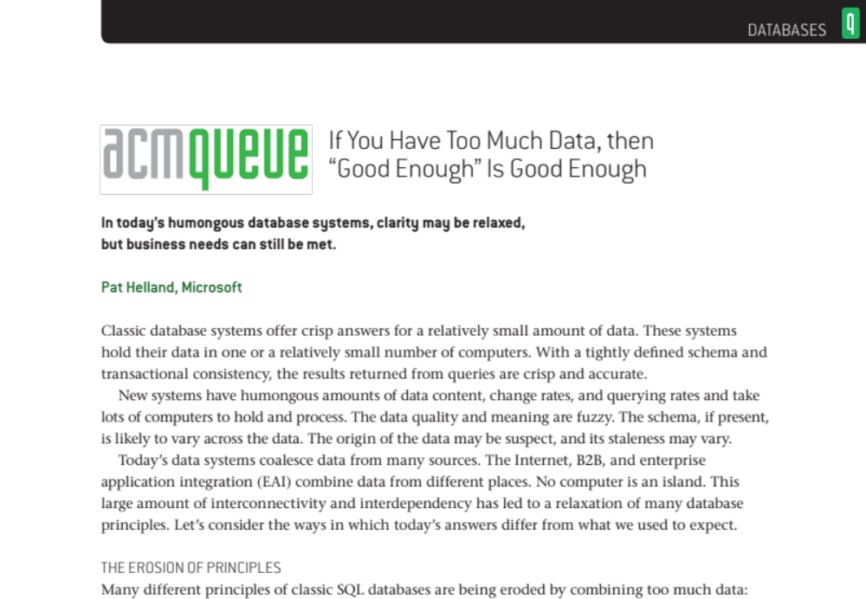
CACM Paper
This talk is captured in a paper from June 2011 in the Communications of the ACM
  www.queue.ACM.org and search for “Helland Too Much”

Slide 4
Takeaways
Classic database systems offered crisp answers over relatively small amounts of data
  The classic database fits in one (or a small number of) computer(s)
  The answers are crisp and accurate → well defined schema and transactional consistency
New systems have a humongous amount of data content,
change rate, and querying rate
  They take LOTS of computers to hold and process
The data quality and meaning is fuzzy
  The schema, if present, may vary across the data
  The origin of the data may be suspect and its staleness will vary
Many business solutions are very happy with “good enough”
  We only know how to provide answers with relaxed clarity but that’s OK
Many of our efforts support these trends
  Search, BI, Streaming, Caching, Cloud, Sync, ETL, and more…

Slide 5
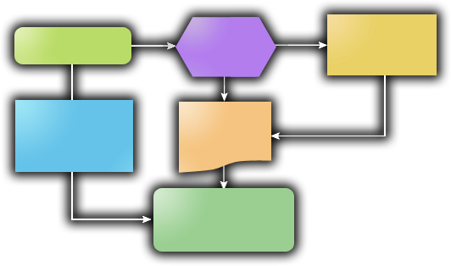




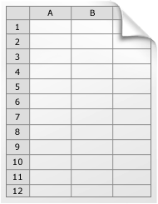









We Are Awash in Data
Internet, B2B, EAI, etc
  Lots of connectivity!
  Seems like everything is
  connected to everything else!
No machine is an island!

Slide 6
Overview: the Erosion of Principles
Unlocked Data
Messages, Web Links, Documents, Forms, …
Unlocking changes it from classic database
Inconsistent Schema
Smashing together data from different sources. Extensibility, different semantics, unknown semantics…
Extract, Transform, & Load
Data from many sources; attempt to shoehorn into shape… Load it into a large system; what does it mean?
Streaming Data
The data doesn’t exist yet but we’re looking for it! Let me know when you find something matching these rules!
Replicated Data
You can change it… I might change it, too. Let’s make some rules so it’s OK and still sort it out later.
Business Intelligence
What can I tell from this old copy of the data? If I can ask a question, I might learn enough to change my business!
Patterns by Inference
Where are the connections that I didn’t think of? Is something going on we don’t know about?
Too Much to Be Accurate
By the time I do the calculation, the answer had changed! Too much, too fast, need to approximate!

Slide 7
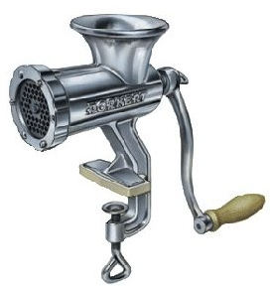
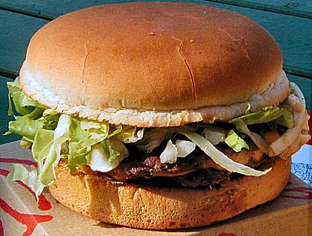
Business Needs
Lead to Lossy Answers
Tasty!
Sometimes it’s the data
causing challenges
  Huge volumes of data
  Data from many sources
  Unclear sources of data
  Data arriving over time
Sometimes it’s the processing that is causing challenges
  Conversions, transformations, interpreting different than intended
  Multiple updaters to the data at different replicas
  Inference and assumptions about interpreting the data
We no longer can pretend we live in a clean world!
  SQL and it’s DDL assume a crisp and clear definition of the data
  That is a subset of the reality of the world
Lossy!

Slide 8
Outline
Introduction
Watering Down the ACID
Schema! We Don’t Need No Stinking Schema!
Contortion and Distortion
Dreaming of Streaming
Swimming While Syncing
Serendipity When You Least Expect It…
Heisenberg Was an Optimist…
Conclusion: My Karma Ran Over Your Dogma

Slide 9
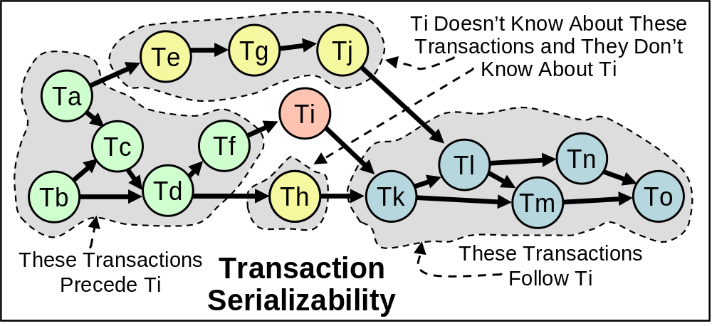
Transactions Inside the Classic Database
Transactions make you feel alone
  No one else manipulates the data when you are
Transactional serializability
  The behavior is as if a serial order exists

Slide 10
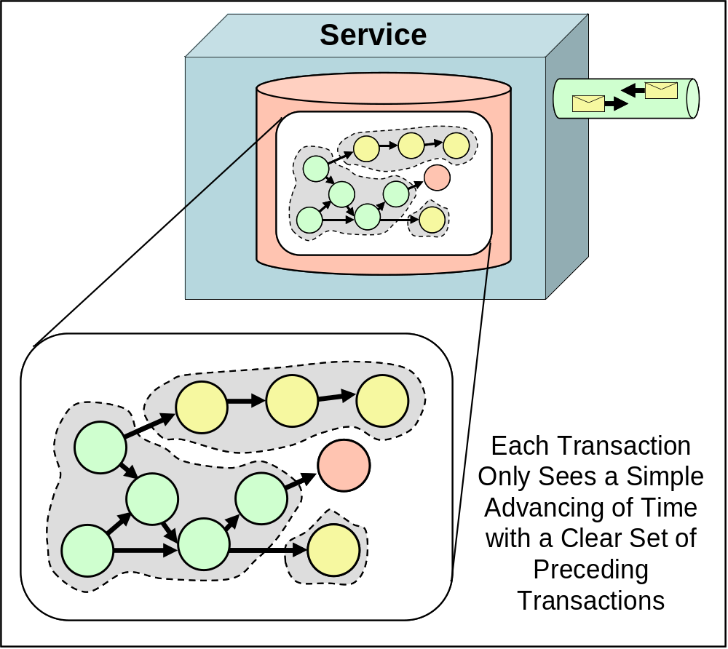
Life in the “Now”
Transactions live in the “now” inside services
  Time marches forward
  Transactions commit
  Advancing time
  Transactions see
  the committed
  transactions
A “Service” is
a database and its
accompanying
application logic
  The transaction does
  not leave this service

Slide 11
Sending Unlocked Data Isn’t “Now”
Messages contain unlocked data
  Assume no shared transactions
Unlocked data may change
  Unlocking it allows change
Messages are not from the “now”
  They are from the past
There is no simultaneity at a distance!
  Similar to speed of light
  Knowledge travels at speed of light
  By the time you see a distant object it may have changed!
  By the time you see a message, the data may have changed!
Services, transactions, and locks bound simultaneity!
  Inside a transaction, things appear simultaneous (to others)
  Simultaneity only inside a transaction!
  Simultaneity only inside a service!

Slide 12
Outside Data: a Blast from the Past
All data from distant stars is from the past
  10 light years away; 10 year old knowledge
  The sun may have blown up 5 minutes ago
    We won’t know for 3 minutes more…
All data seen from a distant service is from the “past”
  By the time you see it, it has been unlocked and may change
Each service has its own perspective
  Inside data is “now”; outside data is “past”
  My inside is not your inside; my outside is not your outside
Going to SOA is like going from Newtonian to Einstonian physics
  Newton’s time marched forward uniformly
    Instant knowledge
  Before SOA, distributed computing many systems look like one
    RPC, 2-phase commit, remote method calls…
  In Einstein’s world, everything is “relative” to one’s perspective
  SOA has “now” inside and the “past” arriving in messages

Slide 13
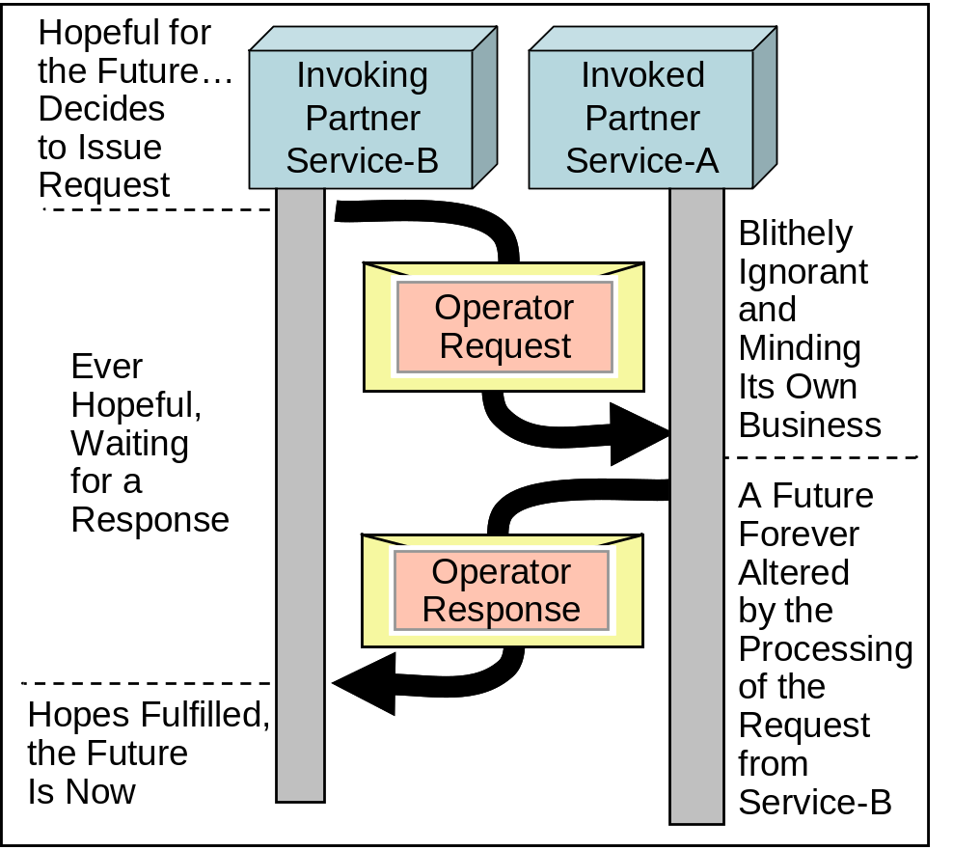
Operators: Hope for the Future
Messages may contain operators
  Requests for business functionality part of the contract
  Service-B sends an operator to Service-A
If Service-A accepts the operator, it is part of its future
  It changes the state of
  Service-A
Service-B is hopeful
  It wants Service-A to do
  the work
  When it receives a reply,
  its future is changed!

Slide 14
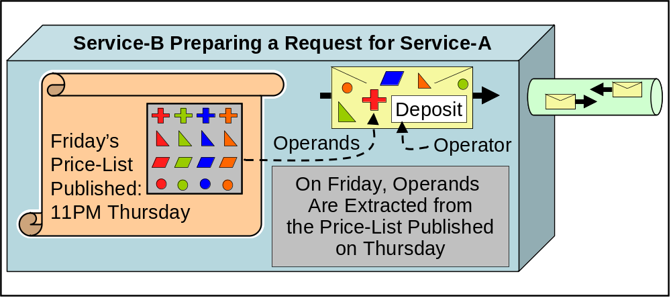
Operands: Past and Future
Operands may live in the past
  Values published as reference data
  Come from Service-A’s past
Operands may live in the future
  They may contain a proposed value submitted to Service-A

Slide 15
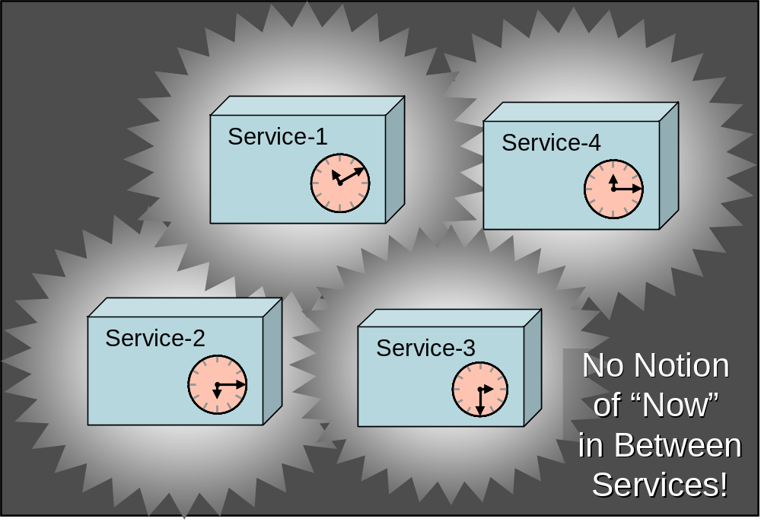
Between Services: Life in the “Then”
Everything between services lives in the past or future
  Operators live in the future
  Operands live in the past or the future
It’s not meaningful to speak of “now” between services
  No shared transactions → no simultaneity
Life in the “then”
  Past or future
  Not now
Each service has
a separate “now”
  Different temporal
  environments!

Slide 16
Services Dealing with “Now” and “Then”
Services Make the “Now” Meet the “Then”
  Each Service Lives in Its Own “Now”
  Messages Come and Go Dealing with the “Then”
  The Business-Logic of the Service Must Reconcile This!!
Example: accepting an order
A biz publishes daily prices
Probably want to accept
yesterday’s prices for a while
Tolerance for time differences
must be programmed
Example:
“Usually ships in 24 hours”
Order processing has old info
Available inventory not accurate
Deliberately “fuzzy”
Allows both sides to cope with
difference in time domains!
The world is no longer flat!
  SOA is recognizing that there is more than one computer
  Multiple machines mean multiple time domains
  Multiple time domains mandate we cope with ambiguity to
  allow coexistence, cooperation, and joint work

Slide 17
Outline
Introduction
Watering Down the ACID
Schema! We Don’t Need No Stinking Schema!
Contortion and Distortion
Dreaming of Streaming
Swimming While Syncing
Serendipity When You Least Expect It…
Heisenberg Was an Optimist…
Conclusion: My Karma Ran Over Your Dogma

Slide 18
Messages and Schema
Schema for a message describes the message’s contents and form
  Both the message and the schema should be immutable
  The purpose of the message is to communicate and be understood
  If the message (or its schema) change, the meaning will change!
Hopefully, the schema is understandable to the message’s reader
  Understanding is a fascinating concept
  Sometimes, people from different countries “understand” each other but miss the nuances
  This kind of “understanding” happens all the time across systems
  Happens with me and my wife, too!!!
Sometimes, only part of the schema maps to concepts understood by the message’s reader
  The reader must approximate its understanding of the rest!
Schema
Message

Slide 19
Extensibility → Scribbling in the Margins
Extensibility is the addition of non-schema specified information into the message
  The schema does not specify the additional stuff
  The sender wanted to add it anyway
Adding extensions is like scribbling in the margins
  Sometimes adding notes to a form helps!
  Sometimes it does no good at all!
Message
Schema
Service
Purchase Order
Customer
Delivery Addr
SKUs
Purchase Order
Customer
Delivery Addr
SKUs
Don’t Deliver in AM

Slide 20
Schema versus Name/Value
Moving from DDL → XSD → Name/Value
  SQL to XML for communication
  Many storage systems moving to name/value pairs
    E.g. Microsoft’s SSDS and Amazon’s SimpleDB
  Name/Value pairs becoming one standard for data interchange
Devolving from Schema to Name/Value
  Arguably, the transition AWAY from strict and formal typing is causing a loss of correctness
  Bugs are allowed through that would have been caught!
Evolving from Structure to Name/Value
  Name/Value allows for more adaptive systems
  They look at what is available and make do!

Slide 21




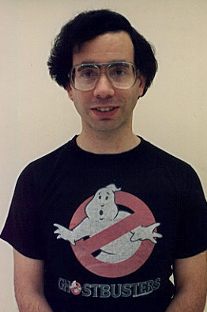

Railroads Led to Stereotypes
Before railroads, most people didn’t travel
  You were not likely to see people you didn’t know!
  People lived in small villages and rarely saw strangers…
In America, railroads took people far away more often
  They were thrown into train stations and trains with strangers!
  People didn’t know who to trust and who to be suspicious of!
Standard dress styles emerged to identify roles
  You dressed as you wished to be treated
  People treated you in accordance with your appearance
People adopt the conventions of a stereotype to gain the benefits of a community

Slide 22
Stereotypes Are in the Eye of the Beholder!
People dynamically adapt and evolve their dress to identify their stereotype and community
  Some groups change fast to maintain elitism (e.g. grunge)
  Others change slow to encourage conformity (e.g. bankers)
Dynamic and loose typing allows for adaptability
  What name/value pairs are YOU interested in?
Schema-less interoperability is NOT as crisp and correct as tightly defined schemas
  There are more opportunities for confusion and mistakes
Look for patterns and infer the role
  It works for humans with stereotypes and styles
  It allows flexibility (with a cost of screw ups) for data sharing
Sure and Certain Knowledge of the Person (or Schema) Has Advantages
Scaling to Infinite Numbers of Friends Isn’t Possible, Though!
Emerging Adaptive Schemes for Data (Analogous to Stereotypes)

Slide 23
Descriptive vs. Prescriptive Schema
Increasingly, we use descriptive schema, not prescriptive
Prescriptive Schema
One Schema for All the Data
We Can Change It and the Data Changes
Example: DDL in the SQL Database
Descriptive Schema
I’m Writing a Unique Document/Entity
Here’s What I Mean When I Write It
The Doc Is Immutable and So Is the Schema

Slide 24
Outline
Introduction
Watering Down the ACID
Schema! We Don’t Need No Stinking Schema!
Contortion and Distortion
Dreaming of Streaming
Swimming While Syncing
Serendipity When You Least Expect It…
Heisenberg Was an Optimist…
Conclusion: My Karma Ran Over Your Dogma

Slide 25


Extract, Transform, and Load
Extract
  Take a subset of the source data
Transform
  Apply some (perhaps very complicated) modifications to the data
Load
  Stuff it into a database for further usage
  Hopefully, in a form where information across the different sources can be used fruitfully!
Extract
Transform
Load

Slide 26
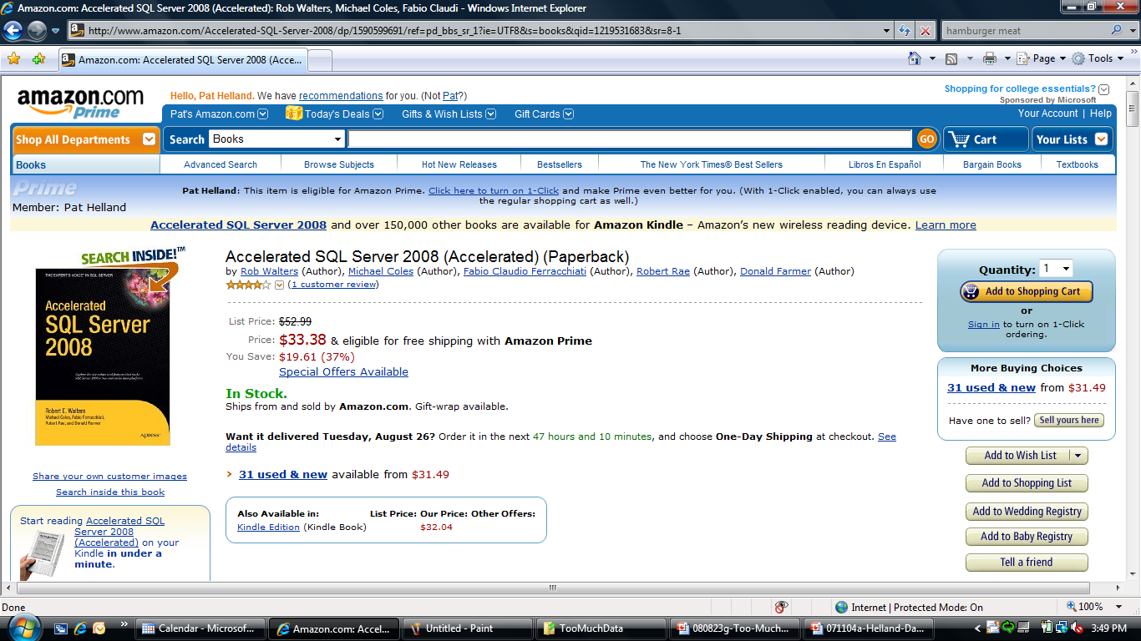







The Amazon Product Catalog
Tens of millions of
products
> Million merchants
Hundreds of millions
of product feeds per day
Hundreds of millions of
catalog references / day
Amazon
Product
Catalog
Amazon
Product
Catalog
Caches
Amazon
Website
Merchants
Extract, Transform,
& Load
Shoppers

Slide 27

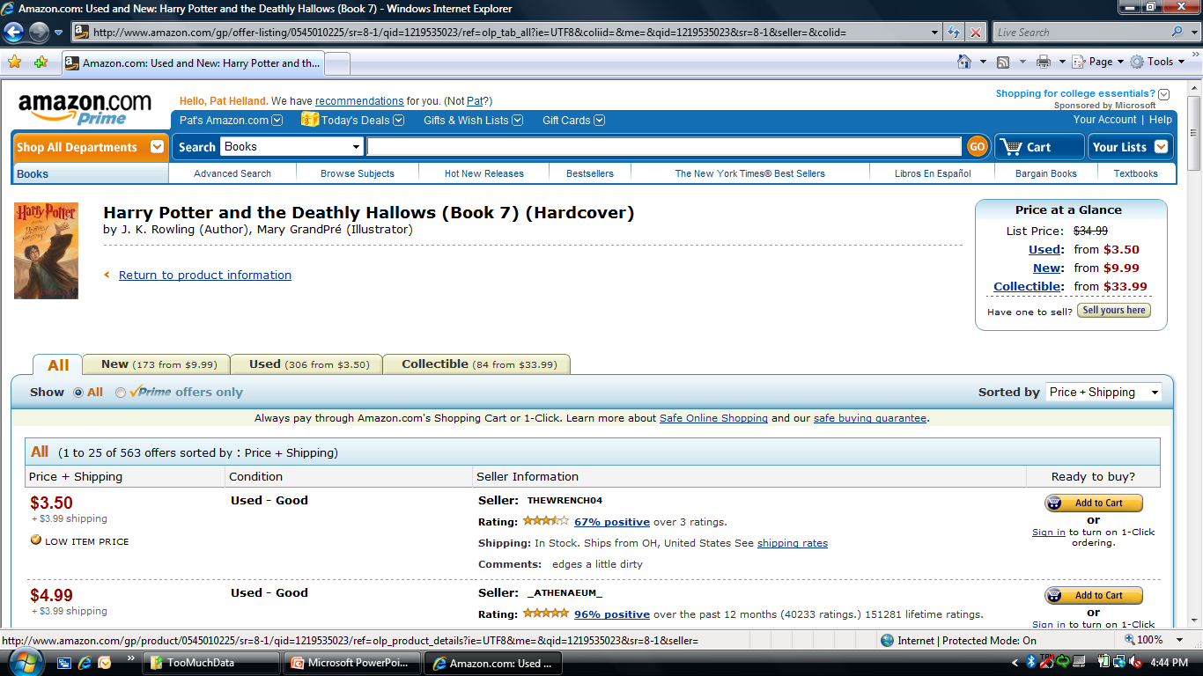
Merchant Feeds and SKUs
Over 1,000,000 merchants feed Amazon product and/or pricing data
  Amazon is a marketplace in addition to a retailer
Merchants specify their product by THEIR unique SKU
  SKU (Stock Keeping Unit) is a unique number within the merchant
  Some merchants recycle their SKUs
The Amazon
Catalog must
MATCH the
product identity
to similar
(or identical)
products from
other merchants

Slide 28




ISBN and ASINs
ISBN – International Standard Book Number
  10 digit number assigned to books – developed in 1970
ASIN – Amazon Standard Identification Number
  Begins with 0 if it is a book with an ISBN → it IS the ISBN
  Begins with a B if it is not an ISBN
In the early days, Amazon sold only new books
  The publisher gave them ISBNs and there was no confusion!
Later Amazon sold non-books with ASINs assigned by the Retail branch of Amazon as SKUs
  These were 10 digits beginning with B
When Amazon started selling stuff for others (i.e. a marketplace), the identity fun began!
  SKUs can be offered by a merchant
  Amazon “Retail” feeds became the same SKU feeds as other merchants
  When is one merchant selling the SAME thing as the next?
  How do they ensure a consistent product display?

Slide 29
Ambiguity of Identity
ISBN, UPC (Universal Product Code), and other “unique” identifiers help a LOT in matching
  Not all SKU descriptions have unique codes!
  Not all UPCs refer to a unique item
    Sometimes the same UPC for multiple related items!
Shoes don’t seem to have UPCs…
  Lots of stuff needs matching by description
  Manufacturer identifier helps!
Who’s the manufacturer?
  Hewlett-Packard, HP, Hewlett Packard, H-P, H/P, Compaq,
  Digital, … Hmmm…
What’s the color?
  Green, Emerald, Asparagus, Chartreuse, Olive, Pear, Shamrock, Jade, Kelly Green, Myrtle, Pine Green, Spinach, Forest Green…

Slide 30




Data Transformation and Consolidation
Merchants feed in product descriptions and they are matched and consolidated
  Portions of the description may come from different merchants
Amazon Product Catalog
Data Cleanup
Amazon
Product
Catalog
Caches
Merchants
Item Matching
Description Consolidation
Matching
Data
Product
Data

Slide 31
Through the
Looking Glass…
The Data Quality and
Meaning Are Fuzzy
We’re All Happy They Are!!!
Extract, Transform, and Load is usually lossy
  In fact, frequently the data is riddled with problems!
Amazon’s product catalog processes HUGE amounts of input from millions of vendors
  It has problems, inaccuracies, and duplicates!
  It creates tremendous value for Amazon, its merchants, and customers
  Amazon does a phenomenal job creating value!
Amazon Product Catalog
Amazon Product
Catalog Caches
Merchants
Lossy!

Slide 32
Outline
Introduction
Watering Down the ACID
Schema! We Don’t Need No Stinking Schema!
Contortion and Distortion
Dreaming of Streaming
Swimming While Syncing
Serendipity When You Least Expect It…
Heisenberg Was an Optimist…
Conclusion: My Karma Ran Over Your Dogma

Slide 33

Classic Relational Is Set Oriented against Existing Stuff
SQL counts on transactions to “freeze” the database
  A set-oriented query against the records there at the time
  It doesn’t matter what will be there AFTER the query is executed!
Suspend Time with Transaction!
Arguably, classic SQL runs at a single location in space (one database) and at a single point in time
(one transaction) !
Select *
WHERE <clause>

Slide 34
Streaming Is Set Oriented against Not-Yet-Existing Stuff
Events arrive into some databases
  Sensors, messages, or record inserts by applications
  The contents of the database change over time!
Streaming databases provide set-oriented operations across time
  The query waits around looking for stuff that satisfies the WHERE
  When stuff matches, it is delivered to the new set
Select * WHERE <clause>
Time

Slide 35
Non-Yet-Existing Stuff
Arrives in Clumps
It’s hard to think about the newly arriving stuff as completely normalized
  It is easier to think of it as entities which arrive as a clump
  You can think of these as messages, records, entities, or events
  They are rarely normalized!
It’s OK the events are not normalized!
  They aren’t going to be changed!
  They are immutable evidence of something that occurred
  There is no need to change them
Typically, the incoming events have some unique identity
  They are unique and immutable…

Slide 36

Ambiguity in Time
Streaming databases blur time
  You ask a question and it remains standing for a while
  Data items passing the qualifications are delivered
Streaming databases usually remain in a single point in space
  The work is (typically) processed in a single database
  Stuff arrives at that database and is delivered as a result of the query
  (if it matches)
Select *
WHERE <clause>
A Trend Towards Loosening
the Definition of Time for Data

Slide 37
Outline
Introduction
Watering Down the ACID
Schema! We Don’t Need No Stinking Schema!
Contortion and Distortion
Dreaming of Streaming
Swimming While Syncing
Serendipity When You Least Expect It…
Heisenberg Was an Optimist…
Conclusion: My Karma Ran Over Your Dogma

Slide 38

Replicated Data and Sync
Replication provides multiple copies of the same entity
  If it is read only, this is the same as caching
  If it is single writer, this is the same a pub-sub
Replication usually implies multi-master replication
  Unlike caching and pub-sub, more than one replica may be the origination point for changes
  The changes are occasionally synchronized
  Sometimes, there are changes made to different replicas which require reconciliation
Entity-X
Entity-X
Entity-X
Entity-X

Slide 39
Identity and Replication
When managing different replicas, it is essential to have a crisp and clear notion of identity
  This is a replica of that
  They have the SAME identity even if they are on different machines
  They may have a different set of updates but they have the SAME identity
There are many different ways to label a shared identity
  Most map beautifully to a URL representation
Need a crisp and clear notion of versions and lineage
  This version has that version as a parent
  Versions are within the same entity which has a unique identity
X
Y
X
Y
Z
Z
X
Y
X
Y
Z
Z

Slide 40

Version Management in a Replicated World
Replica-R1
Replica-R2
Replica-R3
R2; #1
It is essential to be able to capture lineage in the versions of an entity
  Who is my parent(s)?
We must also be able to support multiple parents merging and reconciling
  Independent changes coming together and reconciling
R2; #2
R1; #1
R2; #1
R2; #3
R2; #2
R1; #2
R3; #1
R2; #1
R2; #3
R3; #1
R2; #2
R1; #3
R3; #2
R2; #1
R1; #3
R2; #3
R3; #1
History Is Not a Linear List but a DAG (Directed Acyclic Graph)!
R1; #3
R1; #4
R2; #3
R2; #1
R3; #2

Slide 41
What Are the Semantics of Reconciliation?
The semantics of reconciliation are up to the application
  There are business rules that need to be enforced
  If they can be enforced while allowing disconnected work, that’s great!
This is NOT a general purpose WRITE semantic
  You need to have prescribed policies and mechanisms…
Business invariants and commutativity
  Businesses have invariants… Stuff they need to hold true
  How can the operations on the replicas commute (be reorderable) while preserving the business invariants?
If you preserve the business invariants (with commutativity), you can do decoupled work across the replicas
  When the changes are synched, they still are OK!

Slide 42
Ambiguity in Space AND Time!
Ambiguity in Space
  Replication means you can update an entity at different places!
  When the changes come together, they will be reconciled
Ambiguity in Time
  Different changes may happen in different orders
  Only when the replicas are synched will the order be imposed
A Trend Towards Loosening
the Definition of Update History!
Active Work Area: the Management of Business Invariants While Allowing Disconnected Update and Reconciliation
Allows Loosening of Update History without Breaking the Business

Slide 43
Outline
Introduction
Watering Down the ACID
Schema! We Don’t Need No Stinking Schema!
Contortion and Distortion
Dreaming of Streaming
Swimming While Syncing
Serendipity When You Least Expect It…
Heisenberg Was an Optimist…
Conclusion: My Karma Ran Over Your Dogma

Slide 44
Observing Patterns by Inference
An important discipline in data analysis is the inference of patterns for identity and relationship
  This is seminal to fraud and anti-terrorist activities!
Identity
  Are two different entities really the same underlying thing or person?
  Are they accidentally or intentionally misrepresented as the same?
Relationships
  Who (or what) is close to who (or what)?
  What does a pattern of relationships mean?
Identity and Relationships
  Can the relationships show new associations of identity?
  Can new identities show new relationships?

Slide 45
Entities, Observations,
Annotations, and Iteration
Most of these systems work by accreting annotations (attributes) to the entities
  You keep the original data and ADD new observations
  You have indices around the original and added attributes
  The emergence of patterns causing additional attribution
This causes a feedback loop
  Tying together entities leads to new shared relationships
  New shared relationships can identify entities to be tied together!
X
C
Y
A
D
Z
B

Slide 46
Serendipity When You Least Expect It!
Entity analysis leads to tremendous understanding!
  Fraud analysis
    Without this, you probably could not use credit cards online… huge loss
  Homeland security
    Tremendous traction in tracking surprising patterns leading to suspicious people
    Interesting work in “anonymizing” the identities in the pattern to share relationships without violating privacy
  Item matching in marketplace catalogs
    Are those two SKUs really the same product for sale?
Entity Analysis Requires Entities!
Need Unique Identities for the Entities and Relationships
Need Unique Identities to Append Additional Attributes
Classic SQL’s “Inside Data” Notions Are Inadequate

Slide 47
Outline
Introduction
Watering Down the ACID
Schema! We Don’t Need No Stinking Schema!
Contortion and Distortion
Dreaming of Streaming
Swimming While Syncing
Serendipity When You Least Expect It…
Heisenberg Was an Optimist…
Conclusion: My Karma Ran Over Your Dogma

Slide 48
How Certain Are You of Search Results?
Latency
  The web crawlers are, well, … crawlers…
Relevancy
  How often is the result what you are looking for??
Demographics
  Are teenagers looking for the same answers from the input string as older folks?
  Do your home locale, interests, and/or recent searches impact what you want?
Timeliness
  Do current events (e.g. disasters, important news flashes) change your desired results?
Advertising
  Just because an advertiser pays money to the search provider, does that mean you really want THAT answer?
There Is No “Right” Answer!

Slide 49
The U.S. Census Is HARD!
Just imagine walking house to house counting people
  You don’t have enough census workers to knock on everyone’s door at the same time!
  People move!
  People lie!
  People live with their girlfriends and don’t tell Mom and Dad!
Do you organize the count by address, social security number, name, or something else?
  People change most of these things…
What if someone dies after you counted them?
  Do they count?
What if someone is born after their house was counted but before other houses are counted?
  Do they count?
Big → Inaccurate!

Slide 50
Chad and the Election Results…
Not Trying to Raise Politics nor Argue Who Should Have Won in 2000… but…
Big Complex Systems (Like Elections) Are Filled with Irregularities
They Tend to Break Down When Lots of Accuracy Is Needed
In the 2000 US presidential election, the election depended on the State of Florida
  The state vote was very close
  Each recount yielded different answers
  There were concerns about different aspects of Florida’s policies
Individual paper ballots were scrutinized to decide if the paper holes were stuck with “chad” causing incorrect readings
  Policies for reconciling each questionable ballot were called into question
Under the Microscope, Everything Was Questioned!

Slide 51

Under Scale We Lose Precision
“You Can’t Handle the Truth!”
Big Is Hard!
  Time
  Meaning
  Mutual Understanding
  Dependencies
  Staleness
  Derivation
Werner Heisenberg said that when things get small we get more uncertain of their state
  When computing get LARGE, we get even more uncertain
We don’t understand what is the truthful answer!
  We want the truth!
  We just don’t know how to get the truth!

Slide 52
Outline
Introduction
Watering Down the ACID
Schema! We Don’t Need No Stinking Schema!
Contortion and Distortion
Dreaming of Streaming
Swimming While Syncing
Serendipity When You Least Expect It…
Heisenberg Was an Optimist…
Conclusion: My Karma Ran Over Your Dogma

Slide 53
Data on the Outside versus
Data on the Inside
Data on the Inside
  Encapsulated
  SQL
  Transaction
  protected
  Schema in DDL
Data on the Outside
  Immutable with
  Versions
  Identity
  May be replicated, transformed, extracted, derived, inferred, streamed and much more!
We’ve paid more attention to inside data than outside data
  Yet, the huge growth in data is dominated by outside data!
Service
Message
Data
Message
Data Outside
the Service
Data Inside
the Service

Slide 54
Identity, Versioning,
Immutability, and Derivation
Outside data seems (usually) to have a clear identity
  Messages, events, feeds, entities all are unique and identifiable
Replication, caching, (and more) show a special role for the management of versions of each unique thing
  Sometimes things are changed by creating a new version
  Sometimes, divergent versions are created and later reconciled
When dealing with uniquely identified outside data, it is always immutable (or comprised of immutable versions)
  From the identity (perhaps with a version) comes the immutable contents
Lots of data is derived from other pieces of data
  It would be nice to manage the dependencies
  From the dependencies, we could track changes and more
  Unclear how this works when dependencies flow into and out of a classic database (inside data)
    Not a strong a notion of identity inside the classic database!

Slide 55
Need New Transcendent
Theories and Taxonomy
Identity and Versions
Outside Data Comes with Identity and (Optional) Versions
Relaxing Time Constraints
OK to Express the Existence of a Set of Entities
Before They Are Known to You
Relaxing Space Constraints
Outside data should have a virtual identity (e.g. URL).
Replication issues give somewhat inaccurate results.
Derived from What?
Would be GREAT to know the derivation of the knowledge. New versions may drive recalc… Divestitures → Forget!
How Lossy Is the Derivation?
Can we invent a bounding to describe the inaccuracies being introduced? Is this a multi-dimensional inaccuracy?
Loss from Mappings!
Loss from Size!
Attribution by Pattern
Just like Mulligan Stew… Patterns derived from attributes derived from patterns, ad nauseum! Bounding taint !?!?
Don’t Forget Inside Data!
This is definitely NOT trying to denigrate the value of SQL.
SQL is a piece in a larger puzzle!

Slide 56
Takeaways
Classic database systems offered crisp answers over relatively small amounts of data
  The classic database fits in one (or a small number of) computer(s)
  The answers are crisp and accurate → well defined schema and transactional consistency
New systems have a humongous amount of data content,
change rate, and querying rate
  They take LOTS of computers to hold and process
The data quality and meaning is fuzzy
  The schema, if present, may vary across the data
  The origin of the data may be suspect and its staleness will vary
Many business solutions are very happy with “good enough”
  We only know how to provide answers with relaxed clarity but that’s OK
Many of our efforts support these trends
  Search, BI, Streaming, Caching, Cloud, Sync, ETL, and more…

