Slide 1
Scalable and Elastic Data Management in the Cloud
Amr El Abbadi
Computer Science, UC Santa Barbara
amr@cs.ucsb.edu
Collaborators: Divy Agrawal, Sudipto Das, Aaron J. Elmore

Slide 2
A Short History Of Computing
Main Frame with terminals
Network of PCs & Workstations.
Client-Server
Large cloud.

Slide 3











Paradigm Shift in Infrastructure

Slide 4
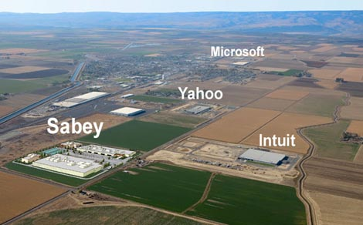
Cloud Reality: Data Centers

Slide 5
The Big Cloud Picture
Builds on, but unlike the earlier attempts:
  Distributed Computing
  Distributed Databases
  Grid Computing
Contributors to success
  Economies of scale
  Elasticity and pay-per-use pricing

Slide 6
Economics of Cloud Users
Pay by use instead of provisioning for peak
Capacity
Resources
Resources
Demand
Capacity
Demand
Time
Time
Static data center
Data center in the cloud
Unused resources
Slide Credits: Berkeley RAD Lab

Slide 7
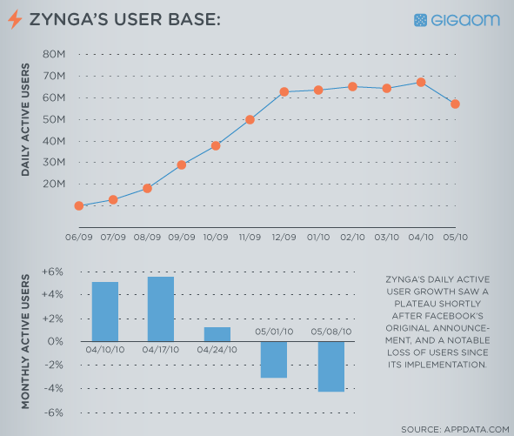
Cloud Reality: Elasticity

Slide 8
Scaling in the Cloud
Client Site
Client Site
Client Site
Load Balancer (Proxy)
App Server
App Server
App Server
App Server
App Server
MySQL Master DB
MySQL Slave DB
Database becomes the Scalability Bottleneck
Cannot leverage elasticity
Replication

Slide 9
Scaling in the Cloud
Client Site
Client Site
Client Site
Load Balancer (Proxy)
App Server
App Server
App Server
App Server
App Server
MySQL Master DB
Replication
MySQL Slave DB

Slide 10



Scaling in the Cloud
Client Site
Client Site
Client Site
Load Balancer (Proxy)
App Server
App Server
App Server
App Server
App Server
Scalable and Elastic,
but limited consistency and operational flexibility
Key Value Stores

Slide 11
BLOG Wisdom
“If you want vast, on-demand scalability, you need a non-relational database.” Since scalability requirements:
  Can change very quickly and,
  Can grow very rapidly.
Difficult to manage with a single in-house RDBMS server.
But we know RDBMS scale well:
  When limited to a single node, but
  Overwhelming complexity to scale on multiple server nodes.

Slide 12
Why care about transactions?
confirm_friend_request(user1, user2)
{
begin_transaction();
update_friend_list(user1, user2, status.confirmed);
update_friend_list(user2, user1, status.confirmed);
end_transaction();
}
Simplicity in application design with ACID transactions
Notes:
Stress about the ACID properties of transactions and how the applications benefit from it by simplifying their design.

Slide 13
confirm_friend_request_A(user1, user2) {
try {
update_friend_list(user1, user2, status.confirmed);
} catch(exception e) {
report_error(e);
return;
}
try {
update_friend_list(user2, user1, status.confirmed);
} catch(exception e) {
revert_friend_list(user1, user2);
report_error(e);
return;
}
}
confirm_friend_request_B(user1, user2) {
try{
update_friend_list(user1, user2, status.confirmed);
} catch(exception e) {
report_error(e);
add_to_retry_queue(operation.updatefriendlist, user1, user2, current_time());
}
try {
update_friend_list(user2, user1, status.confirmed);
} catch(exception e) {
report_error(e);
add_to_retry_queue(operation.updatefriendlist, user2, user1, current_time());
}
}
It gets too complicated with reduced consistency guarantees

Slide 14
Data Management in the Cloud
Data – central in modern applications
DBMS – mission critical component in cloud software stack
Data needs for web applications
  OLTP systems: store and serve data
  OLAP systems: decision support, intelligence
Disclaimer: Privacy is critical, but not today’s topic.

Slide 15
Outline
Design Principles learned from Key-Value Stores.
Transactions in the Cloud
Elasticity and live migration in the Cloud

Slide 16
Key Value Stores
Gained widespread popularity
  In house: Bigtable (Google), PNUTS (Yahoo!), Dynamo (Amazon)
  Open source: HBase, Hypertable, Cassandra, Voldemort

Slide 17
Design Principles
What have we learned from Key-value stores?

Slide 18
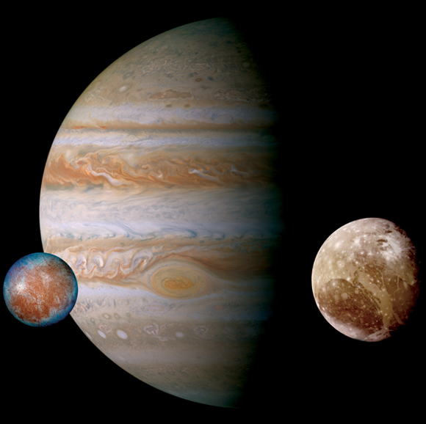
Design Principles [DNIS 2010]
Separate System and Application State
  System metadata is critical but small
  Application data has varying needs
  Separation allows use of different class of protocols

Slide 19
Design Principles [DNIS 2010]
Decouple Ownership from Data Storage
  Ownership is exclusive read/write access to data
  Decoupling allows lightweight ownership migration
Transaction Manager
Recovery
Ownership
[Multi-step transactions or
Read/Write Access]
Cache Manager
Storage
Classical DBMSs
Decoupled ownership and Storage

Slide 20
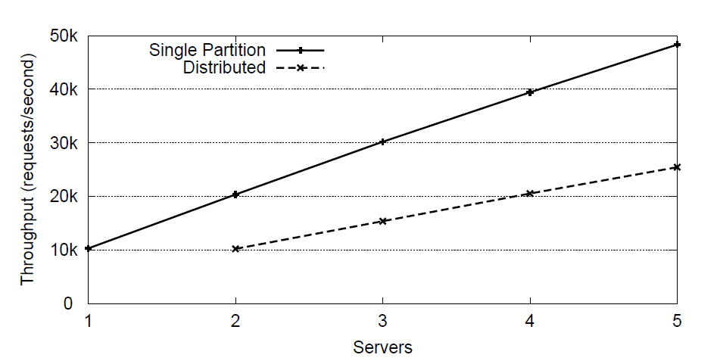
Design Principles [DNIS 2010]
Limit most interactions to a single node
  Allows horizontal scaling
  Graceful degradation during failures
  No distributed synchronization
Thanks: Curino et al VLDB 2010

Slide 21

Design Principles [DNIS 2010]
Limited distributed synchronization is practical
  Maintenance of metadata
  Provide strong guarantees only for data that needs it

Slide 22
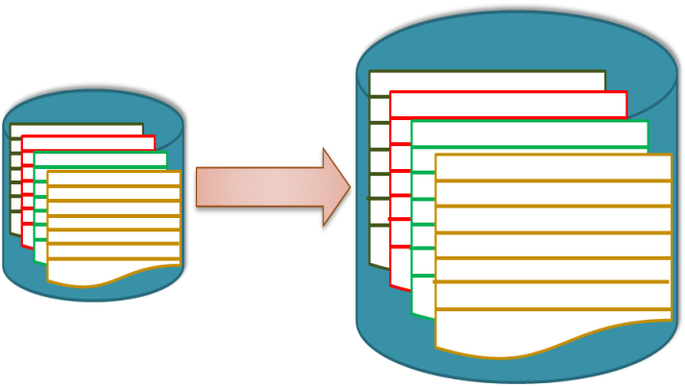
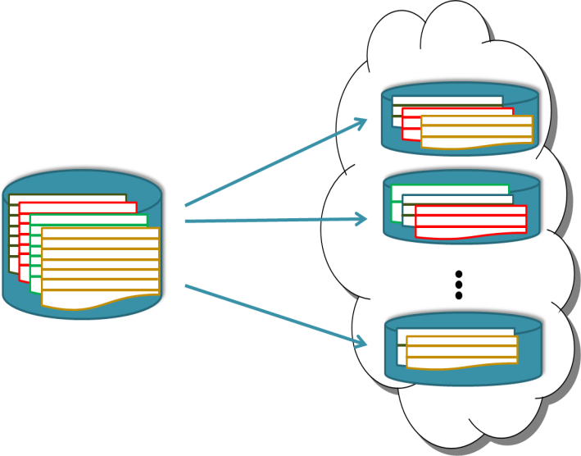
Two approaches to scalability
Scale-up
  Preferred in classical enterprise setting (RDBMS)
  Flexible ACID transactions
  Transactions access a single node
Scale-out
  Cloud friendly (Key value stores)
  Execution at a single server
    Limited functionality & guarantees
  No multi-row or multi-step transactions

Slide 23
Challenges for Transactional support in the cloud

Slide 24
Challenge: Transactions and Scale-out
Scale Out
Key Value Stores
RDBMSs
ACID Transactions

Slide 25

Challenge: Elasticity in Database tier
Load Balancer
Application/Web/Caching tier
Database tier
Notes:
So what does elasticity in the database tier mean?
Mention the cost performance trade-off and repeat the fact that it is the cloud infrastructure that allows us to optimize operating cost, something that was not thought important in classical infrastructures.

Slide 26

Challenge: Autonomic Control
Managing a large distributed system
  Detecting failures and recovering
  Coordination and synchronization
  Provisioning
  Capacity planning
  …
  “A large distributed system is a Zoo”
Cloud platforms inherently multitenant
  Balance conflicting goals
    Minimize operating cost while ensuring good performance
Notes:
To top it off, in designing these large distributed database management systems, another major challenge is in managing such large systems.
For instance, detecting and recuperating from node failures that become a norm in large systems, loose coordination and synchronization between the nodes, lease and load management, performance modeling, and the laundry list continues.
A famous quote says that a large distributed system is a Zoo and the challenge for us is to automate the management of such large systems through the design of Autonomic system controllers that minimize the need for human intervention.

Slide 27
Transactions in the Cloud
RDBMS
Key Value Stores
Fission
Fusion
ElasTraS [HotCloud ’09]
Cloud SQL Server [ICDE ’11]
RelationalCloud [CIDR ‘11]
G-Store [SoCC ‘10]
MegaStore [CIDR ‘11]
ecStore [VLDB ‘10]

Slide 28
Data Fission (breaking up is so hard ….)
Major challenges
  Data Partitioning
  Fault-tolerance of Data
Three systems
  ElasTraS (UCSB)
  SQL Azure (MSR)
  Relational Cloud (MIT)

Slide 29
Data Partitioning
Traditional Approach:
  Table level partitioning
  Challenge: Distributed transactions
Partition the schema
  Intuition: partition based on access patterns
  Co-locate data items accessed together

Slide 30
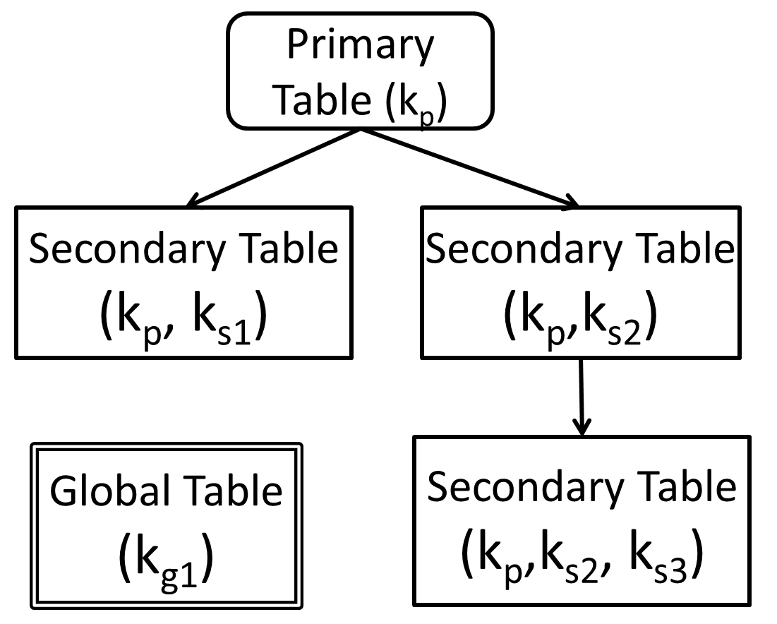
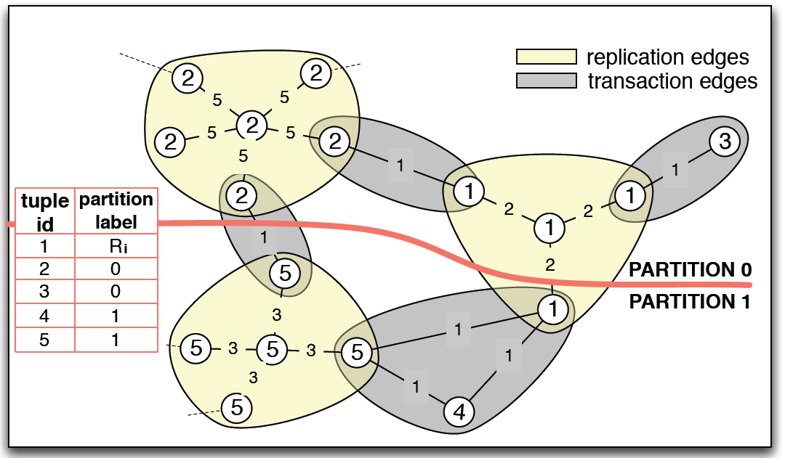
Schema Level Partitioning
Pre-defined partitioning scheme
  e.g.: Tree schema
  ElasTras, SQLAzure
  (TPC-C)
Workload driven partitioning scheme
  e.g.: Schism in RelationalCloud

Slide 31
Fault-tolerance and Load Balancing
Decouple Storage
  Elastras
Explicit Replication by transaction managers
  SQL Azure
    Paxos like commit protocol
Workload-driven Data Placement
  Relational Cloud (Kairos)
    Solve non-linear optimization problem to minimize servers and maximize load balance

Slide 32
Overview of ElasTraS Architecture
Metadata Manager
TM Master
Lease
Management
Health and Load Management
Master and MM Proxies
OTM
Txn Manager
OTM
OTM
P₁
P₂
P_{n}
DB Partitions
Log Manager
Durable Writes
Distributed Fault-tolerant Storage
Notes:
Because there is so much out there already, I’d just spend one slide giving an overview of ElasTraS.

Slide 33
Data Fusion (come together….)
Combining the individual key-value pairs into larger granules of transactional access
Megastore
  Entity groups: granule of transactional access
  Statically defined by the applications
G-Store
  Key-value group: granule of transactional access
  Dynamically defined by the applications

Slide 34
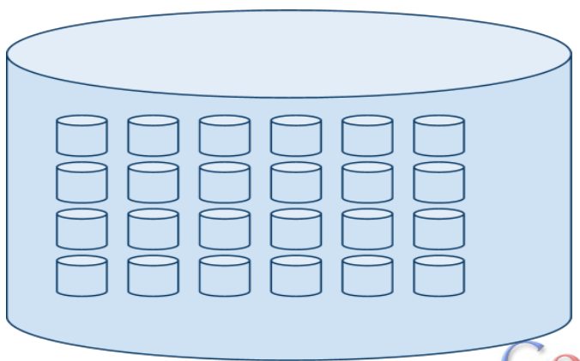
Megastore: Entity Groups
Entity groups are sub-database (static partitioning)
  Cheap transactions within Entity groups (common)
  Expensive cross-entity group transactions (rare)

Slide 35
Megastore Entity Groups
Semantically Predefined
Email
  Each email account forms a natural entity group
  Operations within an account are transactional: user’s send message is guaranteed to observe the change despite of fail-over to another replica
Blogs
  User’s profile is entity group
  Operations such as creating a new blog rely on asynchronous messaging with two-phase commit
Maps
  Dividing the globe into non-overlapping patches
  Each patch can be an entity group

Slide 36
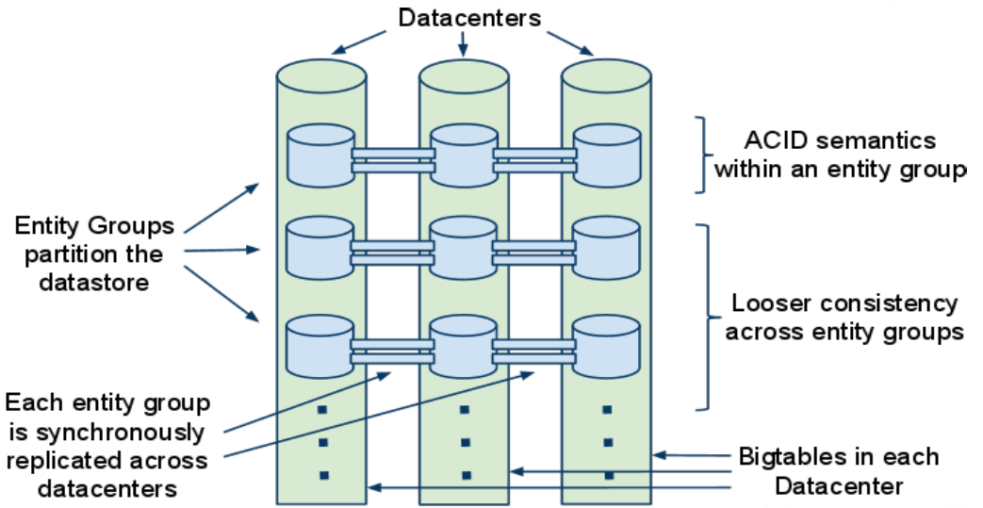
Megastore
Slides adapted from authors’ presentation

Slide 37
Dynamic Partitioning:
G-store
Das et al. SoCC 2010
Notes:
Good afternoon. Today I’ll be presenting our paper entitled “Zephyr: Live Migration in Shared Nothing Databases for Elastic Cloud Platforms”. This is joint work with my colleague Aaron Elmore and our advisors Divy Agrawal and Amr El Abbadi at UC Santa Barbara.

Slide 38
Dynamic Partitions: Data Fusion
Access patterns evolve, often rapidly
  Online multi-player gaming applications
  Collaboration based applications
  Scientific computing applications
Not amenable to static partitioning
  Transactions access multiple partitions
  Large numbers of distributed transactions
How to efficiently execute transactions while avoiding distributed transactions?
Notes:
Now we know how to scale-out when the partitions are statically defined. So lets make it a bit more interesting: How to scale-out with transactions on dynamically formed partitions?
Recall that our concept of partitions are the data items that are frequently being accessed within the same transaction. For certain applications, that might change with time. For instance, in online multi-player games, the application needs transactional access on the player profiles that are part of the same game instance, and this set changes with time. Similar behavior is observed in a number of collaboration based applications (examples?).

Slide 39

Online Multi-player Games
ID | Name | $$$ | Score
Player Profile

Slide 40


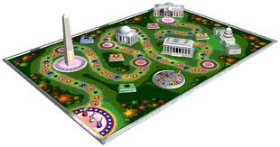


Online Multi-player Games
Execute transactions on player profiles while the game is in progress
Notes:
If the player profiles are part of the same database partition, then transactions on this group of players can be executed efficiently.

Slide 41

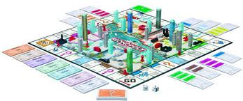

Online Multi-player Games
Partitions/groups are dynamic
Notes:
However, this group of players change with time, thus resulting in the concept of dynamically defined database partitions.

Slide 42





















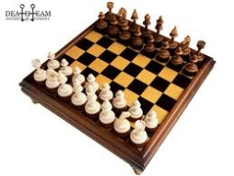

Online Multi-player Games
Hundreds of thousands of concurrent groups
Notes:
Scale.

Slide 43
G-Store
Transactional access to a group of data items formed on-demand
  Dynamically formed database partitions
Challenge: Avoid distributed transactions!
Key Group Abstraction
  Groups are small
  Groups have non-trivial lifetime
  Groups are dynamic and on-demand
Multitenancy: Groups are dynamic tenant databases

Slide 44
Transactions on Groups
Without distributed transactions
Grouping Protocol
Key Group
Ownership of keys at a single node
One key selected as the leader
Followers transfer ownership of keys to leader

Slide 45
Grouping protocol
Log entries
L(Joining)
L(Joined)
L(Free)
Follower(s)
Create Request
_{J}
_{JA}
_{JAA}
_{D}
_{DA}
Group Opns
Leader
L(Creating)
L(Joined)
L(Deleting)
L(Deleted)
Time
Delete Request
  Handshake between leader and follower(s)
  Conceptually akin to “locking”

Slide 46
Efficient transaction processing
How does the leader execute transactions?
  Caches data for group members ➔ underlying data store equivalent to a disk
  Transaction logging for durability
  Cache asynchronously flushed to propagate updates
  Guaranteed update propagation
Leader
Transaction Manager
Log
Cache Manager
Asynchronous update Propagation
Followers

Slide 47
Prototype: G-Store
An implementation over Key-value stores
Application Clients
Transactional Multi-Key Access
Grouping middleware layer resident on top of a key-value store
Grouping Layer
Transaction Manager
Grouping Layer
Transaction Manager
Grouping Layer
Transaction Manager
Key-Value Store Logic
Key-Value Store Logic
Key-Value Store Logic
Distributed Storage
G-Store

Slide 48
G-Store Evaluation
Implemented using HBase
  Added the middleware layer
  ~15000 LOC
Experiments in Amazon EC2
Benchmark: An online multi-player game
Cluster size: 10 nodes
Data size: ~1 billion rows (>1 TB)
For groups with 100 keys
  Group creation latency: ~10 – 100ms
  More than 10,000 groups concurrently created
Notes:
Paper has more detailed evaluation

Slide 49
Latency for Group Operations

Slide 50
Live database migration
Migrate a database partition (or tenant) in a live system
Multiple partitions share the same database process
Migrate individual partitions on-demand in a live system
  Virtualization in the database tier

Slide 51
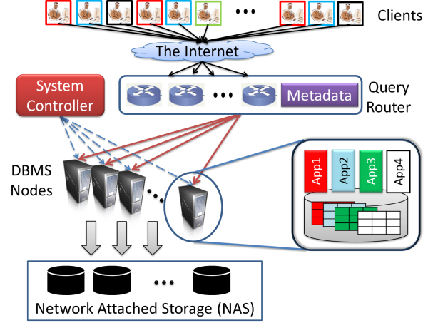
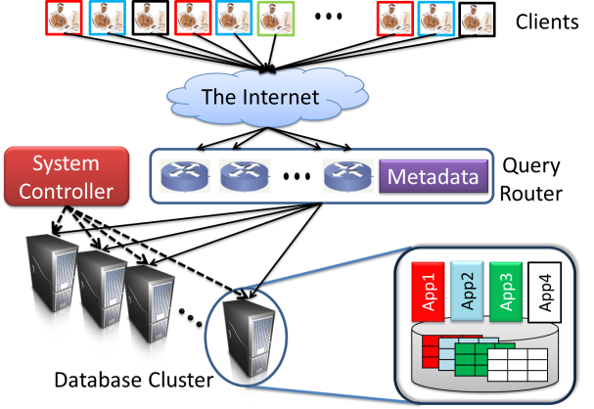
Two common DBMS architectures
Decoupled storage architectures
  ElasTraS, G-Store, Deuteronomy, MegaStore
  Persistent data is not migrated
  Albatross [VLDB 2011]
Shared nothing architectures
  SQL Azure, Relational Cloud, MySQL Cluster
  Migrate persistent data
  Zephyr [SIGMOD 2011]

Slide 52
Zephyr: Live Migration in Shared Nothing Databases for Elastic Cloud Platforms
Elmore et al. SIGMOD 2011
Notes:
Good afternoon. Today I’ll be presenting our paper entitled “Zephyr: Live Migration in Shared Nothing Databases for Elastic Cloud Platforms”. This is joint work with my colleague Aaron Elmore and our advisors Divy Agrawal and Amr El Abbadi at UC Santa Barbara.

Slide 53
VM Migration for DB Elasticity
VM migration [Clark et al., NSDI 2005]
One tenant-per-VM
  Pros: allows fine-grained load balancing
  Cons
    Performance overhead
    Poor consolidation ratio [Curino et al., CIDR 2011]
Multiple tenants in a VM
  Pros: good performance
  Cons: Migrate all tenants ➔ Coarse-grained load balancing

Slide 54
Problem Formulation
Multiple tenants share same database process
  Shared process multitenancy
  Example systems: SQL Azure, ElasTraS, RelationalCloud, and may more
Migrate individual tenants
    VM migration cannot be used for fine-grained migration
Target architecture: Shared Nothing

Slide 55
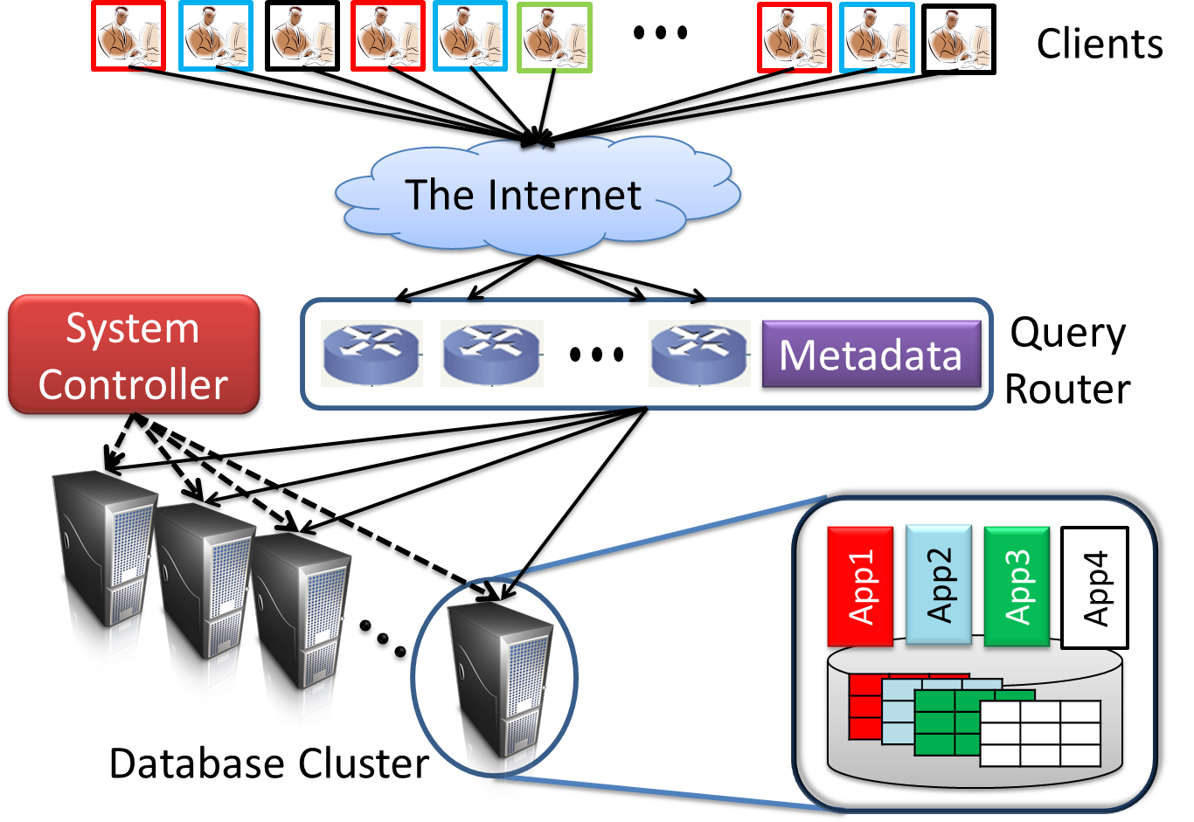
Shared nothing architecture

Slide 56
Live Migration Challenges
How to ensure no downtime?
  Need to migrate the persistent database image (tens of MBs to GBs)
How to guarantee correctness during failures?
  Nodes can fail during migration
  How to ensure transaction atomicity and durability?
  How to recover migration state after failure?
How to guarantee serializability?
    Transaction correctness equivalent to normal operation
How to minimize migration cost? …

Slide 57
UCSB Approach
Migration executed in phases
  Starts with transfer of minimal information to destination (“wireframe”)
Source and destination concurrently execute transactions in one migration phase
Database pages used as granule of migration
  Pages “pulled” by destination on-demand
Minimal transaction synchronization
  A page is uniquely owned by either source or destination
  Leverage page level locking
Logging and handshaking protocols to tolerate failures

Slide 58
Simplifying Assumptions
For this talk
  Small tenants
    i.e. not sharded across nodes.
  No replication
  No structural changes to indices
Extensions in the paper
  Relaxes these assumptions

Slide 59
Design Overview
P₁
P₂
Owned Pages
P₃
P_{n}
T_{S1},…, T_{Sk}
Active transactions
Source
Destination
Page owned by Node
Page not owned by Node

Slide 60
Init Mode
Freeze index wireframe and migrate
P₁
P₁
P₂
P₂
Owned Pages
P₃
P₃
Un-owned Pages
P_{n}
P_{n}
T_{S1},…, T_{Sk}
Active transactions
Source
Destination
Page owned by Node
Page not owned by Node

Slide 61
What is an index wireframe?
Source
Destination

Slide 62
Dual Mode
Requests for un-owned pages can block
P₁
P₃ accessed by T_{Di}
P₁
P₂
P₂
P₃
P₃
P₃ pulled from source
P_{n}
P_{n}
Old, still active transactions
T_{Sk+1},…, T_{Sl}
T_{D1},…, T_{Dm}
New transactions
Source
Destination
Index wireframes remain frozen
Page owned by Node
Page not owned by Node

Slide 63
Finish Mode
Pages can be pulled by the destination, if needed
P₁
P₁
P₂
P₂
P₃
P₃
P₁, P_{2,} … pushed from source
P_{n}
P_{n}
T_{Dm+1},…, T_{Dn}
Completed
Source
Destination
Page owned by Node
Page not owned by Node

Slide 64
Normal Operation
Index wireframe un-frozen
P₁
P₂
P₃
P_{n}
T_{Dn+1},…, T_{Dp}
Source
Destination
Page owned by Node
Page not owned by Node

Slide 65
Artifacts of this design
Once migrated, pages are never pulled back by source
  Transactions at source accessing migrated pages are aborted
No structural changes to indices during migration
  Transactions (at both nodes) that make structural changes to indices abort
Destination “pulls” pages on-demand
  Transactions at the destination experience higher latency compared to normal operation

Slide 66
Implementation
Prototyped using an open source OLTP database H2
  Supports standard SQL/JDBC API
  Serializable isolation level
  Tree Indices
  Relational data model
Modified the database engine
  Added support for freezing indices
  Page migration status maintained using index
  Details in the paper…
Tungsten SQL Router migrates JDBC connections during migration

Slide 67
Experimental Setup
Two database nodes, each with a DB instance running
Synthetic benchmark as load generator
  Modified YCSB to add transactions
    Small read/write transactions
Compared against Stop and Copy (S&C)

Slide 68

Experimental Methodology
    Default transaction parameters:
    10 operations per transaction 80% Read, 15% Update, 5% Inserts
System Controller
Metadata
Workload: 60 sessions
100 Transactions per session
Migrate
    Hardware: 2.4 Ghz Intel Core 2 Quads, 8GB RAM, 7200 RPM SATA HDs with 32 MB Cache
    Gigabit ethernet
    Default DB Size: 100k rows (~250 MB)

Slide 69
Results Overview
Downtime (tenant unavailability)
  S&C: 3 – 8 seconds (needed to migrate, unavailable for updates)
  Zephyr: No downtime. Either source or destination is available
Service interruption (failed operations)
  S&C: ~100 s – 1,000s. All transactions with updates are aborted
  Zephyr: ~10s – 100s. Orders of magnitude less interruption

Slide 70
Results Overview
Average increase in transaction latency (compared to the 6,000 transaction workload without migration)
  S&C: 10 – 15%. Cold cache at destination
  Zephyr: 10 – 20%. Pages fetched on-demand
Data transfer
  S&C: Persistent database image
  Zephyr: 2 – 3% additional data transfer (messaging overhead)
Total time taken to migrate
  S&C: 3 – 8 seconds. Unavailable for any writes
  Zephyr: 10 – 18 seconds. No-unavailability

Slide 71
Failed Operations
Orders of magnitude fewer failed operations, and lower failure rate as throughput increases

Slide 72
Highlights of Zephyr
A live database migration technique for shared nothing architectures with no downtime
  The first end to end solution with safety, correctness and liveness guarantees
Database pages as granule for migration
Prototype implementation on a relational OLTP database
Low cost on a variety of workloads

Slide 73
Conclusion and Cloud Challenges
Transactions at Scale
  Without distributed transactions!
Lightweight Elasticity
  In a Live database!
Autonomic Controller
  Intelligence without the human controller!
And of course Data Privacy

