Slide 1
Content Recommendation on Y! sites
Deepak Agarwal
dagarwal@yahoo-inc.com
Stanford Info Seminar
17th Feb, 2012

Slide 2
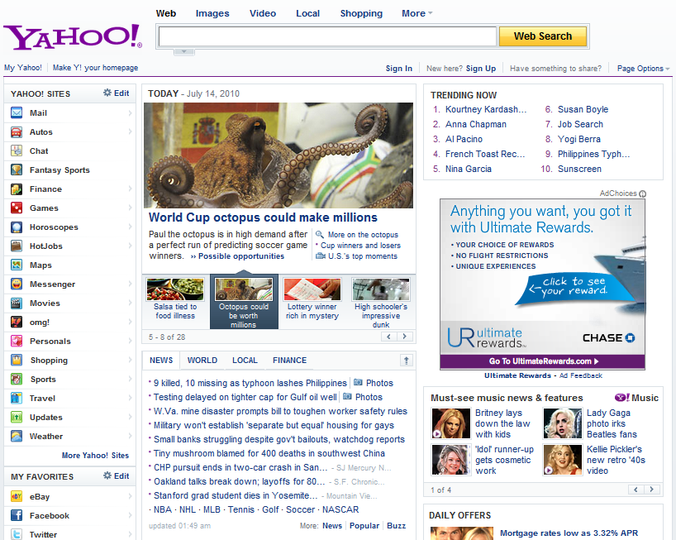
Recommend search queries
Recommend packages:
Image
Title, summary
Links to other Y! pages
Pick 4 out of a pool of K
K = 20 ~ 40
Dynamic
Routes traffic other pages
Recommend applications
Recommend news article

Slide 3
Objective
Serve content items to users to maximize click-through rates
More clicks leads to more pageviews on the Yahoo! network
We can also consider weighted versions of CTR or multiple objectives
More on this later

Slide 4
Rest of the talk
CTR ESTIMATION
  Serving estimated most popular (EMP)
  Personalization
    Based on user features and past activities
Multi-Objective Optimization
  Recommendation to optimize multiple scores like CTR, ad-revenue, time-spent, ….

Slide 5
4 years ago when we started ….
Today module
Editorial placement, no Machine Learning
We built logistic regression based on user and item features: Did not work
Simple counting models
Collect data every 5 minutes, count clicks and views.
This worked but several nuances
F1
F2
F3
F4
NEWS
Notes:
Focus on Today module. Publishes trendy, eclectic articles on a broad range of topics including sports, finance, entertainment etc.
For each visit, select 4 to display from an inventory of K. Hundreds of millions of visits/day, ~600M visitors per month.

Slide 6
Simple algorithm we began with
Initialize CTR of every new article to some high number
  This ensures a new article has a chance of being shown
Show the most popular CTR article (randomly breaking ties) for each user visit in the next 5 minutes
Re-compute the global article CTRs after 5 minutes
Show the new most popular for next 5 minutes
Keep updating article popularity over time
Quite intuitive. Did not work! Performance was bad. Why?

Slide 7
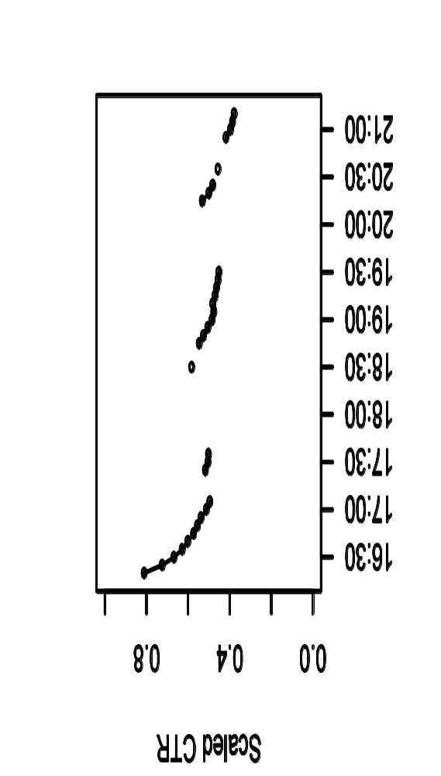
Bias in the data: Article CTR decays over time
This is what an article CTR curve looked like
We were computing CTR by cumulating clicks and views.
  Missing decay dynamics? Dynamic growth model using a Kalman filter.
  New model tracked decay very well, performance still bad
    And the plot thickens, my dear Watson!

Slide 8
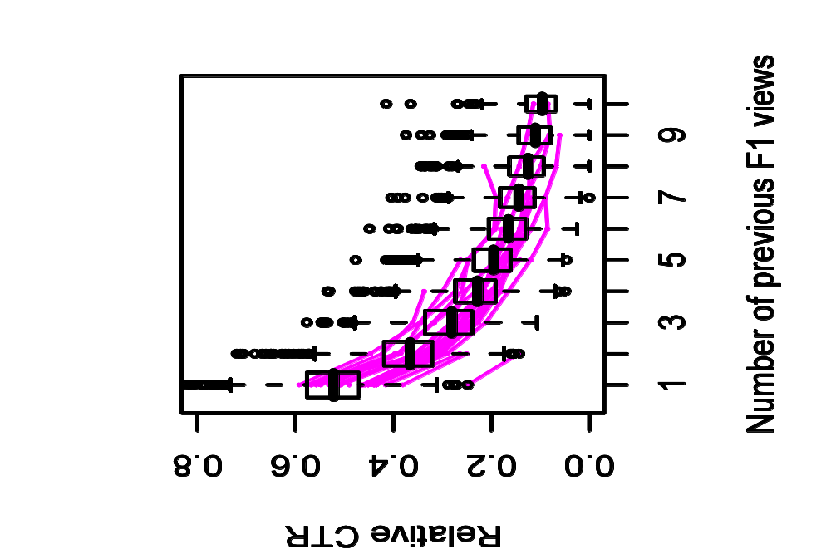
Explanation of decay: Repeat exposure
Repeat Views → CTR Decay

Slide 9
Clues to solve the mystery
User population seeing an article for the first time have higher CTR, those being exposed have lower
  but we use the same CTR estimate for all ?
Other sources of bias? How to adjust for them?
A simple idea to remove bias
  Display articles at random to a small randomly chosen population
    Call this the Random bucket
    Randomization removes bias in data
      (Charles Pierce,1877; R.A. Fisher, 1935)

Slide 10
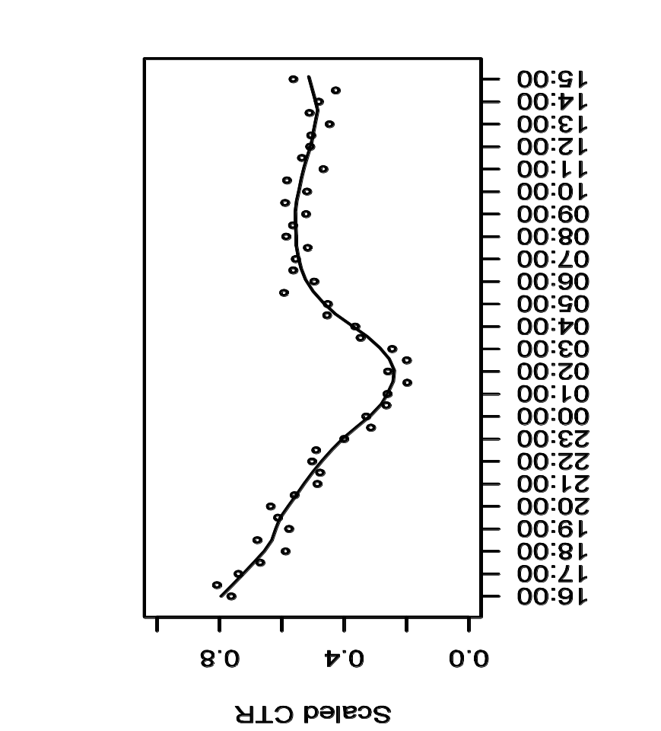
CTR of same article with/without randomization
Serving bucket
Random bucket
Decay
Time-of-Day

Slide 11
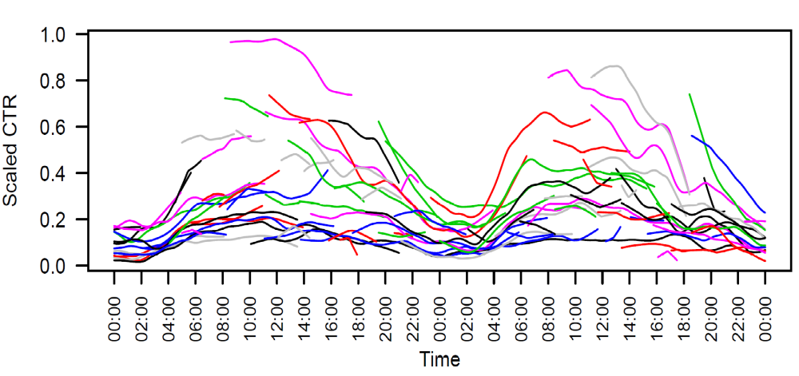
CTR of articles in Random bucket
Track
Unbiased CTR, but it is dynamic. Simply counting clicks and views still didn’t won’t work well.

Slide 12
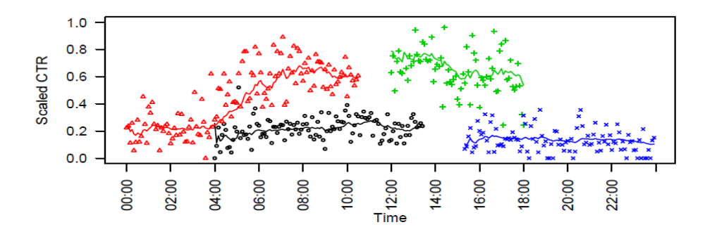
New algorithm
Create a small random bucket which selects one out of K existing articles at random for each user visit
Learn unbiased article popularity using random bucket data by tracking (through a non-linear Kalman filter)
Serve the most popular article in the serving bucket
Override rules: Diversity, voice,….

Slide 13
Other advantages
The random bucket ensures continuous flow of data for all articles, we quickly discard bad articles and converge to the best one
This saved the day, the project was a success!
  Initial click-lift 40% (Agarwal et al. NIPS 08)
  after 3 years it is 200+% (fully deployed on Yahoo! front page and elsewhere on Yahoo!), we are still improving the system
    Improvements both due to algorithms & feedback to humans
  Solutions “platformized” and rolled out to many Y! properties

Slide 14
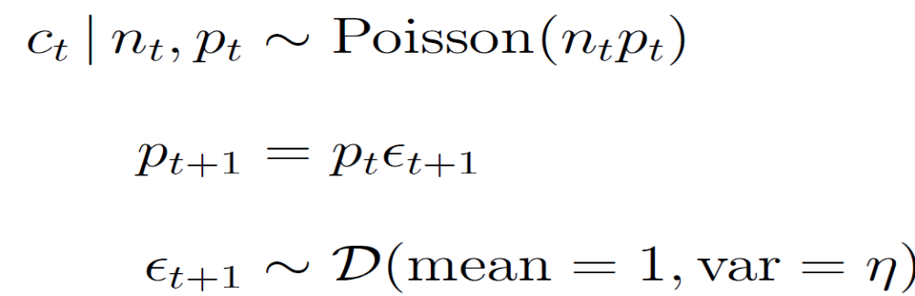

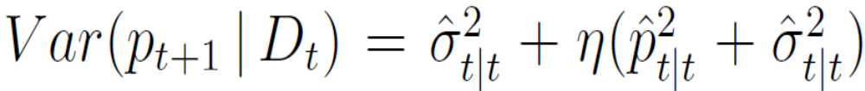
Time series Model: Kalman filter
Dynamic Gamma-Poisson: click-rate evolves over time in a multiplicative fashion
Estimated Click-rate distribution at time t+1
  Prior mean:
  Prior variance:
High CTR items more adaptive

Slide 15
Updating the parameters at time t+1
Fit a Gamma distribution to match the prior mean and prior variance at time t
Combine this with Poisson likelihood at time t to get the posterior mean and posterior variance at time t+1
  Combining Poisson with Gamma is easy, hence we fit a Gamma distribution to match moments

Slide 16
More Details
Agarwal, Chen, Elango, Ramakrishnan, Motgi, Roy, Zachariah. Online models for Content Optimization, NIPS 2008
Agarwal, Chen, Elango. Spatio-Temporal Models for Estimating Click-through Rate, WWW 2009

Slide 17
Lessons learnt
It is ok to start with simple models that learn a few things, but beware of the biases inherent in your data
  E.g. of things gone wrong
    Learning article popularity
      Data used from 5am-8am pst, served from 10am-1pm pst
      Bad idea if article popular on the east, not on the west
Randomization is a friend, use it when you can. Update the models fast, this may reduce the bias
  User visit patterns close in time are similar
Can we be more economical in our randomization?

Slide 18

Multi-Armed Bandits
Consider a slot machine with two arms
p₁ >
p₂
(unknown payoff probabilities)
The gambler has 1000 plays, what is the best way to experiment ?
(to maximize total expected reward)
This is called the “bandit” problem, have been studied for a long time.
Optimal solution: Play the arm that has maximum potential of being good

Slide 19
Recommender Problems: Bandits?
Two Items: Item 1 CTR= 2/100 ; Item 2 CTR= 250/10000
  Greedy: Show Item 2 to all; not a good idea
  Item 1 CTR estimate noisy; item could be potentially better
    Invest in Item 1 for better overall performance on average
This is also referred to as Explore/exploit problem
  Exploit what is known to be good, explore what is potentially good
Article 2
Probability density
Article 1
CTR

Slide 20
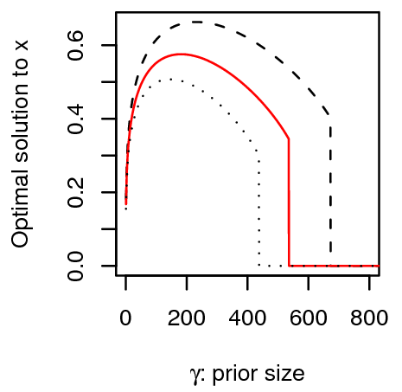
Bayes optimal solution in next 5 mins
2 articles, 1 uncertain
Optimal allocation to uncertain article
Uncertainty in CTR: pseudo #views

Slide 21
More Details on the Bayes Optimal Solution
Agarwal, Chen, Elango. Explore-Exploit Schemes for Web Content Optimization, ICDM 2009
  (Best Research Paper Award)

Slide 22
Recommender Problems: bandits in a casino
Items are arms of bandits, ratings/CTRs are unknown payoffs
  Goal is to converge to the best CTR item quickly
  But this assumes one size fits all (no personalization)
Personalization
  Each user is a separate bandit
  Hundreds of millions of bandits (huge casino)
Rich literature (several tutorials on the topic)
  Clever/adaptive randomization
  Our random bucket is a solution (epsilon-greedy)
  For highly personalized/large content pool/small traffic:
    UCB (mean + k.std), Thompson sampling (random draw from posterior) are good practical solutions.
    Many opportunities for novel research in this area

Slide 23
Personalization
Recommend articles:
Image
Title, summary
Links to other pages
For each user visit,
Pick 4 out of a pool of K
Routes traffic to other pages
1
2
3
4

Slide 24

DATA
Algorithm selects
article j with
item features x_{j}
(keywords, content categories, ...)
User i
with
user features x_{it} (demographics,
browse history,
search history, …)
(i, j) : response y_{ij}
visits
(rating or click/no-click)
Notes:
During time interval t
User visits to the webpage
Some item inventory at our disposal
Decision problem: for each visit, select an item to display
each display generates a response
Goal: choose items to maximize expected clicks

Slide 25
Types of user features
Demographics, geo: Declared
  We did not find them to be useful in front-page application
Browse behavior based on activity on Y! network ( x_{it} )
  Previous visits to property, search, ad views, clicks,..
  This is useful for the front-page application
Previous clicks on the module ( u_{it} )
  Extremely useful for heavy users
    Obtained via matrix factorization

Slide 26
Approach: Online logistic with E/E
Build a per item online logistic regression
For item j,
Coefficients for item j estimated via online logistic regression
Explore/exploit for personalized recommendation
  epsilon-greedy and UCB perform well for Y! front-page application

Slide 27
Bipartite Graph completion problem
Observed Graph
no-click
Articles
Articles
Users
Predicted
CTR Graph
Users
click

Slide 28
User profile to capture historical module behavior
u_{i}
v_{j}
Item popularity
i
j
User popularity

Slide 29
Estimating granular latent factors via shrinkage
If user/item have high degree, good estimates of factors available else we need back-off
Shrinkage: We use user/item features through regressions
regression weight matrix
user/item-specific correction term (learnt from data)

Slide 30
Estimates with shrinkage
For new user/article, factor estimates based on features
For old user/article, factor estimates
Linear combination of regression and user “ratings”

Slide 31
Estimating the Regression function via EM
Maximize
Integral cannot be computed in closed form,
approximated via Gibbs Sampling

Slide 32
Scaling to large data: Map-Reduce
Randomly partition users in the Map
Run separate models in the reducers on each partition
Care is taken to initialize each partition model with same values, constraints are put on model parameters to ensure the model is identifiable in each partition
Create ensembles by using different user partitions
  Estimates of user factors in ensembles uncorrelated, averaging reduces variance

Slide 33
Data Example
1B events, 8M users, 6K articles
Trained factorization offline to produce user feature u_{i}
Baseline: Online logistic without u_{i}
Overall click lift: 9.7%,
Heavy users (> 10 clicks in the past): 26%
Cold users (not seen in the past): 3%

Slide 34
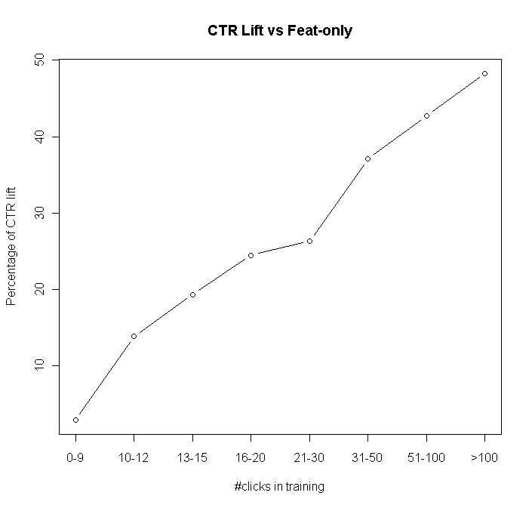
Click-lift for heavy users

Slide 35
More Details
Agarwal and Chen: Regression Based Latent Factor Models, KDD 2009

Slide 36
Multi-Objectives
Beyond Clicks

Slide 37
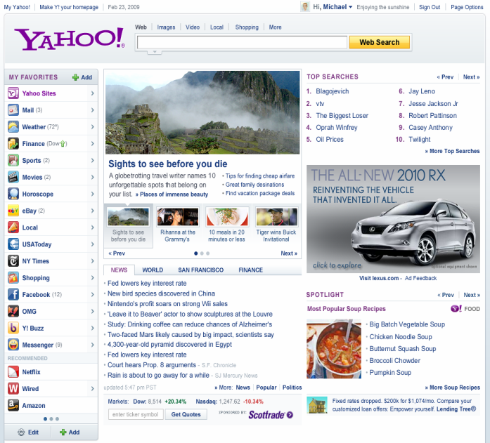
Post-click utilities
Recommender
EDITORIAL
AD SERVER
PREMIUM DISPLAY
(GUARANTEED)
NETWORK PLUS
(Non-Guaranteed)
Clicks on FP links influence downstream supply distribution
content
SPORTS
NEWS
Downstream engagement
(Time spent)
OMG
FINANCE

Slide 38
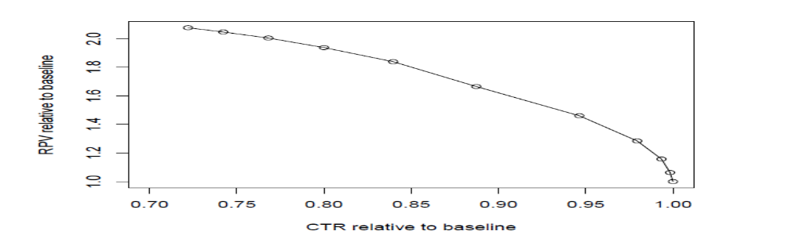
Serving Content on Front Page: Click Shaping
What do we want to optimize?
Usual: Maximize clicks (maximize downstream supply from FP)
But consider the following
  Article 1: CTR=5%, utility per click = 5
  Article 2: CTR=4.9%, utility per click=10
    By promoting 2, we lose 1 click/100 visits, gain 5 utils
If we do this for a large number of visits --- lose some clicks but obtain significant gains in utility?
  E.g. lose 5% relative CTR, gain 20% in utility (revenue, engagement, etc)

Slide 39
How are Clicks being Shaped ?
AFTER
BEFORE
Supply distribution
Changes
SHAPING can happen with respect to multiple downstream metrics (like engagement, revenue,…)

Slide 40




Multi-Objective Optimization
K properties
n articles
m user segments
A₁
S₁
news
x_{ij}: variables
known p_{ij}, d_{ij}
A₂
S₂
finance
…
…
…
omg
A_{n}
S_{m}
  CTR of user segment i on article j: p_{ij}
  Time duration of i on j: d_{ij}

Slide 41
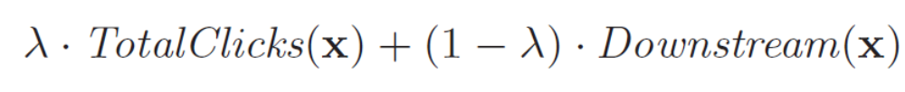
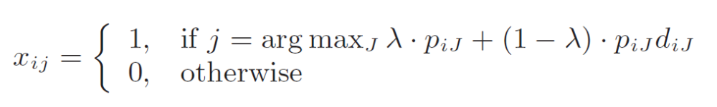
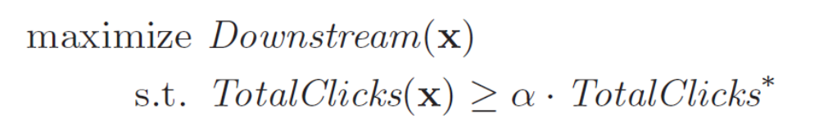
Multi-Objective Program
Scalarization
Linear Program

Slide 42
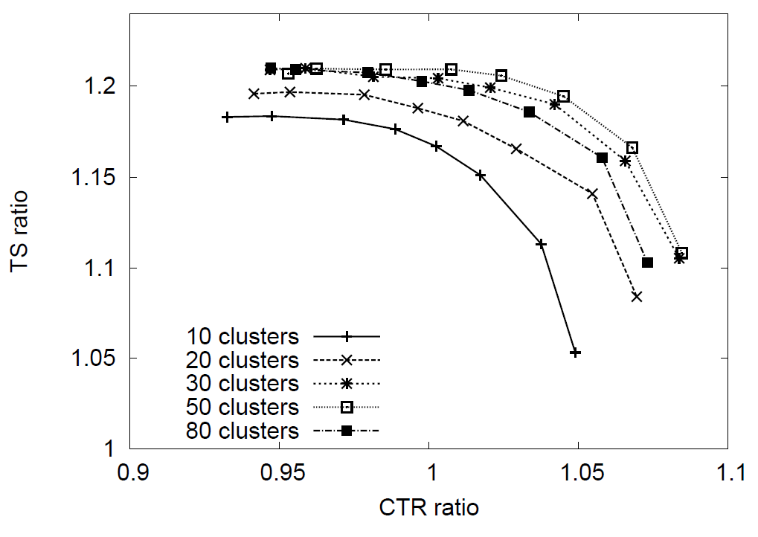
Pareto-optimal solution (more in KDD 2011)

Slide 43
Other constraints and variations
We also want to ensure major properties do not lose too many clicks even if overall performance is better
  Put additional constraints in the linear program

Slide 44
More Details
Agarwal, Chen, Elango, Wang: Click Shaping to Optimize Multiple Objectives, KDD 2011

Slide 45
Can we do it with Advertising Revenue?
Yes, but need to be careful.
  Interventions can cause undesirable long-term impact
  Communication between two complex distributed systems
  Display advertising at Y! also sold as long-term guaranteed contracts
    We intervene to change supply when contract is at risk of under-delivering
    Research to be shared in the future

Slide 46
Summary
Simple models that learn a few parameters are fine to begin with BUT beware of bias in data
  Small amounts of randomization + fast model updates
Clever Randomization using Explore/Exploit techniques
Granular models are more effective and personalized
  Using previous module activity particularly good for heavy users
Considering multi-objective optimization is often important

Slide 47
Information Discovery:
Content Recommendation versus Search
Search
  User generally has an objective in mind (strong intent)
    E.g. Booking a ticket to San Diego
    Recall is very important to finish the task
    Retrieving documents relevant to query important
Other ways of Information Discovery
  User wants to be informed about important news
  User wants to learn about latest in pop music
Intent is weak
  Good user experience: depends on the quality of recommendations

Slide 48
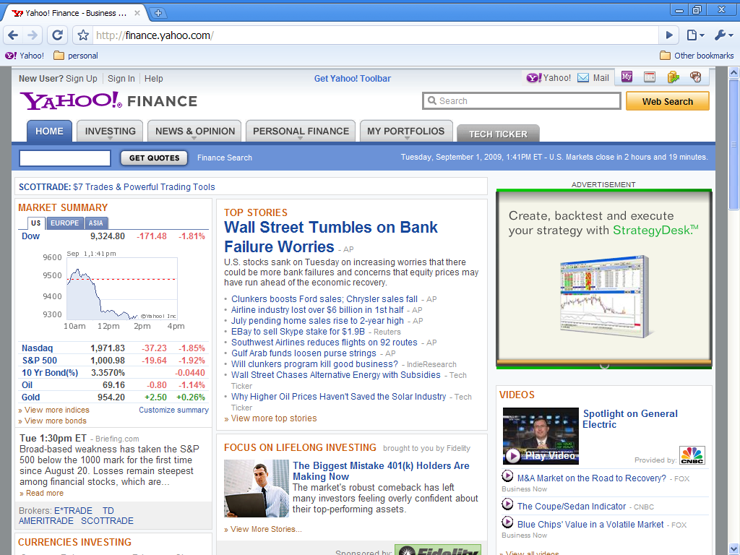

Other examples: Stronger context

Slide 49
Fundamental issue: Goodness score
Develop a score S(user,item,context)
  Goodness of an item for a user in a given context
One option (mimic search)
  (user, context) is query, item is document
    Rank items from a content pool using relevance measure
    E.g. Bag of words based on user’s topical interests;
    bag of words for item based on landing page characteristics and other meta-data
For content recommendation, query is complex
  we want a better and more direct measure of user experience (relevance)

Slide 50
CTR as goodness score
Scoring items based on click-rates (CTR) on item links better surrogate of user satisfaction
CTR can be enhanced by incorporating other aspects that measure value of a click
  E.g. How much advertising revenue does a publisher obtain?
  How much time did the user spend reading the article?
  What are the chances of user sharing the article?

Slide 51
Ranking items
Given a CTR estimation strategy, how do we rank items?
Constraints for good long-term user experience
  Editorial oversight
    Editors/journalists select items/sources that are of high quality
  Voice/Brand
    Typical content associated with a site
  Some degree of relevance
    Do not show Hollywood celebrity gossip on serious news article
  Degree of Personalization
    Typical user interest, session activity
Approach: Recommend items to maximize CTR
  subject to constraints

Slide 52
Current Research: the 3 M Approach
Multi-context
  User interaction data from multiple contexts
    Front page, My Yahoo!, Search, Y! news,…
    How to combine them? (KDD 2011)
Multi-response
  Several signals (clicks, share, tweet, comment, like/dislike)
    How to predict all exploiting correlations?
    Paper under preparation
Multi-Objective
  Short term objectives (proxies) to optimize that achieve long-term goals (this is not exactly mainstream machine learning but it is an important consideration)

Slide 53

Whole Page optimization
Today Module 4 slots
Trending
10 slots
K1
K3
Goal: Display content
Maximize CTR in
long time-horizon
User covariate vector x_{it}
(includes declared and inferred)
(Age=old, Finance=T, Sports=F)
NEWS
8 slots
K2

Slide 54
Collaborators
Bee-Chung Chen (Yahoo! Research, CA)
Liang Zhang (Yahoo! Labs, CA)
Raghu Ramakrishnan (Yahoo! Fellow and VP)
Xuanhui Wang (Yahoo! Labs)
Rajiv Khanna (Yahoo! Labs, India)
Pradheep Elango(Yahoo! Labs, CA)
Engineering & Product Teams (CA)

Slide 55
E-mail: dagarwal@yahoo-inc.com
Thank you !

Slide 56
Bayesian scheme, 2 intervals, 2 articles
Only 2 intervals left : # visits N₀, N₁
Article 1 prior CTR p₀ ~ Gamma(α, γ)
  Article 2: CTR q₀ and q₁, Var(q₀) = Var(q₁) = 0
  Assume E(p₀) < q₀ [else the solution is trivial]
Design parameter: x (fraction of visits allocated to article 1)
Let c |p₀~ Poisson(p₀(xN₀)) : clicks on article 1, interval 0.
Prior gets updated to posterior: Gamma(α+c,γ+xN₀)
Allocate visits to better article in interval 2
  i.e. to item 1 iff post mean item 1 = E[p₁ | c, x] > q₁

Slide 57
Optimization
Expected total number of clicks
E[#clicks] if we always show the certain item
Gain(x, q₀, q₁)
Gain from experimentation
x_{opt}=argmax_{x} Gain(x, q₀, q₁)

Slide 58
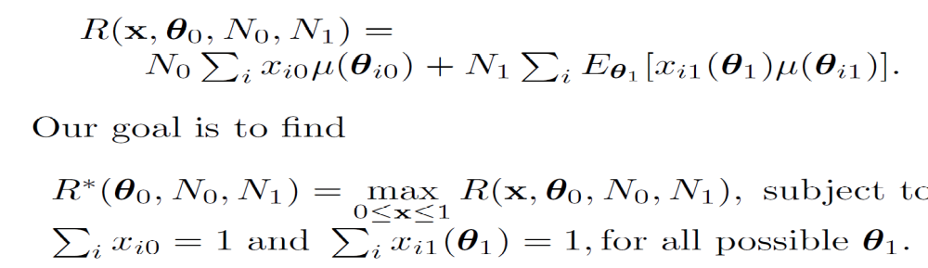
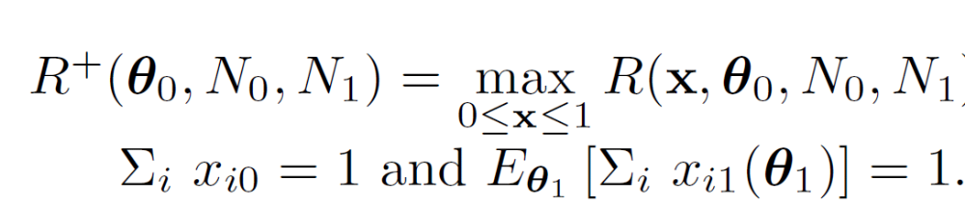
Generalization to K articles
Objective function
Langrange relaxation (Whittle)

Slide 59
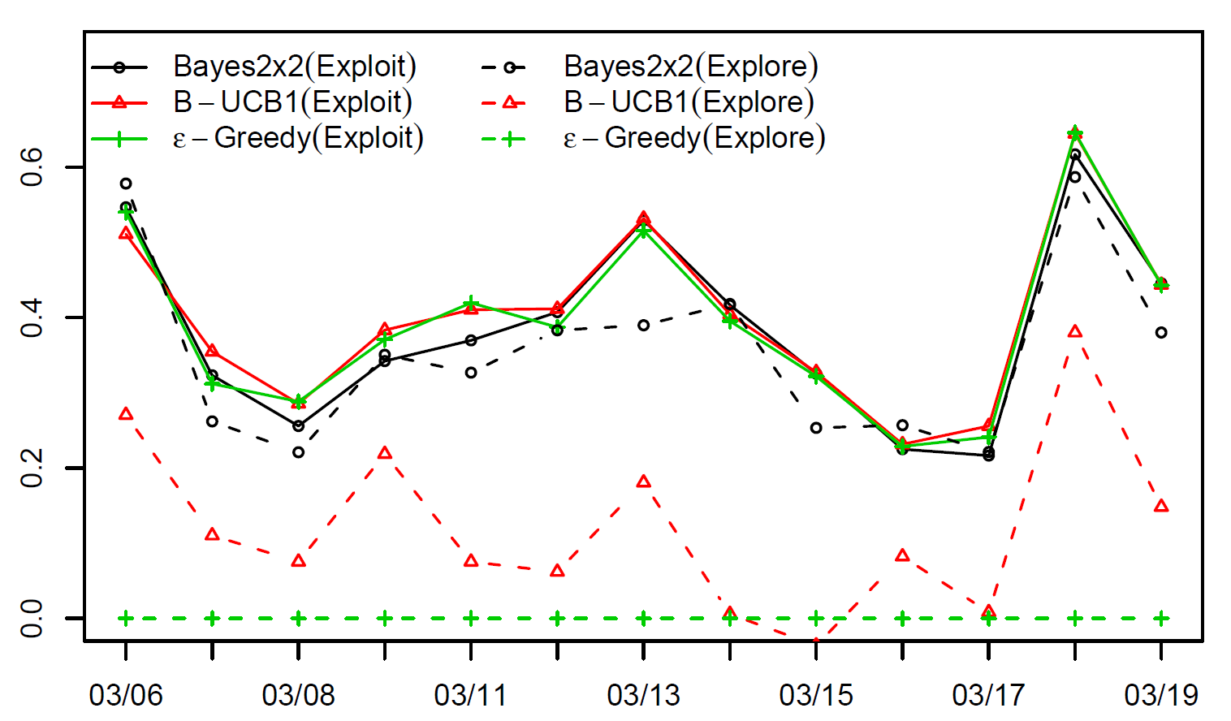
Test on Live Traffic
15% explore (samples to find the best article);
85% serve the “estimated” best (false convergence)

