Slide 1

Christopher Ré
Joint work with the Hazy Team
http://www.cs.wisc.edu/hazy

Slide 2



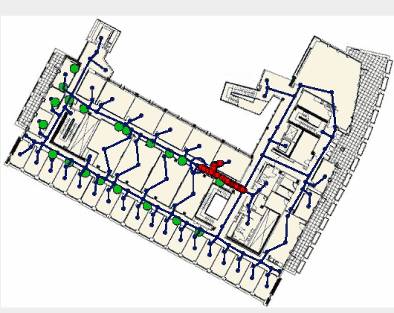
Two Trends that Drive Hazy
Data in unprecedented number of formats
2. Arms race for deeper understanding of data
Automated ➔ Statistical AND Manage Data ➔ RDBMS
Hazy integrates statistical techniques into an RDBMS
Hazy Hypothesis: Handful of statistical operators
capture a diverse set of applications.

Slide 3
Outline
Three Application Areas for Hazy
Drill Down: One Text Application
Maintaining the Output of Classification
Hazy Heads to the South Pole

Slide 4




Data constantly generated on the Web, Twitter, Blogs, and Facebook
Extract and Classify sentiment about products, ad campaigns, and customer facing entities.
Build tools to lower cost of analysis
Statistical tools for extraction (e.g., CRFs) and classification (e.g., SVM). Performance and maintenance are data management challenges (DMC)

Slide 5
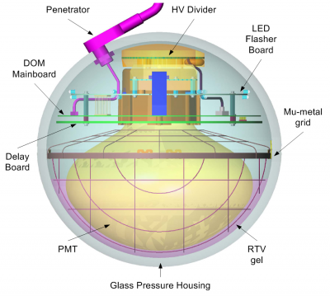

A physicist interpolates sensor readings and uses regression to more deeply understand their data
DMC: Transform and maintain large volumes of sensor data and derived analysis
Models that maps sequences of words to entities similar to some
models that maps sensor readings to meaning

Slide 6


OCR and Speech
A social scientist wants to extract the frequency of synonyms of English words in 18th century texts.
Getting text is challenging! (statistical model of transcription errors)
OCR & Speech
Output of speech and OCR models similar to output of text labeling models
DMC: Process large volumes of statistical data

Slide 7
Takeaway and Implications
Statistical processing on large data
enables wide variety of new applications.
Hazy Hypothesis: Handful of statistical operators capture a diverse set of applications
Key challenges are maintenance and performance (data management challenges)

Slide 8
Outline
Three Application Areas for Hazy
Drill Down: One Text Application
Maintaining the Output of Classification
Hazy Heads to the South Pole

Slide 9
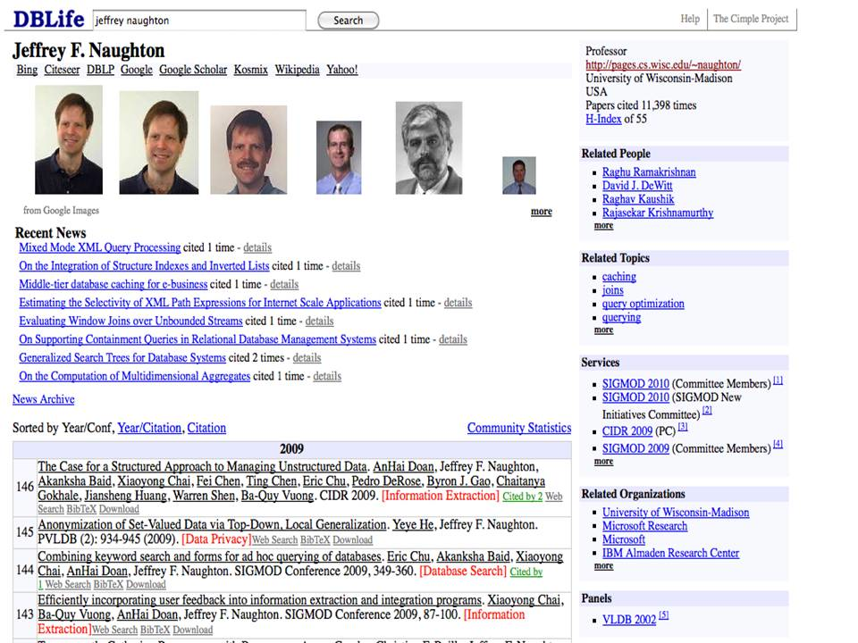

Classify publications by subject area

Slide 10
The workflow requires several steps
Classify publication by subject area
Simplified workflow
Paper references are crawled from the Web.
Entities (Papers, Authors,…) are extracted and deduplicated.
Each paper is classified by subject area
DB is queried to render Web page.
We still use the RDBMS for rendering, reports, etc.
Hazy Evidence: We know names for these operators

Slide 11
How Hazy Helps

Slide 12

Statistical Computations Specified Declaratively
Tuples In. Tuples out. Hazy handles the statistical and traditional details.
CREATE CLASSIFICATION VIEW V(id,label)
ENTITIES FROM Papers
EXAMPLES FROM Example
Declarative SQL-Like Program
Hazy/RDBMS

Slide 13
Hazy Helps with Corrections
Paper 10 is not about query optimization -- it is about
Information Extraction
CREATE CLASSIFICATION VIEW V(id,label)
ENTITIES FROM Papers
EXAMPLES FROM Example
Declarative SQL-Like Program
Hazy/ RDBMS
Easy as an INSERT: Update fixes that entry – and perhaps more – automatically.

Slide 14
Design Goals: Hazy should…
… look like SQL as much as possible
  Ideal: application unaware of statistical techniques
  Build on solutions for classical data management problems
… automate routine tasks
  E.g., updates propagate through the system
  Eventually, order operators for performance

Slide 15

Where Hazy is Now

Slide 16
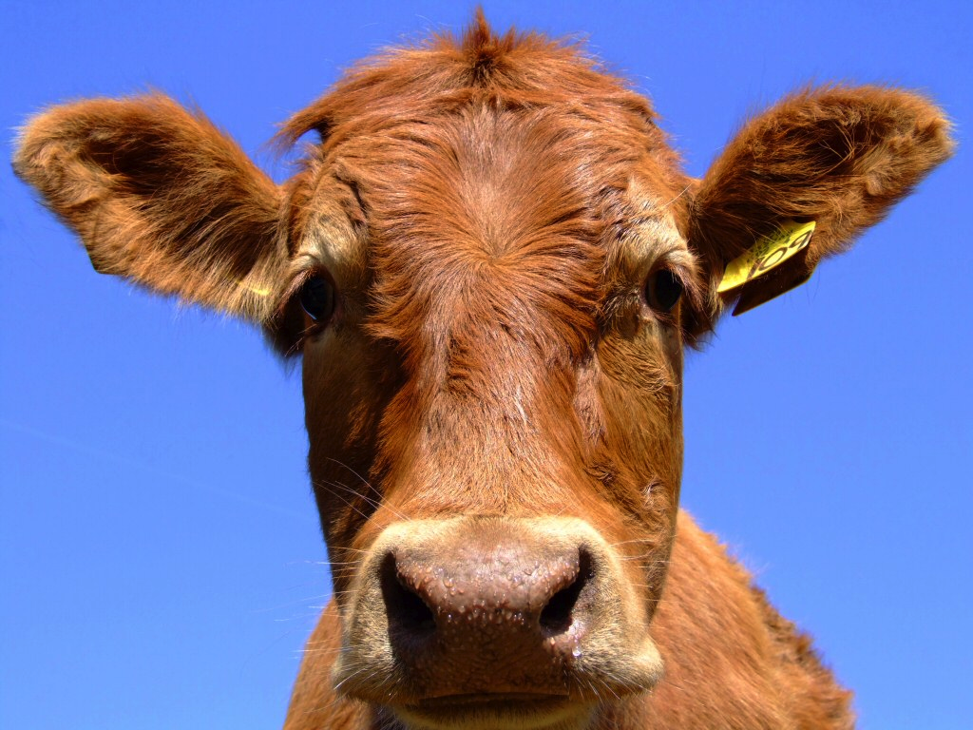
Building Like Mad (Cows)
Developer declares task to Hazy using
SQL-like views
CREATE CLASSIFICATION VIEW V(id,label)
ENTITIES FROM Paper(id, vec)
EXAMPLES FROM EX_Paper (id,vec,label)
USING SVM_L2
In PostgreSQL, we’ve built:
  Classification: SVMs, Least Squares
  Deduplication: synonym detection and coref
  Factor Analysis: Low-Rank for NetFlix
  Transducers for Sequences: Text, Audio, & OCR
  Sophisticated Reasoning: Markov Logic Networks
Model-based Views (Deshpande et al)

Slide 17
Reasoning by Analogy…
Hazy Hypothesis: Handful of statistical operators
capture a diverse set of applications.
Classical | Hazy Operator
Selection | Classification
Projection | Deduplication
Join | Factor Analysis
SQL’s LIKE | Transducer algebra
Constraints | Markov Logic Networks

Slide 18
Outline
Three Application Areas for Hazy
Drill Down: One Text Application
Maintaining the Output of Classification
Hazy Heads to the South Pole

Slide 19
Maintenance: What about corrections?
Paper 10 is not about query optimization -- it is about
Information Extraction
CREATE CLASSIFICATION VIEW ….
ENTITIES FROM PAPERS …
EXAMPLES FROM Ex…
Declarative SQL-Like Program
Hazy/ RDBMS
Easy as an INSERT: Update fixes that entry and others automatically! How does Hazy do this?

Slide 20
Background: Linear Models
Label papers as DB Papers or Non-DB Papers
DB Papers
1
2
w
1. Map each papers to R^{d}
Non-DB Papers
2. Classify via plane
3
5
4
Experts: Logistic Regressions, SVMs, with/without Kernels. We leverage that they all perform inference the same way.

Slide 21
What happens on an update?
Paper 3 is not a Database Paper!
DB Papers
1
2
w
Non-DB Papers
3
5
4
Oh no! The model (w) changes in wild and crazy ways!
… well not really.

Slide 22
Intuition: Model Changes only Slightly
Paper 3 is not a Database Paper!
DB Papers
1
2
w’
w
Non-DB Papers
3
5
4
That is, ||w – w’|| is small.
It would be a waste of effort to relabel all 1, 4, 5. Can we just focus in on 2 and 3?

Slide 23
Hazy-Classify
Cluster data by how likely to change classes
PID | eps
1 | +0.2
3 | +0.1
2 | -0.2
5 | -0.4
4 | -3
1
2
DB Papers
1
2
DB Papers
hw
w’
w
only relabel here
Non-DB Papers
ε₄
3
ε₅
lw
5
4
Prop: There exist hw and lw functions of ||w – w’|| s.t. pid can change labels only if pid.eps in [lw,hw]

Slide 24
But the clustering may get out of date!
Need to recluster periodically, how do we decide?
Setup: Measure the time to recluster, call that C
Set a timer T = 0 // intuition, the waste time.
On each update: Alg from prev. slide. Add time to T.
If T > C then recluster and set T = 0
Two claims that can made precise (theorems):
Algorithm w/in a factor of 2 of optimal run time on any instance.
Essentially optimal deterministic strategy.
On DBLife, Citeseer, and ML datasets, Hazy is 10x+ faster than scan.

Slide 25
Other Features of Hazy-Classify
Hazy has a main-memory (MM) engine
Hazy-Classify supports Eager and Lazy Materialization Strategies
  Improves either by an order of magnitude
An index that keeps in memory only elements likely to change classes
  Allows 1% of data in memory with MM perf.
  Enables active learning on 100Gb+ corpus.

Slide 26

Hazy Heads to the South Pole

Slide 27
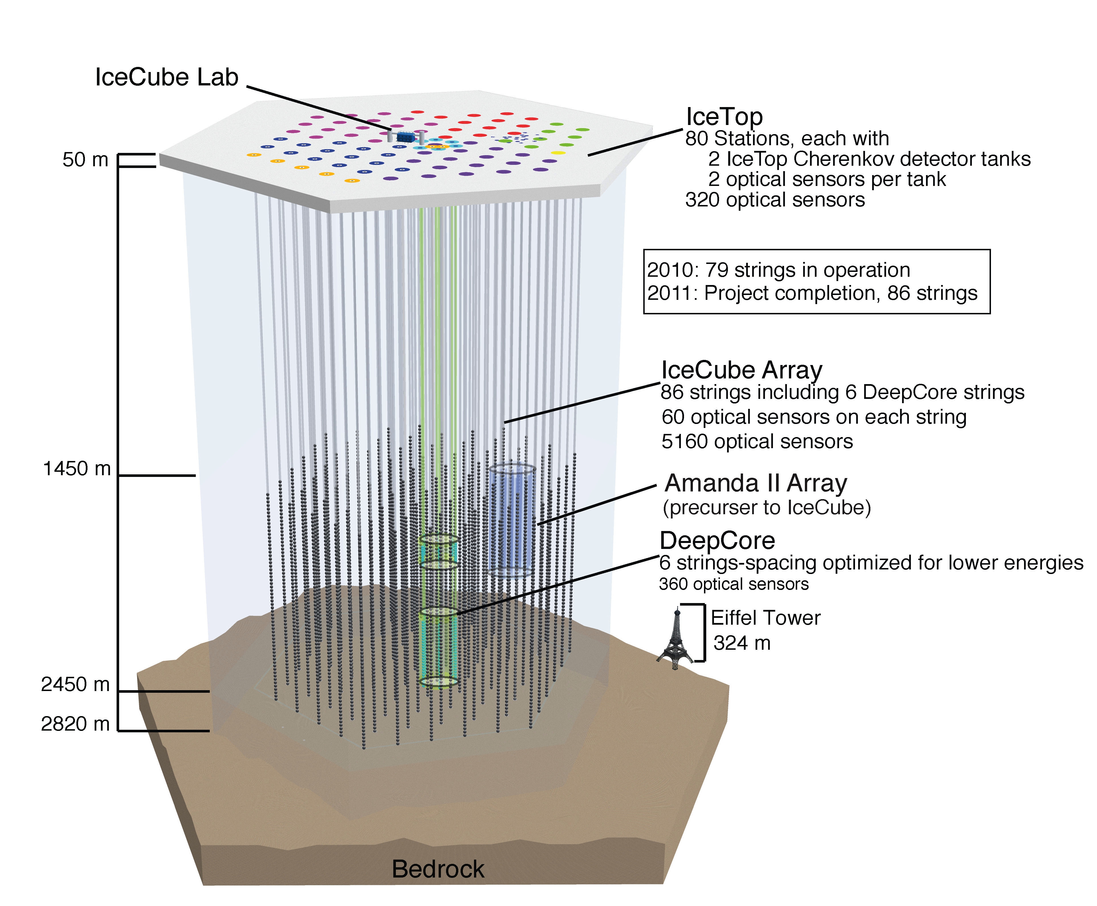
IceCube
Digital Optical Module (DOM)

Slide 28
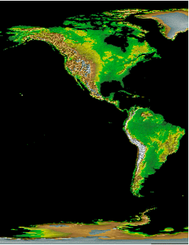
Workflow of IceCube
In Madison: Lots of data analysis.
Via satellite: Interesting DOM readings
At Pole: Algorithm says “Interesting!”
In Ice: Detection occurs.

Slide 29
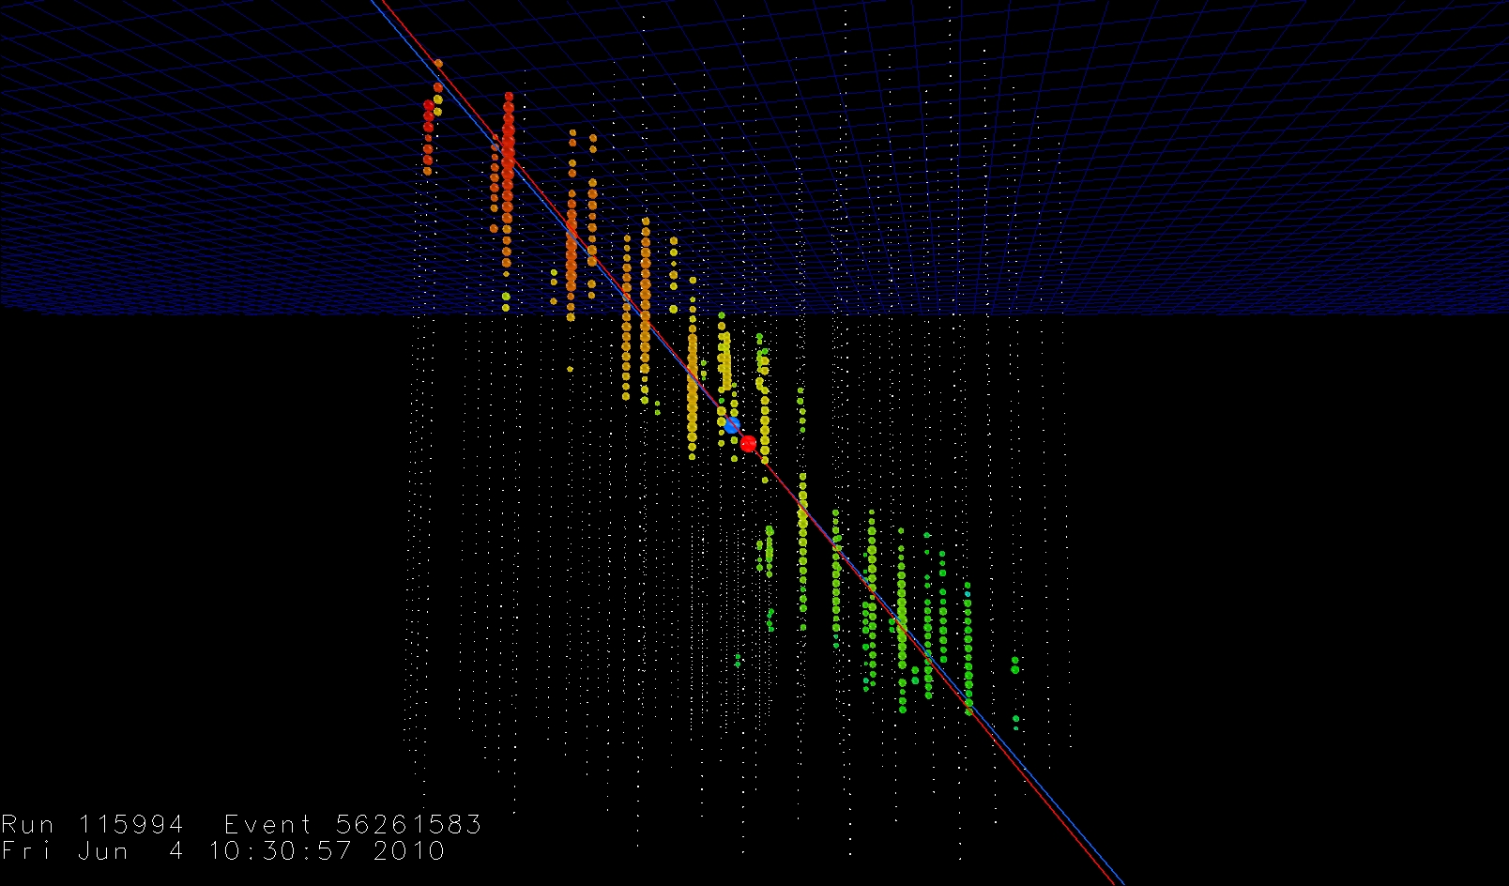
A Key Phase: Detecting Direction
Here, Speed ≈ Quality
Mathematical structure used to help track neutrinos is similar to labeling text/tracking/OCR!

Slide 30
Framework: Regression Problems
x | the model
y_{i} | A data item
f | Scores the error
P | Enforces prior
Examples:
1. Neutrino Tracking: y_{i} is a sensor reading
2. CRFs: y_{i} is (token, label)
3. Netflix: y_{i} is (user,movie,rating)
Others tools also fit this model,e.g., SVMs
Claim: General data analysis technique that is amenable to RDBMS processing

Slide 31
Background: Gradient Methods
Gradient Methods: Iterative. 1. Take current x,
2. Derivate F wrt x,
3. Move in opposite direction
F(x)

Slide 32
Incremental Gradient Methods
Gradient Methods: Iterative.
1. Take current x,
2. Approximate derivative of F wrt x,
3. Move in opposite direction
Can use a single data item to approximate

Slide 33
Incremental Gradient Methods (iGMs)
Why use iGMs? Provably, iGMs converge to an optimal for many problems, but the real reason is:
iGMs are fast.
Technical connection: iGM processing ≈ a single tuple. RBDMS processing techniques apply
No more complicated than a COUNT.
Notes:
To demonstrate this claim, let me show you the

Slide 34
Hazy’s SQL version of
Incremental Gradient
-- (1) Curry (cache) the model, x
SELECT cache_model($mid, $x);
-- (2) Shuffle
SELECT * INTO Shuffled FROM Data ORDER BY RANDOM();
-- (3) Execute the Gradient Steps
SELECT GRAD($mid, y) FROM Shuffled
-- (4) Write the model back to the model instance table
UPDATE model_instance SET model=retrieve_model($mid)
WHERE mid=$mid;
Input: Data(id,y), GRAD
Code generated automatically.
Hazy Params: $mid and $model.
Hazy does more optimization. This is a basic block.
Notes:
Add in the point: We get synchronization and a bunch of stuff for free.

Slide 35


More applications than a cube of ice!
Recommending Movies on Netflix
  Experts: Low-rank Factorization.
  Old SOTA : 4+ hours.
  In RDBMS : 40 minutes.
  Hazy-MM : 2 minutes.
Same Quality
Hazy-MM: We compile plans using g++ with a main memory engine (useful in IceCube).
  Buzzwords: A novel parallel execution strategy for incremental gradient methods to optimize convex relaxations with constraints or proximal point operators.
Prof.
Ben Recht

Slide 36
A Common Backbone
All of Hazy’s operators can have a
weight learning or regression phase.
Classical | Hazy Enhanced
Selection | Classification
Projection | Deduplication
Join | Factor Analysis
SQL’s LIKE | Transducer algebra
Constraints | Markov Logic Networks

Slide 37
Futuring
(I learned this term from my wife)
A main-memory engine for use in IceCube
We are releasing our algorithms to Mahout
We have some corporate partners who have given access to their data.

Slide 38
Incomplete Related Work
Numeric methods to Hadoop Ricardo [Das et al 2010], Mahout [Ng et al].
Deduplication
Coref Systems (UIUC), Dedupalog [ICDE09]
Incremental Gradients
Bottou, VowPal Rabbit (Y!), Pegasos
Rules+Probability: MLNs [Richardson 05]
PRMs [Koller 99]
Declarative IE
System T From IBM, DBLife [Doan et al], [Wang et al 2010]
Model-Based Views: MauveDB [Deshpande et. al 05]

Slide 39
Conclusion
Future of data management is in managing these less precise sources
Hazy Hypothesis: Handful of statistical operators
capture a diverse set of applications.
Key challenges: performance and maintenance.
Hazy attacks this.

