Slide 1
Efficiently Supporting Changes to Declarative Schema Mappings
Todd J. Green
University of California, Davis
January 28, 2011
@Stanford InfoSeminar

Slide 2
Change is a Constant in Data Management
Databases are highly dynamic; many kinds of changes need to be propagated efficiently:
  To data (“view maintenance”)
  To view definitions (“view adaptation”)
  Others, such as schema evolution, etc.
Data exchange and collaborative data sharing systems (e.g., Orchestra [Ives+ 05]) exacerbate this need:
  Large numbers of materialized views
  Frequent updates to data, schemas, mapping/view definitions

Slide 3
Change Propagation: a Problem of
Computing Differences
View maintenance
source data
view definition
materialized view
Given:
R
V
change to source data (difference wrt current version)
R¢
Goal:
compute change to materialized view (difference)
V¢
View adaptation
source data
view definition
materialized view
Given:
R
V
change to view definition (another kind of difference)
Goal:
compute change to materialized view
V¢
Notes:
DRAW SOMETHING for change to view definition?

Slide 4
Challenges in Change Propagation
View maintenance: studied since at least the mid-eighties [Blakeley+ 86], but existing solutions quite narrow and limited
  Various known methods to compute changes “incrementally”, e.g., count algorithm [Gupta+ 93]
  How do we optimize this process? What is space of all update plans?
View adaptation: less attention, but renewed importance in context of data exchange/collaborative data sharing systems
  Previous approaches: limited to case-based methods for simple changes [Gupta+ 01]
  Complex changes? Again, space of all update plans?
Key challenge: compute changes using database queries!

Slide 5
Roadmap
Part I: a grand unified theory of change propagation
Part II: a practical implementation in Orchestra

Slide 6
Part I: Theoretical Underpinnings [Green,Ives,Tannen 09]
A novel, unified approach to view maintenance, view adaptation that allows the incorporation of optimization strategies:
  Representing changes and data together: Z-relations
  View maintenance, view adaptation as special cases of a more general problem: rewriting queries using views (on Z-relations)
A sound and complete algorithm for rewriting relational algebra (RA) queries (with difference!) using RA views on Z-relations
  Enabled by the surprising decidability of Z-equivalence of RA queries
Maintaining/adapting views under bag or set semantics via excursion through Z-semantics

Slide 7
Representing Changes as Data: Z-Relations
Can think of changes to data as a kind of annotated relation
inserted tuple | +
deleted tuple | –
Z-relation: a relation where each tuple is associated with a (positive or negative) count
  Positive counts indicate (multiple) insertions;
  negative counts, (multiple) deletions
  Uniform representation for both data and changes to data
  Update application = union (a query!)
R¢
a | b | 2
c | d | –3
R’ = R [ R¢

Slide 8
Relational Algebra (RA) on Z-Relations
join (⋈) multiplies counts
union ([), projection (¼) add counts
selection (¾) multiplies counts by 0 or 1
difference (–) subtracts counts
Note,DifNote, difference can lead to negative counts (unlike “proper subtraction” in bag semantics where negative counts are truncated to 0)
(same as for semiring-annotated relations
[Green+07])

Slide 9
Incremental View Maintenance:
An Application of Z-Relations
Source relation:
Materialized view (with duplicates):
a | b | 1
c | b | 1
b | c | 1
b | a | 1
a | a | 1
a | c | 1
b | b | 2
c | c | 1
V(x,y) :– R(x,z), R(z,y)
R
2 copies of (b,b)
deletion
R¢
b | a | -1
c | d | +1
V¢
b | b | -1
b | d | +1
delete 1 copy of (b,b)
insertion
insert 1 copy of (b,d)
Delta rules [Gupta+ 93] for V with Z-relations semantics:
V¢(x,y) :– R(x,z), R¢(z,y)
V¢(x,y) :– R¢(x,z), R’(z,y)

Slide 10
Delta Rules: a Special Case of
Rewriting Queries Using Views on Z-Relations
Query (to compute diff.):
Materialized views:
V¢(x,y) :– R’(x,z), R’(z,y)
– V¢(x,y) :– R(x,z), R(z,y)
V(x,y) :– R(x,z), R(z,y)
R’(x,y) :– R(x,y)
R’(x,y) :– R¢(x,y)
rewrite V¢ using the materialized views
... OTHER PLANS...?
Another delta rules
rewriting:
Delta rules rewriting:
V¢(x,y) :– R(x,z), R¢(z,y)
V¢(x,y) :– R¢(x,z), R’(z,y)
V¢(x,y) :– R¢(x,z), R(z,y)
V¢(x,y) :– R’(x,z), R¢(z,y)
Notes:
Animate!

Slide 11
View Adaptation: Another Application of Rewriting Queries Using Views
Old view definition:
New view definition:
V(x,y) :– R(x,z), R(z,y)
V(x,y) :– R(x,z), R(y,z)
V’(x,y) :– R(x,z), R(z,y)
reformulate using materialized view V
... AGAIN, OTHER PLANS...?
A plan to “adapt” V into V’:
V’(x,y) :– V(x,y)
– V’(x,y) :– R(x,z), R(y,z)

Slide 12
Bag Semantics, Set Semantics via Z-Semantics
Even if we can solve the problems for Z-relations, what does this tell us about the answers we actually need: for bag semantics or set semantics?
For positive RA (RA⁺) queries/views on bags
  Z-semantics and bag semantics agree
  Further, eliminate duplicates to get set semantics
  Still works if rewriting is actually in RA (introduces difference)!
Also works for RA queries/views with restricted use of difference
  Still covers, e.g., the incremental view maintenance case
Notes:
EXTRA SLIDE AT END WITH PRECISE RESULTS FOR LAST BULLET?

Slide 13
Z-Equivalence Coincides with
Bag-Equivalence for Positive RA (RA⁺)
Lemma. For RA⁺ queries Q, Q’ we have Q ´_{Z} Q’ (equivalent on Z-relations) iff Q ´_{N} Q’ (equivalent on bag relations)
Corollary. Checking Z-equivalence for RA⁺: convert to unions of conjunctive queries (UCQs), check if isomorphic
  CQs Q ´_{N} Q’ iff Q ≅ Q’ [Lovász 67, Chaudhuri&Vardi 93]
  UCQs Q ´_{N} Q’ iff Q ≅ Q’ [Cohen+ 99]
Complexity of above: graph-isomorphism complete for UCQs; for RA⁺ (exponentially more concise than UCQs), don’t know!

Slide 14
Z-Equivalence is Decidable for RA
Key idea. Every RA query Q can be (effectively) rewritten as a single difference A – B where A and B are positive
  Not true under set or bag semantics!
Corollary. Z-equivalence of RA queries is decidable
  Proof. A – B ´_{Z} C – D where A, B, C, D are positive
  , A [ D ´_{Z} B [ C
  , A [ D ´_{N} B [ C which is decidable [Cohen+ 99]
  Same problem undecidable for set, bag semantics!
Alternative representation of relational algebra queries justified by above: differences of UCQs

Slide 15
Rewriting Queries Using Views with Z-Relations
Given: query Q and set V of materialized views, expressed as differences of UCQs
Goal: enumerate all Z-equivalent rewritings of Q (w.r.t. V)
Approach: term rewrite system with two rewrite rules
By repeatedly applying rewrite rules – both forwards and backwards (folding and augmentation) – we reach all (and only) Z-equivalent rewritings
unfolding | replace view predicate with its definition
cancellation | e.g., (A [ B) – (A [ C) becomes B – C

Slide 16
An Infinite Space of Rewritings
There are only finitely many positive (nontrivial) rewritings of RA query Q using RA views V
With difference, can always rewrite ad infinitum by adding terms that “cancel”
But even without this:
Now consider
Q = R²
´_{Z} VR – R⁴ (equiv. is w.r.t. V)
´_{Z} VR – VR³ [ R⁶
´_{Z} VR – VR³ [ VR⁵ – R⁸
´_{Z} ...
Let RS denote relational composition of R with S, i.e.,
RS(x,y) :– R(x,z), S(z,y)
Let V contain single view
V = R [ R³
none of these have
“cancelling” terms!
repeated relational composition

Slide 17
How Do We Bound the Space of Rewritings? Use Cost Models!
Can make some reasonable cost model assumptions:
  cost(A [ B) ≥ cost(A) + cost(B)
  cost(A ⋈ B) ≥ cost(A) + cost(B) + card(A ⋈ B)
  etc.
Theorem. Under above assumptions, can find minimal-cost reformulation of RA query Q using RA views V in a bounded number of steps

Slide 18
Highlights of Other Results
Z-equivalence remains decidable for RA with built-in predicates (<, ≤, >, ≥, ≠) over dense linear order
  Basic idea: can linearize (cf., e.g., [Cohen+ 99]) queries, then test for isomorphism
  e.g., Q(x,y) :- R(x,y), x ≠ y → Q(x,y) :- R(x,y), x < y Q(x,y) :- R(x,y), y < x
Full characterization of class of RA queries where Z-semantics and bag semantics agree on all bag instances, hence where Z-semantics can be used for evaluation
  Bad news: undecidable class
  Good news: covers incremental maintenance of positive views (where difference is used only for changes to sources)

Slide 19
Roadmap
Part I: a grand unified theory of change propagation
Part II: a practical implementation in Orchestra

Slide 20
Background: Orchestra CDSS [Ives+08] a Collaborative Data Sharing System
Set of peers (e.g., collaborating life scientists), each with database, agree to share information
Peers linked via network of compositional schema mappings
  define how data/updates applied to one peer instance should be transformed and applied to other peer instances
System tracks provenance (lineage) information [Green+ 07] as updates are mapped/transformed
  Basis of provenance-based trust policies
  Also used to guide update propagation

Slide 21
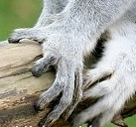

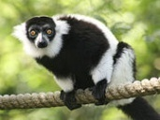

Example: Sharing Morphological Data
Alice’s field observations: A
ID | Species | Image | Character | State
34 | Lemur catta |  | hand color | white
47 | Lemur catta |  | hand color | white
Carol wants to gather information from Alice, Bob, uBio, and put into own data repository:
Bob’s field observations: B, C
Carol’s Guide to Primate Hand Colors
SID | Char | State
61 | hand color | black
Common Name | Hand Color
schema mappings
SID | Species | Picture
61 | Lemur catta
Can do this using
schema mappings
Standard species names: D
Species | Common Name
Lemur catta | Ring-Tailed Lemur
Notes:
make clear in this slide: in this talk “queries” = “update exchange”, i.e., queries carry out update exchange

Slide 22
Example: Sharing Morphological Data (2)
Alice’s field observations: A
Datalog mappings relating databases
ID | Species | Image | Character | State
34 | Lemur catta |  | hand color | white
47 | Lemur catta |  | hand color | white
E(name, color) :–
B(id, “hand color”, color),
C(id, species,_), D(species, name)
E(name, color) :–
A(id, species,_, “hand color”, color),
D(species, name)
Bob’s field observations: B, C
SID | Char | State
61 | hand color | black
Carol’s Guide to Primate Hand Colors: E
Common Name | Hand Color
Ring-Tailed Lemur | white
Common Name | Hand Color
SID | Species | Picture
61 | Lemur catta
Standard species names: D
Species | Common Name
Lemur catta | Ring-Tailed Lemur

Slide 23
Example: Sharing Morphological Data (2)
Alice’s field observations: A
Datalog mappings relating databases
ID | Species | Image | Character | State
34 | Lemur catta |  | hand color | white
47 | Lemur catta |  | hand color | white
E(name, color) :–
B(id, “hand color”, color),
C(id, species,_), D(species, name)
E(name, color) :–
A(id, species,_, “hand color”, color),
D(species, name)
Bob’s field observations: B, C
SID | Char | State
61 | hand color | black
Carol’s Guide to Primate Hand Colors: E
Common Name | Hand Color
Ring-Tailed Lemur | white
Common Name | Hand Color
Ring-Tailed Lemur | black
SID | Species | Picture
61 | Lemur catta
join
Standard species names: D
Species | Common Name
Lemur catta | Ring-Tailed Lemur

Slide 24
Example: Sharing Morphological Data (2)
Alice’s field observations: A
Datalog mappings relating databases
ID | Species | Image | Character | State
34 | Lemur catta |  | hand color | white
47 | Lemur catta |  | hand color | white
E(name, color) :–
B(id, “hand color”, color),
C(id, species,_), D(species, name)
E(name, color) :–
A(id, species,_, “hand color”, color),
D(species, name)
Bob’s field observations: B, C
SID | Char | State
61 | hand color | black
Carol’s Guide to Primate Hand Colors: E
Common Name | Hand Color
Ring-Tailed Lemur | white
Ring-Tailed Lemur | white
Common Name | Hand Color
Ring-Tailed Lemur | black
join
SID | Species | Picture
61 | Lemur catta
Standard species names: D
Species | Common Name
Lemur catta | Ring-Tailed Lemur

Slide 25
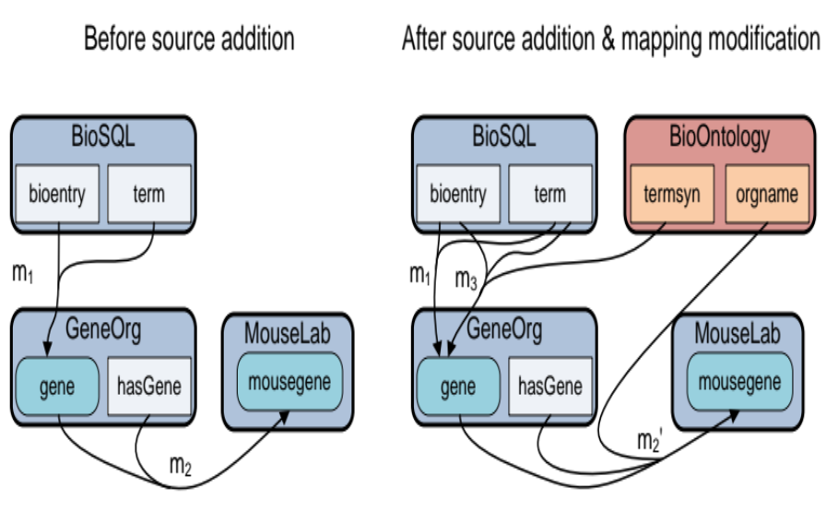
Mapping Evolution in Orchestra
[m1] gene(E,N) :- bioentry(E,T,N), term(T,"gene").
[m2] mousegene(G,N) :- gene(G,N), hasGene(G,12).

Slide 26
Mapping Evolution in Orchestra
[m1] gene(E,N) :- bioentry(E,T,N), term(T,"gene").
[m2] mousegene(G,N) :- gene(G,N), hasGene(G,12).
[m2’] mousegene(G,N) :- gene(G,N), hasGene(G,M), orgname(M,"mus musculus").
[m3] gene(E,N) :- bioentry(E,T,N), term(S,"gene"), termsyn(T,S).

Slide 27
Challenges in Mapping Evolution (Part II)
Can we handle changes to mappings efficiently and incrementally, and in a principled way?
  Mappings in practice are very hard to get right, frequent changes/iterations required over time
  Relationships among peers are clarified, new data sources become available, schemas evolve, ...
  Problem is wide open!
Can we handle changes to data and mappings at the same time?
  Is there a potential performance benefit?
Can we handle/exploit provenance?
Can we do all this in a cost-based way?
  Sometimes many incremental plans possible, yet the best plan might be to recompute from scratch!

Slide 28
Supporting Evolution in Orchestra [Green&Ives 11]
A practical, cost-based reformulation engine to propagate both kinds of changes in this context, based on methods from Part I
  key: cost-based search strategies and heuristics to prune the search space; Z-semantics and differential query plans
  core of engine doesn’t even know whether it’s dealing with data updates or mapping updates or both; they all look the same
Extension of these methods to exploit provenance information as used in Orchestra
Prototype implementation and experimental evaluation

Slide 29
Architectural Overview
Basic idea: pair reformulation algorithm from Part I with DBMS cost estimator, cost-based search strategies
heuristics, search strategies
Changes to
data, view definitions
ORCHESTRA Reformulation
Engine
EFFICIENT UPDATE PLAN
execute! (Z-semantics)
plans
costs
DBMS Cost Estimator
V
V’
DBMS
statistics, indices, etc
old views
updated views

Slide 30
Basic Search Strategy
Huge search space, need to prune whenever possible
Start with views fully unfolded and cancelled
Then do time-boxed hill climbing with folding/augmentation; main data structure the search heap
Parameters:
  time t to allow for search, # k of one-step rewritings to add at each step, max size h of search heap, ...
while (search heap non-empty, time remains) {
  1. remove cheapest plan P from heap
  2. enumerate one-step rewritings P₁, ..., P_{n} of P and compute their costs C₁, ..., C_{n}
  3. pick cheapest k and add to heap }

Slide 31
Engineering Insights
Use quick and dirty cost estimation
  using custom estimator instead of DBMS estimator improved performance ~5x
Use hash consing
  testing equivalence (isomorphism) of rules is extremely common operation, needs to be very fast
  using hash consing improved performance another ~5x
Use a non-imperative language
  we used Java; implementation was PAINFUL
  would probably have been at least as fast and 10x fewer lines of code in Prolog

Slide 32
Speedup is >= 30% on Typical Workloads
(Warning: Unofficial Results)
Composite synthetic workload, PostgreSQL 9.0, collection of 24 mappings, all randomly changed, ~10GB source database (details in paper)
Use provenance? | Changes to data also? | TIME (unopt) | TIME (opt) | SPEEDUP
no | no | 12.2m | 8.5m | 30%
yes | no | 11.4m | 2.2m | 81%
no | yes | 10.5m | 7.2m | 31%
yes | yes | 9.6m | 2.6m | 72%

Slide 33
Another Source of Optimization Opportunities: CDSS Provenance [Green+ 07]
Basic idea: annotate source tuples with tuple ids, combine and propagate during query processing
  Abstract “+” records alternative use of data (union, projection)
  Abstract “¢” records joint use of data (join)
  Yields space of annotations K
K-relation: a relation whose tuples are annotated with elements from K

Slide 34


Combining Annotations in Queries
ID | Species | Img | Character | State
34 | L.catta |  | hand color | white | p
47 | L.catta |  | hand color | white | q
ID | Character | State
61 | hand color | black | r
source tuples
annotated with tuple ids from K
ID | Species | Img
61 | Lemur catta |  | s
Species | Comm. Name
Lemur catta | Ring-tailed Lemur | u

Slide 35
Combining Annotations in Queries
Datalog mappings
ID | Species | Img | Character | State
34 | L.catta |  | hand color | white | p
47 | L.catta |  | hand color | white | q
E(name, color) :–
B(id, “hand color”, color),
C(id, species,_), D(species, name)
ID | Character | State
61 | hand color | black | r
r
join
ID | Species | Img
61 | Lemur catta |  | s
Comm. Name | Hand Color
Ring-tailed Lemur | black
s
r¢s¢u
Species | Comm. Name
Lemur catta | Ring-tailed Lemur | u
u
Operation x¢y means joint use of data annotated by x and data annotated by y

Slide 36
Combining Annotations in Queries
Datalog mappings
ID | Species | Img | Character | State
34 | L.catta |  | hand color | white | p
47 | L.catta |  | hand color | white | q
E(name, color) :–
B(id, “hand color”, color),
C(id, species,_), D(species, name)
p
q
E(name, color) :–
A(id, species,_, “hand color”, color),
D(species, name)
ID | Character | State
61 | hand color | black | r
ID | Species | Img
61 | Lemur catta |  | s
Comm. Name | Hand Color
Ring-tailed Lemur | black | r¢s¢u
Ring-tailed Lemur | white
Ring-tailed Lemur | white
p¢u
p¢u
Species | Comm. Name
Lemur catta | Ring-tailed Lemur | u
q¢u
u
Operation x¢y means joint use of data annotated by x and data annotated by y

Slide 37
Combining Annotations in Queries
Datalog mappings
ID | Species | Img | Character | State
34 | L.catta |  | hand color | white | p
47 | L.catta |  | hand color | white | q
E(name, color) :–
B(id, “hand color”, color),
C(id, species,_), D(species, name)
E(name, color) :–
A(id, species,_, “hand color”, color),
D(species, name)
ID | Character | State
61 | hand color | black | r
Comm. Name | Hand Color
Ring-tailed Lemur | black | r¢s¢u
Ring-tailed Lemur | white
Ring-tailed Lemur | white
ID | Species | Img
61 | Lemur catta |  | s
Comm. Name | Hand Color
Ring-tailed Lemur | black | r¢s¢u
Ring-tailed Lemur | white
p¢u + q¢u
p¢u
Species | Comm. Name
Lemur catta | Ring-tailed Lemur | u
q¢u
Operation x+y means alternate use of data annotated by x and data annotated by y

Slide 38
What Properties Do K-Relations Need?
DBMS query optimizers choose from among many plans, assuming certain identities:
  union is associative, commutative
  join associative, commutative, distributive over union
  projections and selections commute with each other and with union and join (when applicable)
Equivalent queries should produce same provenance!
Proposition. Above identities hold for queries on K-relations iff (K, +, ¢, 0, 1) is a commutative semiring

Slide 39
What is a Commutative Semiring?
An algebraic structure (K, +, ¢, 0, 1) where:
  K is the domain
  + is associative, commutative with 0 identity
  ¢ is associative, commutative with 1 identity
  ¢ is distributive over +
  8 a 2 K, a ¢ 0 = 0 ¢ a = 0
(unlike ring, no requirement for additive inverses)
Big benefit of semiring-based framework: one framework unifies many database semantics

Slide 40
Semirings Explain Relationship Among Commonly-Used Database Semantics
Standard database models:
(B, Æ, Ç, >, ?) | Set semantics
(ℕ, +, ∙, 0, 1) | Bag semantics (SQL duplicates)
(Z, +, ∙, 0, 1) | Z-relations from part I
Ranked or uncertain data:
(P(Ω), [, Å, ;, Ω) | Probabilistic event tables [Fuhr&Rölleke 97]
(PosBool(X), Æ, Ç, >, ?) | Conditional tables [Imielinski&Lipski 84]
(N¹, min, +, 1, 0) | Tropical semiring (costs)
Data access:
(C, min, max, 0, All) C is set of access levels | Dissemination policies [Foster+ PODS 08]

Slide 41
Semirings Unify Existing Provenance Models
X a set of indeterminates, can be thought of as tuple ids
Orchestra provenance model:
(N[X], +, ¢, 0, 1) “most informative” | Provenance polynomials
Other models:
(Lin(X), [, [*, ;, ;*) sets of contributing tuples | Data warehousing lineage [Cui+ 00]
(Why(X), [, d, ;, {;}) sets of sets of contributing tuples | Why-provenance [Buneman+ 01]
(Trio(X), +, ¢, 0, 1) bags of sets of contributing tuples | Trio-style lineage [Das Sarma+ 08]
(B[X], +, ¢, 0, 1) | Boolean prov. polynomials

Slide 42
A Hierarchy of Provenance [Green 09]
Example: 2p²r + pr + 5r² + s
most informative
Orchestra’s provenance polynomials
N[X]
drop coefficients
p²r + pr + r² + s
drop exponents
3pr + 5r + s
B[X]
Trio(X)
drop both exp. and coeff.
pr + r + s
Why(X)
apply absorption
(pr + r ´ r)
r + s
collapse terms
prs
Lin(X)
PosBool(X)
least informative
result ≠ 0?
true
B
A path downward from K₁ to K₂ indicates that there exists a surjective semiring homomorphism h : K₁ → K₂

Slide 43
Another View of CDSS Provenance: as Graph
Datalog mappings:
ID | Species | Character | State
34 | L.catta | hand color | white
47 | L.catta | hand color | white
p
m₁: E(name, color) :–
A(id, species, “hand color”, color),
D(species, name)
q
¢
Comm. Name | Hand Color
Ring-tailed Lemur | white
Species | Comm. Name
L. catta | Ring-Tailed Lemur
pq + pu
u
¢
Provenance table for m₁:
= A.Species
= D.Comm. Name
= A.Character
ID | Species | Character | State
34 | L.catta | hand color | white
47 | L.catta | hand color | white
Species | Comm. Name
L. catta | Ring-Tailed L.
L. catta | Ring-Tailed L.
Comm. Name | Hand Color
Ring-tailed L. | white
Ring-tailed L. | white
pq
pu
Compress table using mapping’s correspondences
Rewrite mappings to fill provenance table (from Alice, Bob, uBio), and Carol’s DB (from provenance table)

Slide 44
Computing the Graph is Easy: Use Datalog!
To record provenance for mapping m₁
we convert it to pair of mappings
The first rule builds the provenance table for m₁.
The second rule projects over m₁ to populate E.
E(name, color) :– A(id, species, “hand color”, color), D(species, name)
M₁(id, species, name, color) :– A(id, species, “hand color”, color),
D(species, name)
E(name, color) :- M₁(id, species, color, name)

Slide 45
Why is Provenance Useful When Mappings Change?
Example (WITHOUT provenance):
E(name, color) :– A(id, species, “hand color”, color), D(species, name)
E(name, color) :– C(name, color, range), G(range)
2-way join + 3-way join
E’(name, color) :– A(id, species, “hand color”, color), D(species, name)
E’(name, color) :– C(name, color, range), G(range)
E’(name, color) :– C(name, color1, range), F(color1, color), G(range)
Incremental plan to compute E’ (faster???)
2-way join + 3-way join...
E’(name, color) :– E(name, color)
E’(name, color) :– C(name, color1, range), F(color1, color), G(range)
–E’(name, color) :– C(name, color, range), G(range)

Slide 46
Why is Provenance Useful When Mappings Change? (2)
Example (WITH provenance):
M₁(name, color,...) :– A(id, species, “hand color”, color), D(species, name)
M₂(name, color,...) :– C(name, color, range), G(range)
E(name, color) :– M₁(name, color,...) E(name, color) :– M₂(name, color,...)
2-way join + 3-way join
M₁’(name, color,...) :– A(id, species, “hand color”, color), D(species, name)
M₂’(name, color,...) :– C(name, color1, range), F(color1, color), G(range)
E’(name, color) :– M₁(name, color,...) E’(name, color) :– M₂(name, color,...)
Incremental plan to compute E’ (and mapping tables)
just a 2-way join!
M₁’(name, color,...) :– M₁(name, color,...)
M₂’(name, color,...) :– M₂(name, color1,...), F(color1, color)
E’(name, color) :– M₁(name, color,...) E’(name, color) :– M₂(name, color,...)

Slide 47
Speedup with Provenance is >= 70%
(but you pay for storage space)
Composite synthetic workload, PostgreSQL 9.0, collection of 24 mappings, all randomly changed, ~5GB source database (details in paper)
Use provenance? | Changes to data also? | TIME (unopt) | TIME (opt) | SPEEDUP
no | no | 12.2m | 8.6m | 29%
yes | no | 11.4m | 2.2m | 81%
no | yes | 10.5m | 7.2m | 31%
yes | yes | 9.6m | 2.6m | 72%

Slide 48
Summary (Part II)
Optimized change propagation is feasible, and can yield large speedups
For systems like Orchestra that store provenance information, even more opportunities for optimization

Slide 49
Summary
Change propagation for RA views can be optimized, via rewriting queries using views and Z-relations
  Sound and complete rewriting algorithm
Changes to view/mapping definitions and changes to data can be handled in the same way, via optimizing queries using materialized views
  Engine doesn’t even know which kind of change it’s dealing with!
These methods can be made practical --- using cost-based, heuristic optimization --- and can yield big speedups
  For systems like Orchestra that store provenance information, even more speedups are possible

Slide 50
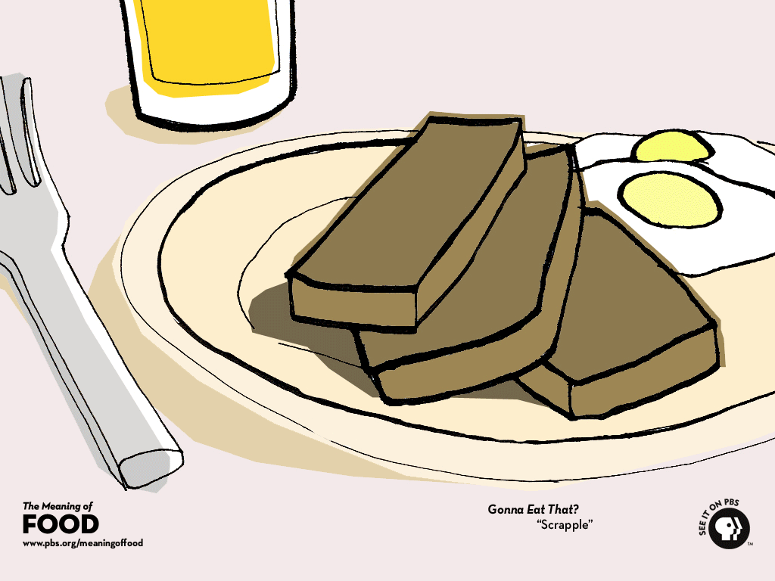
NEW!!!
Supported by NSF CAREER IIS- 1055107
pushing these ideas to the limit...
select l_returnflag,
sum(l_quantity)
from lineitem
where l_shipdate <= ...
group by l_retur...
select
avg(l_quant
from lineitem, orders
where l_shipdate <= ...
group by l_retur...
select ...
from ...
where ...
group by ...
having ...
Scrapple!

Slide 51
Scrapple Project @ UCD
Huge optimization opportunities in data warehousing
  Analytical queries often “variations on a theme”, lots of commonality
  Idea: cache old query results, treat as materialized views to speed up new queries (aka “semantic caching”)
  Also provide: self-adapting, self-tuning recycling pool
Challenges
  must push techniques to handle many more SQL features: aggregation, nested subqueries, arithmetic, ...
  handling updates
  theory much less well-understood
  non-trivial implementation

Slide 52
Related Work
Incremental view maintenance [Blakeley+ 86], [Gupta+ 93], ...
  “deltas” [Gupta+ 93]: an early form of our Z-relations
Answering queries using views [Levy+ 95], [Chaudhuri+ 95], [Afrati&Pavlaki 06], Chase&Backchase [Deutsch,Popa,Tannen 99], ...
Bag-containment/bag-equivalence of CQs/UCQs [Lovász 67], [Chaudhuri&Vardi 93], [Ioannidis&Ramakrishnan 95], [Cohen+ 99], [Jayram+ 06]
View adaptation [Mohania&Dong 96], [Gupta+ 01]

Slide 53
Related Work (cont)
Mapping evolution [Velegrakis+ 03]
Recursively-compiled view maintenance plans [Ahmad&Koch 09, Koch 10]
Data exchange [Fagin+05], P2P data exchange [Fuxman+05]
Youtopia [Koch09]
Mapping adaptation [Yu&Popa05]

Slide 54
Fin

