Slide 1


Human-Centric Challenges in
Building & Using Structured Web Databases
AnHai Doan
University of Wisconsin
Kosmix Corporation

Slide 2
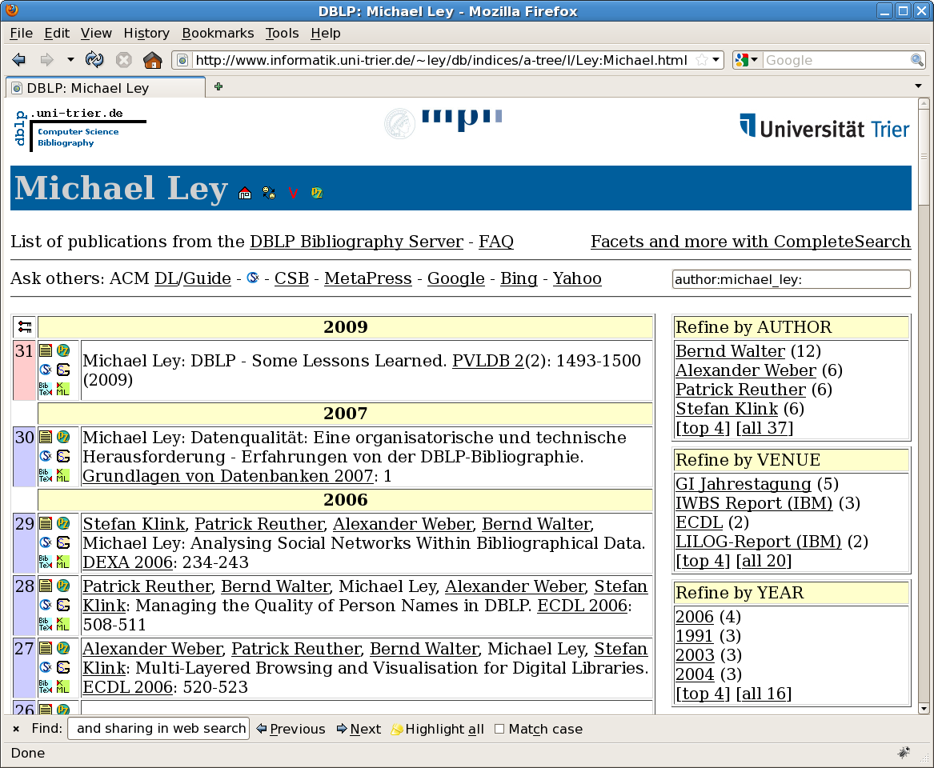
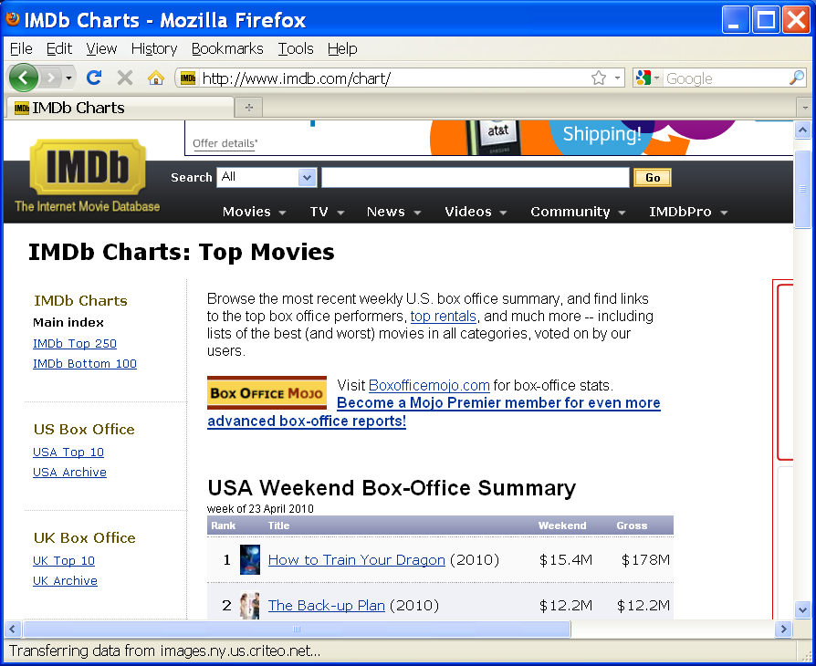
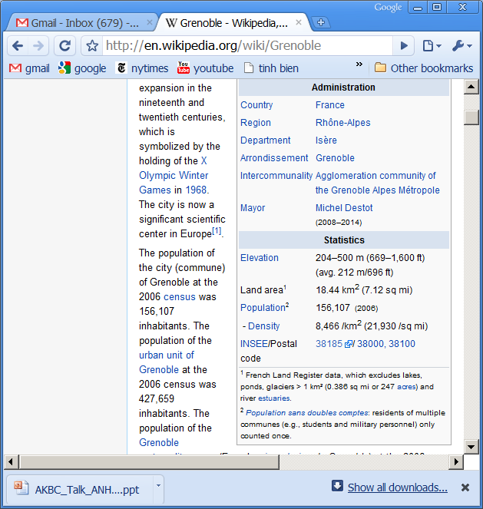
Structured Web Databases
2
2

Slide 3

The Cimple Project @ Wisconsin
Develops platform to build & use structured Web DBs
Example: DBLife
Jagadish
Browse
Keyword search
SQL querying
Question answering
Mining
Alert/Monitor
News summary
Researcher homepages
Conference pages
Group pages
DBworld mailing list
DBLP
Google Scholar
…
information extraction
schema matching
data matching
clustering
classification
information integration
give-talk
SIGMOD-07

Slide 4
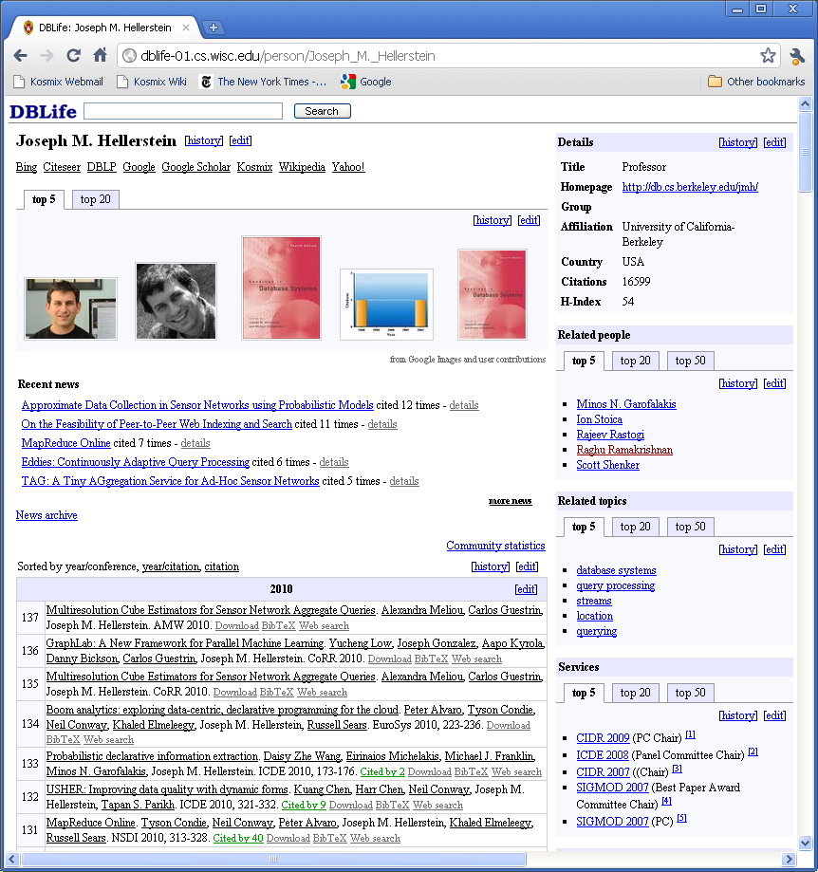
Sample SuperHomepage
4

Slide 5

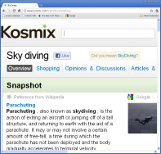






The Social Genome Project @ Kosmix
all
places
people
Twitter users
IMDB
Tripadvisor
Musicbrainz
information
extraction
schema
matching
data matching
clustering
classification
information
integration
actors
@melgibson …
Angelia Jolie
Mel Gibson
events
celebrities
politics …
…
Gibson car crash
Egyptian uprising
5

Slide 6
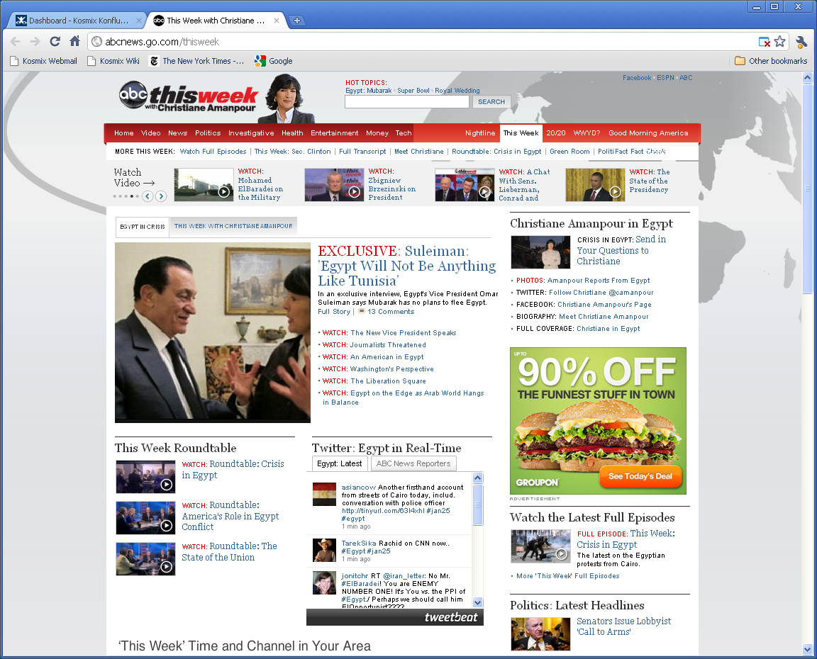
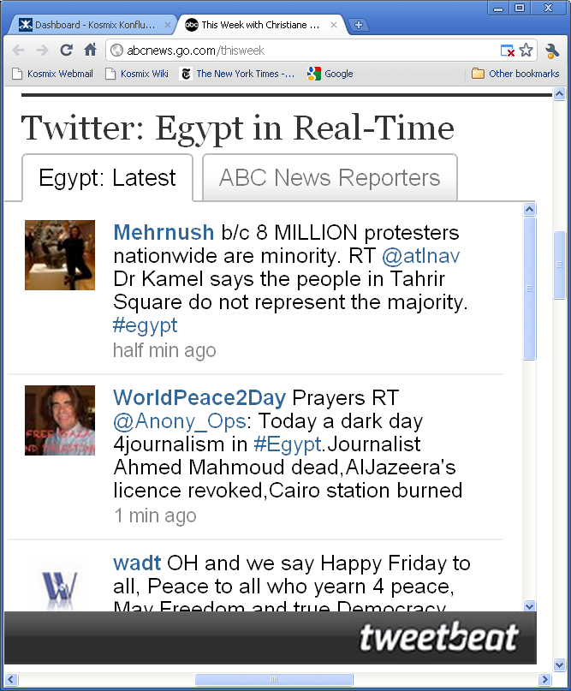
Tweetbeat Example

Slide 7
Rest of the Talk
Building the database
  schema matching
  data matching
  editing data of workflow
  editing the end database / build structured “wikipedia”
Using the database
  how to let naïve users query the database
  generating text from the database
  opportunistic querying / make pages computable
Wrapping up

Slide 8
Schema Matching [WebDB-03, ICDE-08a]
paper | conf
Data integration | VLDB-01
Data mining | SIGMOD-02
title | author | email | venue
OLAP | Mike | mike@a | ICDE-02
Social media | Jane | jane@b | PODS-05
Focus on 1-1 matches for now
  find paper = title, conf = venue
Difficult & costly. Can greatly benefit from crowdsourcing
  lets look at a baseline solution

Slide 9
What Should Human Users Do?
paper | conf
Data integration | VLDB-01
Data mining | SIGMOD-02
title | author | email | venue
OLAP | Mike | mike@a | ICDE-02
Social media | Jane | jane@b | PODS-05
Generate plausible matches
  paper = title, paper = author, paper = email, paper = venue
  conf = title, conf = author, conf = email, conf = venue
Ask users to verify
Does attribute paper match attribute author?
paper | conf
Data integration | VLDB-01
Data mining | SIGMOD-02
title | author | email
OLAP | Mike | mike@a
Social media | Jane | jane@b
Yes
No
Not sure

Slide 10
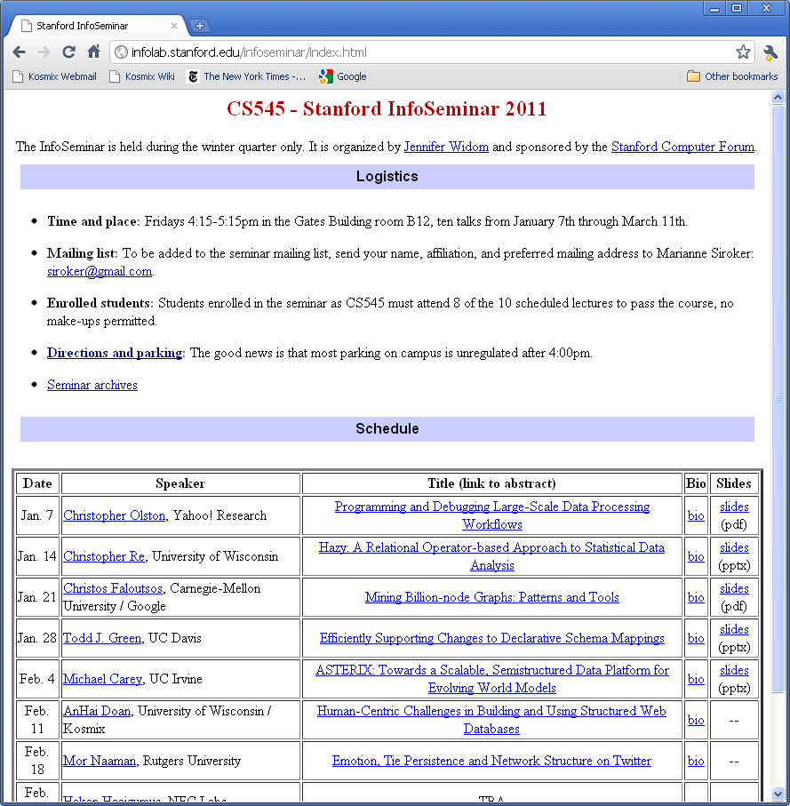
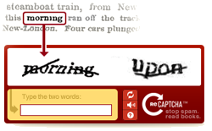
How to Solicit Human Users?
Multiple solutions
  ask for volunteers, pay users, force users, make users “pay”, …
Example
paper = author?

Slide 11
How to Combine User Answers?
Classify users into trusted/untrusted
  if (U has correctly answered X out of Y evaluation questions)
  AND (Y >= t₁)
  AND (X/Y >= t₂) ➔ U is trusted
Monitor trusted answers to question Q. Stop when
  at least t₃ answers
  gap between the #s of majority/minority answers is at least t₄
Also stop if # of answers reaches t₅
Example
  t₃ = 6, t₄ = 3, t₅ = 9
paper = author?
Yes, No, No, Yes, Yes, Yes, Yes ➔ Yes
Yes, Yes, Yes, No, Yes, No, No, No, No ➔ No

Slide 12
How to Combine User Answers?
More complex user models exist
  e.g., probabilistic, see Robert McCann’s dissertation
However
  some are inherently unstable,
  behavior does not follow any model
    must remove them as untrusted
  even trusted users can sometimes go crazy
    must continuously monitor their trustworthiness
    can’t just stop when get enough trusted answers
    those answers must be from multiple trusted users
Arguments for simpler models?
  require far less training data
  easier for admins to understand and tune

Slide 13
How to Optimize?
Exploit constraints
paper = title
paper = author
paper = email
paper = venue
conf = title
conf = author
conf = email
conf = venue
Use algorithm to re-rank lists & remove certain matches
paper = title, .8
paper = author, .6
paper = email, .3
conf = author, .7
conf = venue, .6
conf = email, .4
conf = title, .1
Zooming in
Q₁
Q₂
Q₃
Q₄
Q₅
Q₆
If “human oracle” is correct with prob 0.95
➔ prob of correctly answering Q₆ = 0.77

Slide 14

How to Optimize?
Human users can also help optimize the algorithm
  e.g., verify intermediate results / domain integrity constraints
Is num-pages of the
type CALENDAR-MONTH?
Is it always the case that
start-page < end-page?
paper = title, .8
paper = author, .6
paper = email, .3

Slide 15
Lessons Learned
Use algorithm + humans whenever possible
Tasks should be easy for humans, hard for algorithm
  e.g., cognitive tasks, tasks that require domain semantics
Optimization is crucial
  exploit constraints among tasks
  humans are probabilistic oracles
User modeling is tricky. More is not necessarily better.
More details in [WebDB-03, ICDE-08a]

Slide 16
Data Matching (Aka. Entity Resolution)
Consider data matching for DBLP
Luis Gravano
Luis Gravano, Ken Ross Digital libraries. SIGMOD-04
Luis Gravano, Jingren Zhou Fuzzy matching. VLDB-01
Luis Gravano, Jorge Sanz Packet routing. SPAA-91
Chen Li
Chen Li, Jian Zhou Entity matching. KDD-03
Chen Li, Chris Brown Interfaces. HCI-99
Chen Li, Hu Weifeng Automobile. ICNC-10
No single matcher does well
  use just the name ➔ do badly on Chen Li
  use name + co-authors ➔ do badly on Luis Gravano
Fundamentally
  different data portions have different degrees of semantic ambiguity

Slide 17
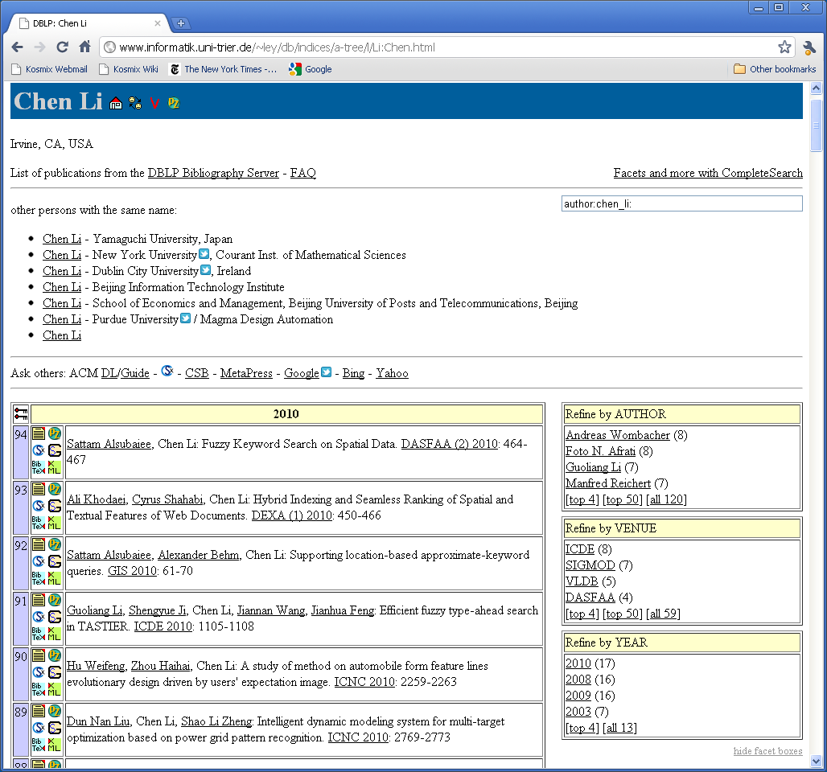
Key challenge:
clean DBLP
and keep it
clean

Slide 18

Current Solution [ICDE-07]
Measure ambiguity degree of each data portion
Apply the right matcher
…
m₁
m₂
m₁
m₃
Similar solution at Kosmix
  also in Web Fountain @ IBM
all
places
people
Mountain View
actors
Angelia Jolie
Mel Gibson
@mfan: saw salt last nite in Mountain View
Problem: tens of thousands of DBLP homepages

Slide 19
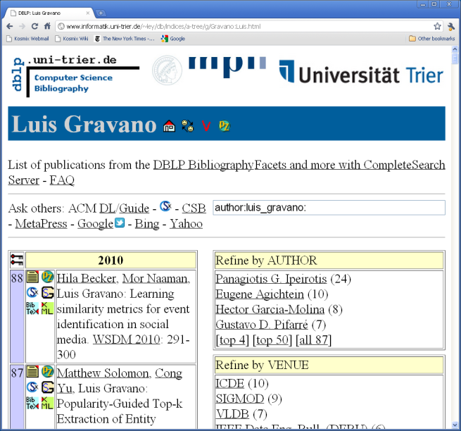
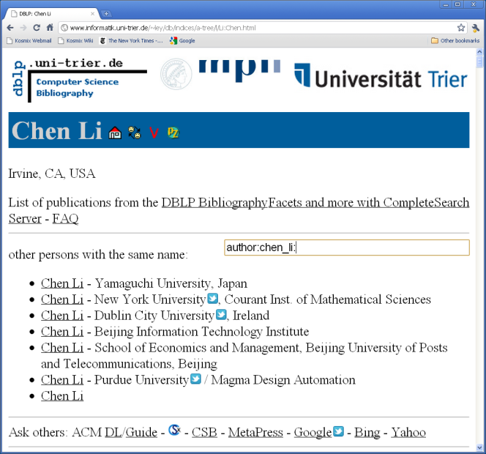
Proposed Crowdsourcing Solution
…
using just author name
using author name, co-authors,
conf proximity
using just author name
using author name, co-authors,
conf proximity
filter pubs
filter pubs
Similar solution for Twitter event monitoring @ Kosmix

Slide 20
Lessons Learned
For large-scale data integration, humans are essential
  in fact, for any large-scale semantics-intensive problem?
In today crowdsourcing tasks, human users
  verify claims, label images, recognize faces, write text, edit data
But they can also help edit “code”
  select the right code module for each data portion
  change the control flow of the code?
  do all of these without knowing how to write code
  only need to know domain semantics

Slide 21
Rest of the Talk
Building the database
  schema matching
  data matching
  editing data of workflow
  editing the end database / build structured “wikipedia”
Using the database
  how to let naïve users query the database
  generating text from the database
  opportunistic querying / make pages computable
Wrapping up
21

Slide 22
Editing Data of the Workflow [SIGMOD-09a]
Extracting conference services
services
name
conf
role
Joe Hellerstein
CIDR 2009
PC Chair
…
…
…
roles
name
role
page
…
…
…
extractConf
findRoles
names
name
page
…
…
extractNames
crawl
url
date
http://.../cidr09/
09/01/2008
…
…
dataSources
What happens to human edits when we refresh workflow?
Notes:
22

Slide 23
Can’t Just Blindly Re-Apply Edits
t → t’
B
B’
D
  If t is in D, should we change it to t’?
p
refresh
p
A
C
Change “A. Smith”
to “D. Smith”
name
A. Smith
A. Jones
name
A. Smith
extractNames
extractNames
… D.
Smith, A. Jones, ...
page
p1
Dr. A. Smith is ...
… …
page
p2
23
Notes:
23

Slide 24
Must Interpret Human Edits
Example: use provenance of output tuple t :
  the set of input tuples that operator p used to produce t
name
A. Smith
A. Jones
A. Smith
name
A. Smith
A. Jones
Change “A. Smith” to “D. Smith”
p1
p1
p1
p1
p2
If the operator produces
{“A. Smith”, “A. Jones”} from p1,
extractNames
extractNames
then replace {“A. Smith”, “A. Jones”}
with {“D. Smith”, “A. Jones”}
page
p1
page
p1
p2
24
Notes:
24

Slide 25
Kosmix Solution
Ask humans to provide constraints
  invariant under any workflow refreshing
name
A. Smith
A. Jones
Name ends with “, INITIAL.”, then
followed by “WORD,” ➔ remove
extractNames
… D.
Smith, A. Jones, ...
page
p1
all
places
people
Mountain View
actors
Angelia Jolie
Mel Gibson

Slide 26
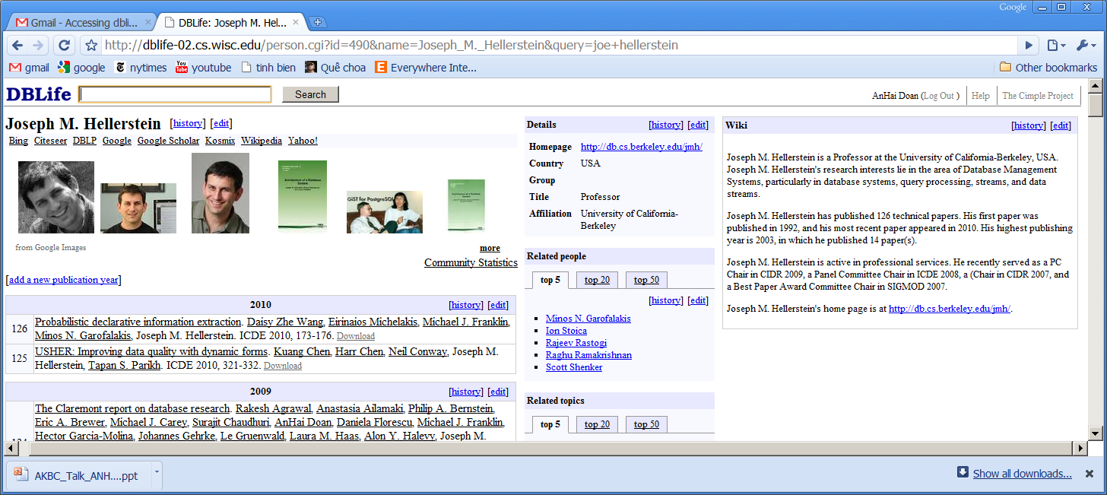
Editing the End Database [ICDE-08b]
To maximize participation, maximize what users can do
  can edit anything on any pages: records, lists, sets, ...
  can use any UI they like: form, excel, wiki, GUI, ...
  can edit page formats (not just page data)
  can add as much text as they want, to any place
Sharp contrast to current solutions

Slide 27
Example
Raises many difficult challenges …
27

Slide 28
Example: Editing a Record
Name: Joe Hellerstein
Organization: UC-Berkeley
Contact: joe@berkeley.edu
remove
HTML
How to interpret edits?
How to push down edits?
How to manage concurrent edits?
How to propagate edits?
Entity #123
name: Joe Hellerstein
org: UC-Berkeley
email: joe@berkeley.edu
View
Entity #123
name: Joe Hellerstein
salary: 150K
org: UC-Berkeley
email: joe@berkeley.edu
Data

Slide 29
Example: Editing a Record
How to edit page format? How to display new data?
Name: Joe Hellerstein
Organization: UC-Berkeley
Contact: joe@berkeley.edu
Name: Joe Hellerstein
Contact: joe@berkeley.edu (try calling first)
Organization: UC-Berkeley
HTML
Name:
Contact: (try calling first)
Organization:
Entity #123
name: Joe Hellerstein
org: UC-Berkeley
email: joe@berkeley.edu
View
Entity #123
name: Joe Hellerstein
salary: 150K
org: UC-Berkeley
email: joe@berkeley.edu
Entity #123
name: Joe Hellerstein
salary: 150K
org: UC-Berkeley
email: joe@berkeley.edu, joe@acm.org
Data

Slide 30
Example: Editing a Record
How to undo? recover from crash?
  roll back to 3pm yesterday
  undo a bad user edit: what if other users have built on that edit?
How to reconcile human / machine edits?
How to split superhomepages?
Name: Joe Hellerstein
Organization: UC-Berkeley
Contact: joe@berkeley.edu
machine
human
Name: Joe Hellerstein
Organization: UC-Berkeley
Contact: joe@berkeley.edu, joe@mit.edu, joe@swivel.com
Joe Berkeley
Joe MIT
machine
machine
human

Slide 31
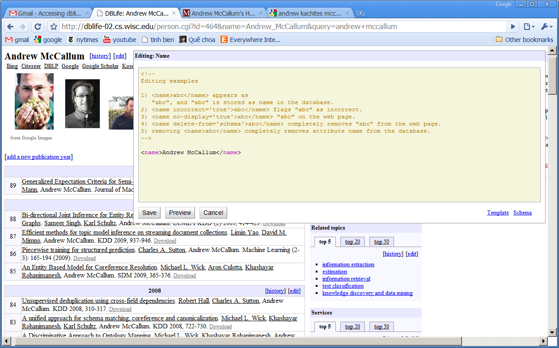
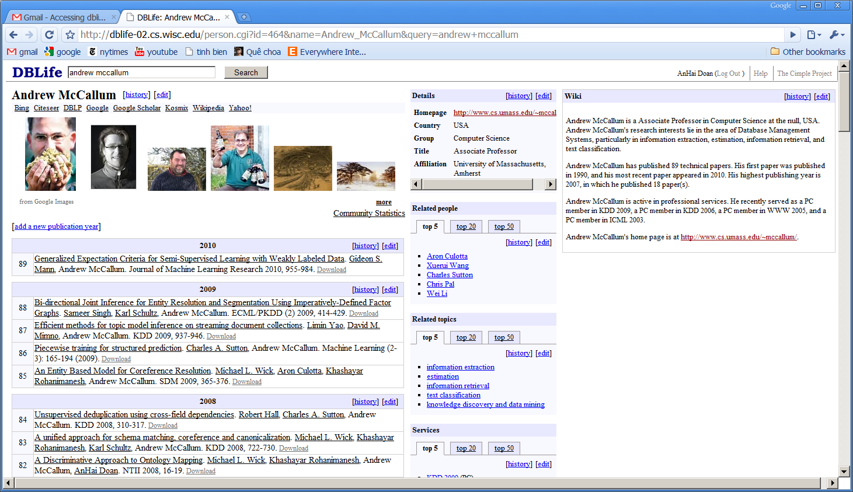
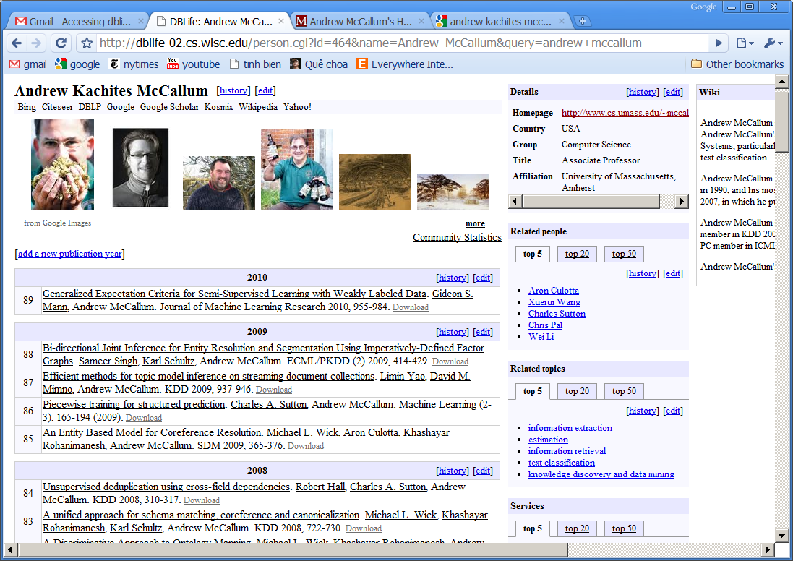
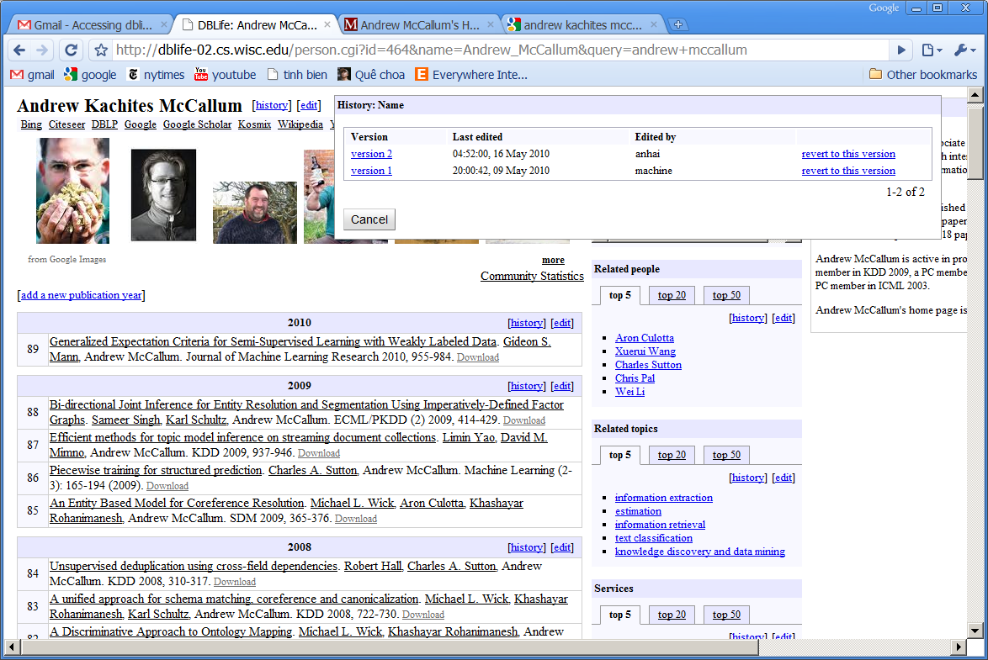
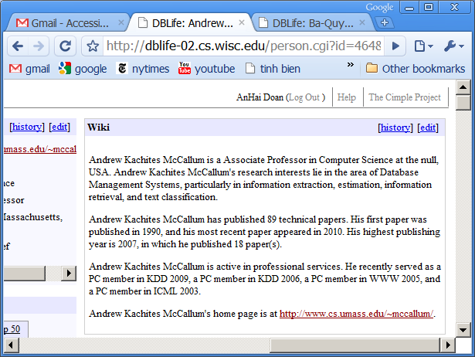

Slide 32
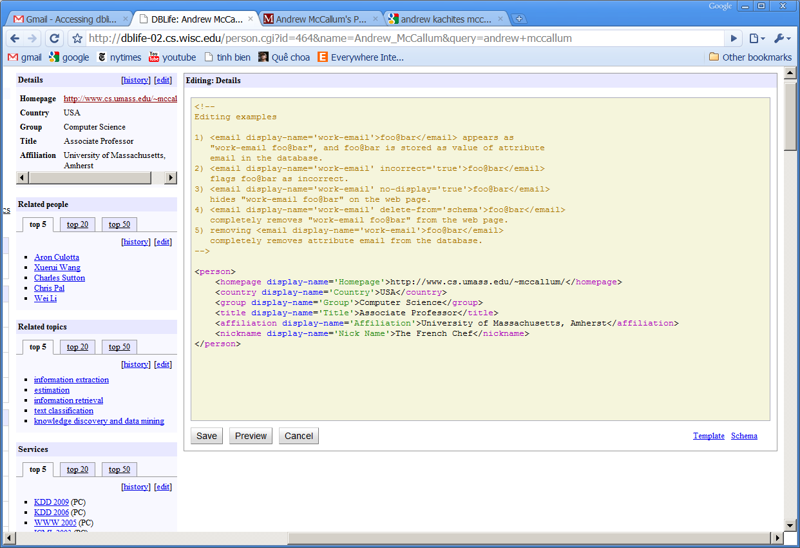
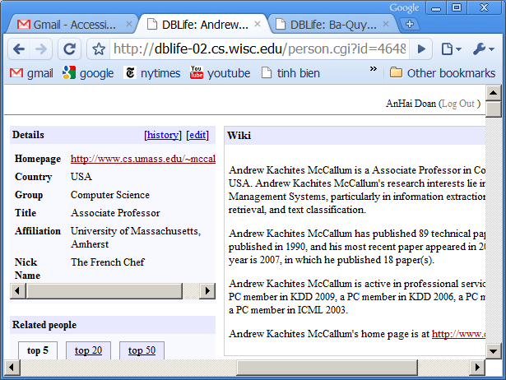

Slide 33
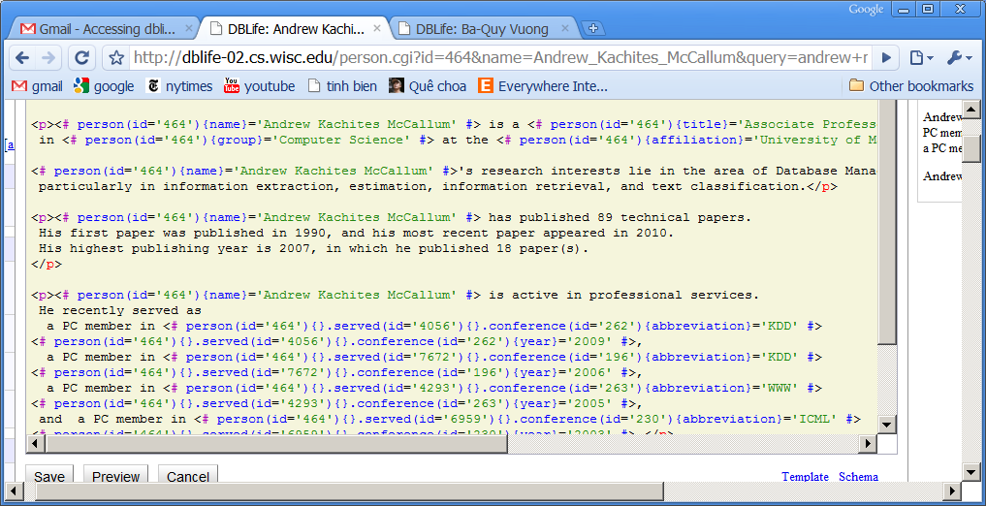
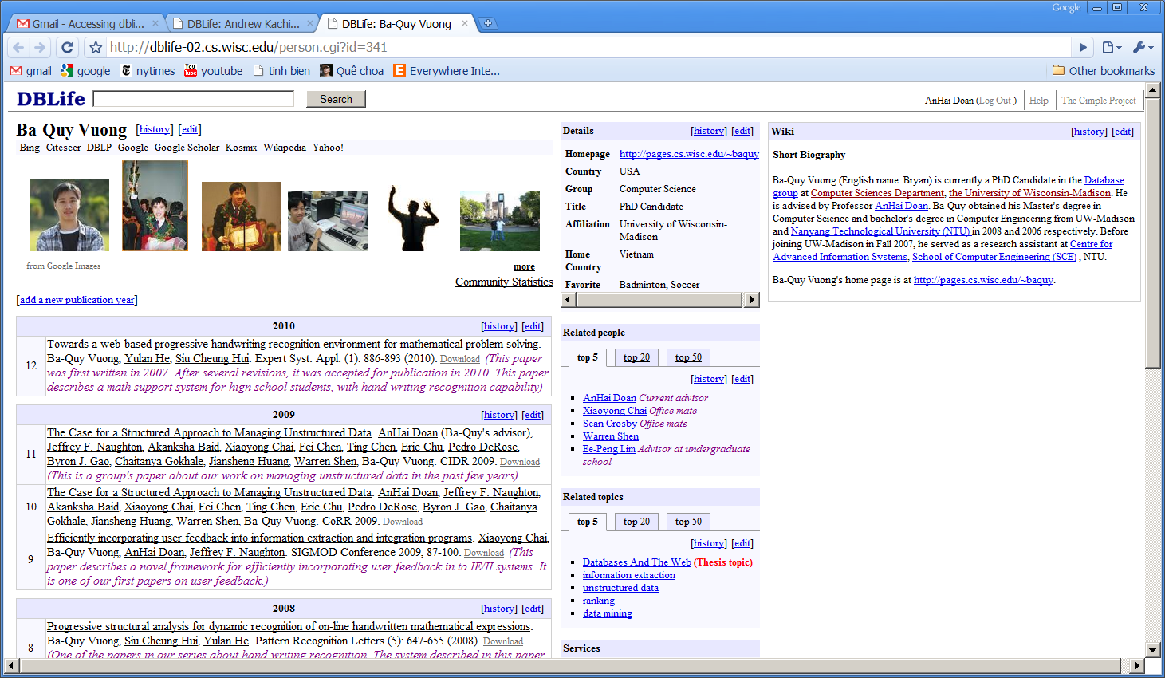
Text mixed with structured data (from the database)
Can edit both

Slide 34
Rest of the Talk
Building the database
  schema matching
  data matching
  editing data of workflow
  editing the end database / build structured “wikipedia”
Using the database
  how to let naïve users query the database
  generating text from the database
  opportunistic querying / make pages computable
Wrapping up
34

Slide 35
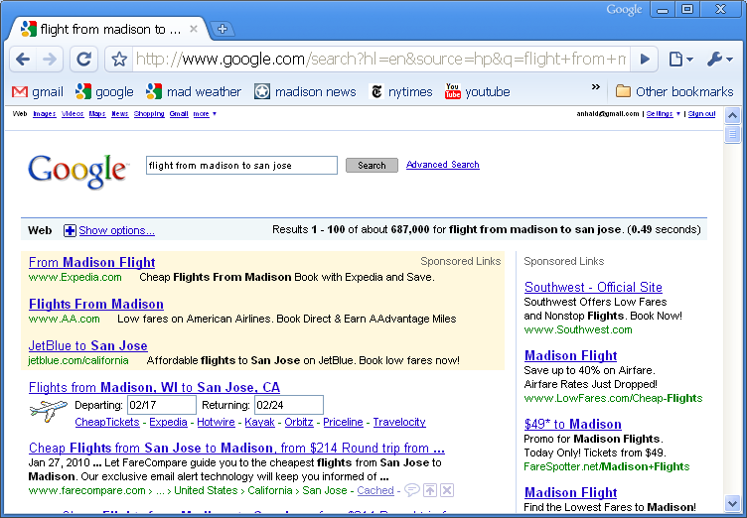
How to Query the Database?
Today users write SQL/XML/SPARQL queries
  Joe Hellerstein can do this in his sleep
But what about Joe Sixpack? My parents?
Current search engines provide a potential answer

Slide 36

Generate & Index Query Forms
[SIGMOD-09b]
Total number of publications
Name Start year End year
This form can be used to answer questions such as:
How many papers have someone published?
Count total number of papers of
Count total number of publications of
How prolific is
How productive is
Search engine
How many papers has David DeWitt published?
Count papers David DeWitt

Slide 37
Guiding Principles [CIDR-09]
For naive users: easier to recognize a desired query form than to write the SQL query
  sort of like “verifying a solution is easier than finding it” in P vs. NP
Most users will continue to search & browse
  no “question answering”, no “structured querying”, not yet
Thus, anticipate what they want
Generate pages that contain what they want
  and can be found quickly with searching / browsing
Allow them to do opportunistic querying

Slide 38
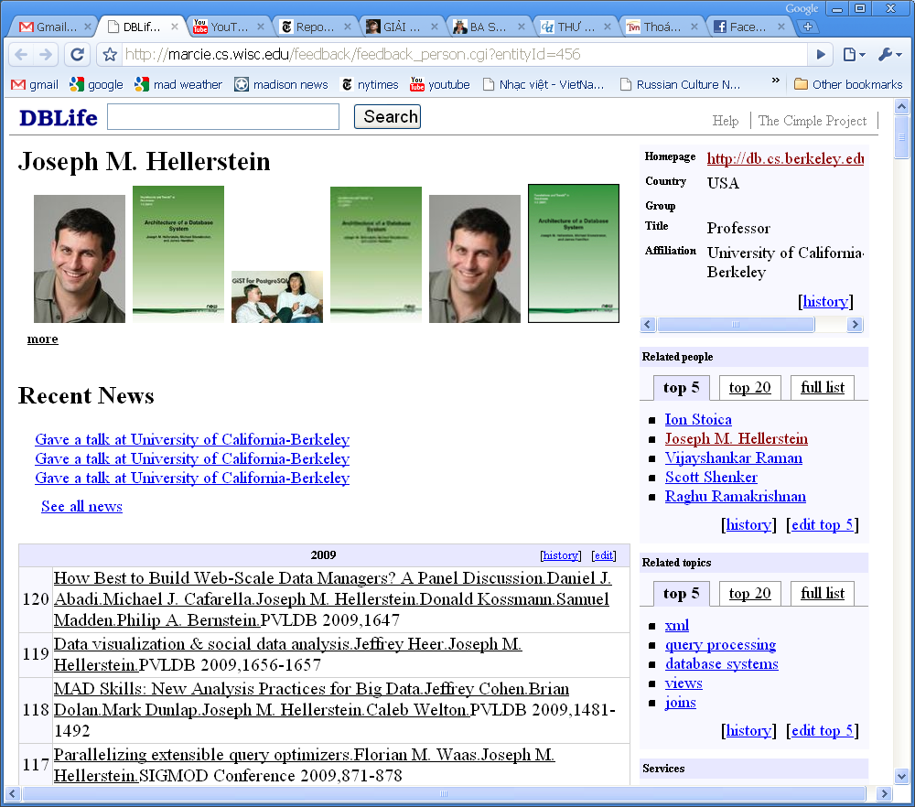
Generate & Index Text
Joe Hellerstein is a Professor at UC-Berkeley, since 1992. He has published 120 papers, on topics such as user defined functions, data streams, declarative networking.
A “wikipedia” page for Joe Hellerstein, automatically generated
Can answer questions such as:
What topics has Joe Hellerstein published on?
How many papers has Joe Hellerstein published?

Slide 39
Generate & Index Text
Disease Mortality rate
Liver cancer 90%
Lung cancer 70%
Heart 30%
Liver cancer has a high death rate (mortality rate)
of 90% within 5 years. The rate for lung cancer
is 70%. The average mortality rate for all cancer
types is 80%. Heart diseases have a death rate
of 30% within 5 years.
What is the death rate for heart diseases?
What is the average mortality rate for cancer?

Slide 40
Generate & Index Text @ Kosmix
50 Cent (a.k.a. Curtis James Jackson III) is a prominent musician born in 1975, around the same time as Melanie Chisholm and Enrique Iglesias (both also born in 1975). His career has spanned about 14 years, since 1997 until now, during which he worked as rapper, actor, entrepreneur, and executive producer.
As of Jul 23, 2010, 50 Cent has released 15 albums, 24 singles, 3 EPs, 28 compilations, and 2 soundtracks. The releases range from hip hop to gangsta rap. Wikipedia provides most detailed biography of 50 Cent, including life and music career, non-musical projects, personal life, controversy, discography, awards and nominations, and filmography.
Flickr has a large collection of his images. He was actively discussed on Yahoo Answers (with over 14875 questions, out of which 203 were posed in the past 30 days). For popular videos, see 50 Cent - Ayo Technology ft. Justin Timberlake (47.8 million views), 50 Cent - In Da Club (38.7 million views), 50 Cent - 21 Questions ft. Nate Dogg (29.8 million views), 50 Cent - Baby By Me ft. Ne-Yo (28.6 million views), and 50 Cent - I Get Money (26.2 million views) in YouTube. He also has 368 tracks of music available for listening on Rhapsody (an online music service where you can listen to full-length songs and read the lyrics at the same time, with millions of songs and the latest music releases). To see his most popular tracks (and how many have listened to it), see the 50 Cent page at Last.fm, a large online music catalogue, with free Internet radio, videos, photos, stats, charts, and concerts. He has been tweeted at least 15 times in the past 10 minutes on Twitter. Finally, he has a website at http://www.50cent.com.

Slide 41
Allow Opportunistic Querying
How many papers has
Michael Franklin published?
Joe Hellerstein is a Professor at UC-Berkeley, since 1992. He has published 120 papers, on topics such as user defined functions, data streams, declarative networking.
Michael Franklin is a Professor at UC-Berkeley, since 1992. He has published 120 papers, on topics such as user defined functions, data streams, declarative networking.
Refresh
Refresh
Michael Franklin is a Professor at UC-Berkeley, since 1996. He has published 130 papers, on topics such as sensor networks, data streams, data spaces.
Anticipate user needs
Allow opportunistic querying
Make pages Excel-like

Slide 42







Wrapping Up [CIDR-09]
Humans are now integral part of the data management process
RDBMS
Form₁
Form₂
Form₁
Form₂
data integration

Slide 43
Wrapping Up [CIDR-09]
Adding humans raises numerous challenges
Need a new data management model
  how is data generated? how is it consumed?
  where are humans in this process? what can they do?
Need human-centric principles
  RDBMS principles: logical independence, declarative querying, etc.
  example human-centric principles hinted at by this talk
    do tasks that are easy for humans, hard for machines
    P vs. NP principle: easier to verify than to create
    can intervene anywhere that they can, using any tool they like
    stick mostly to search and browse for foreseeable future
Need practical systems

Slide 44
Acknowledgment
Joint work with Raghu Ramakrishnan, Jeff Naughton, Luis Gravano, Jun Yang, Robert McCann, Warren Shen, Xiaoyong Chai, Ba-Quy Vuong, Chaitanya Gokhale, Ting Chen, Feng Niu, Fei Chen, and many other great students
With funding from NSF, DARPA, Sloan Foundation, Google, Microsoft, Yahoo, Department of Homeland Security, and MITRE Corp.

