Slide 1

Search As You Type
Chen Li
Chen Li (李晨)
Joint work with colleagues at UCI and Tsinghua.

Slide 2
Demos
http://www.cs.stanford.edu/ “Search” Box
  Try “garcia molina”
  Try “garcia monila”
http://directory.uci.edu/: Try “venkatasubramanian”
http://psearch.ics.uci.edu/
http://fr.ics.uci.edu/haiti/
http://www.miamiherald.com/news/americas/haiti/connect/
http://ipubmed.ics.uci.edu/

Slide 3

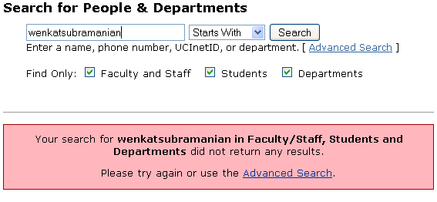
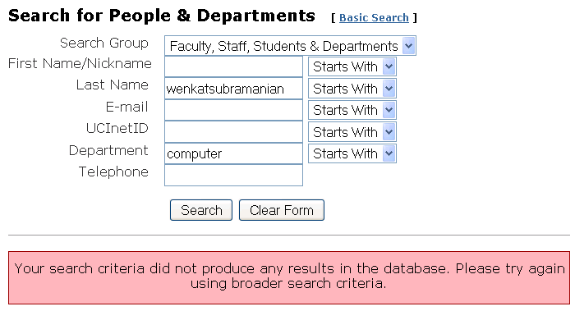
Traditional Keyword Search
Too many results!
No result!
Complicated and still
no result!

Slide 4
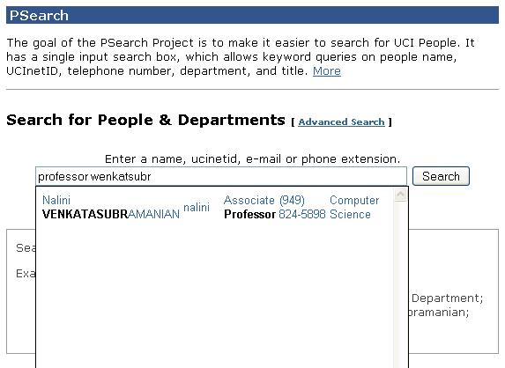
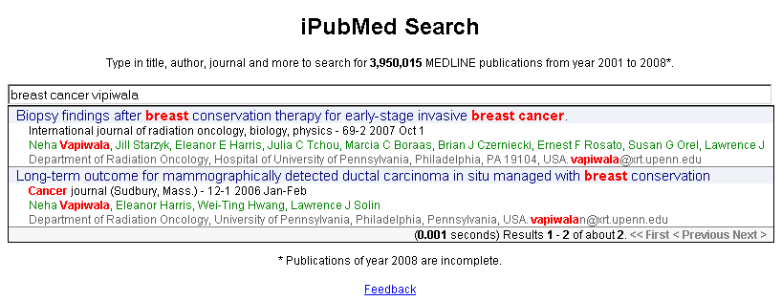
Interactive Fuzzy Keyword Search

Slide 5


What’s new?
Query: “itunes music”
Missing result!
Search on apple.com
Query: “itune”

Slide 6
Challenge: performance!
< 100 ms: server processing, network, javascript, etc
Requirement for high query throughput
  20 queries per second (QPS) → 50ms/query (at most)
  100 QPS → 10ms/query
Other challenges: ranking, space requirements, …

Slide 7


Two Features (Focus of this talk)
Fuzzy Search: finding results with approximate keywords
Full-text: find results with query keywords (not necessarily adjacently)

Slide 8
Edit Distance
Ed(s1, s2) = minimum # of operations (insertion, deletion, substitution) to change s1 to s2
s1: v e n k a t s u b r a m a n i a n
s2: w e n k a t s u b r a m a n i a n
ed(s1, s2) = 1
8
Notes:
8

Slide 9
Problem Setting
Data
  R: a set of records
  W: a set of distinct words
Query
  Q = {p₁, p₂, …, p_{l}}: a set of prefixes
  δ: Edit-distance threshold
Query result
  R_{Q}: a set of records such that each record has all query prefixes or their similar forms

Slide 10
Feature 1: Fuzzy Search

Slide 11
Formulation
Query:
wenkatsubra
Record Strings
carey
jain
nicolau
smith
venkatasubramanian
Find strings with a prefix similar to a query keyword
Do it incrementally!

Slide 12
Observation
  Strings = {exam, example, exemplar, exempt, sample}
  Edit-distance threshold δ = 2
Q’ = exampl
Q = example
Prefix | Distance
exam | 2
examp | 1
exampl | 0
example | 1
exemp | 2
exempt | 2
exempl | 1
exempla | 2
sampl | 2
Prefix | Distance
examp | 2
exampl | 1
example | 0
exempl | 2
exempla | 2
sample | 2
delete e
delete e
match e
delete e
replace e with a
match e

Slide 13
Trie Indexing
Computing set of active nodes Φ_{Q}
  Initialization
  Incremental step
e
s
x
a
a
e
m
Active nodes for Q = example
m
m
p
Prefix | Distance
examp | 2
exampl | 1
example | 0
exempl | 2
exempla | 2
sample | 2
$
p
2
p
l
l
1
l
2
t
e
2
e
0
a
2
$
$
$
r
$

Slide 14
Initialization
Q = ε
0
Prefix | Distance
Prefix | Distance
 | 0
e | 1
ex | 2
s | 1
sa | 2
Prefix | Distance
ε | 0
e
1
s
1
x
2
a
2
a
e
m
m
m
p
$
p
p
l
l
l
t
e
Initializing Φ_{ε} with all nodes within a depth of δ
e
a
$
$
$
r
$

Slide 15
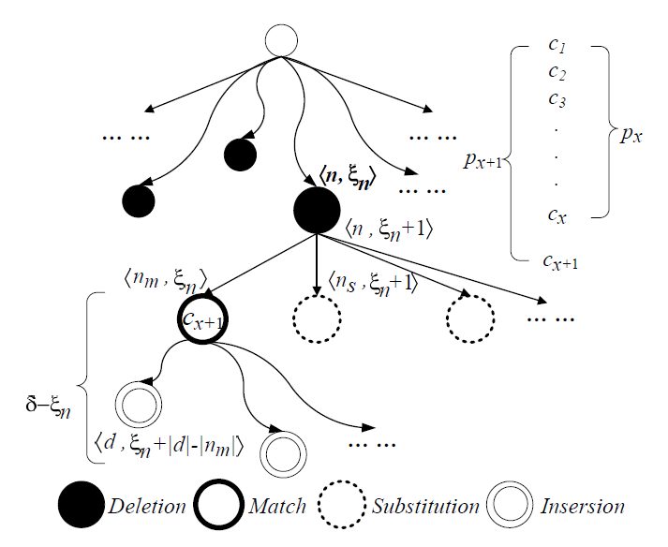
Incremental Algorithm: Overview
Access their leaf nodes as answers.

Slide 16
Incremental Computation: Example
Q = e
1
Prefix | Distance
ε | 0
e | 1
ex | 2
s | 1
sa | 2
Active nodes for Q = ε
e
0
s
1
x
1
a
2
a
2
e
2
m
m
m
p
Prefix | # Op | Base | Op
ε | 1 | ε | del e
s | 1 | ε | sub e/s
e | 0 | ε | mat e
ex | 1 | ε | ins x
exa | 2 | ε | Ins xa
exe | 2 | ε | Ins xe
Prefix | # Op | Base | Op
Prefix | # Op | Base | Op
ε | 1 | ε | del e
Prefix | # Op | Base | Op
ε | 1 | ε | del e
s | 1 | ε | sub e/s
Prefix | # Op | Base | Op
ε | 1 | ε | del e
s | 1 | ε | sub e/s
e | 0 | ε | mat e
Active nodes for Q = e
$
p
p
l
s | 2 | s | del e
l
l
t
e
e | 2 | e | del e
e
a
$
$
ex | 2 | e | sub e/x
ex | 3 | ex | del e
exa | 3 | ex | sub e/a
$
r
exe | 2 | ex | mat e
$
sa | 2 | s | sub e/a
sa | 3 | sa | del e

Slide 17
Incremental Computation: Algorithm
Incremental computation from Φ_{Q’} to Φ_{Q}
add(Φ_{Q} , <n, d>) has effect only if there exists no active node in Φ_{Q} with the same n and smaller d
FOR EACH <n, d> FROM Φ_{Q’}
 | Deletion | add(Φ_{Q} , <n, d+1>)
 | Substitution | FOR EACH n’ FROM non-matching children of n add(Φ_{Q} , <n’, d+1>)
 | Match | add(Φ_{Q} , <m, d>) (m is the matching child of n)
 | Insertion | FOR EACH m’ FROM descendents of m add(Φ_{Q} , <m’, d+x>) (x is the distance from m’ to m)
Algorithm Details

Slide 18
Feature 2: Full-text search
Find answers with query keywords
Not necessarily adjacently

Slide 19
Multi-Prefix Intersection
ID | Record
1 | Li data…
2 | data…
3 | data Lin…
4 | Lu Lin Luis…
5 | Liu…
6 | VLDB Lin data…
7 | VLDB…
8 | Li VLDB…
Q = vldb li
d
l
v
a
i
u
l
6 | VLDB Lin data…
t
$
n
u
$
i
d
8 | Li VLDB…
a
1
8
$
$
4
s
b
$
3
4
6
5
$
$
1
2
3
6
4
6
7
8

Slide 20
Multi-Prefix Intersection: Method 1
ID | Record
1 | Li data…
2 | data…
3 | data Lin…
4 | Lu Lin Luis…
5 | Liu…
6 | VLDB Lin data…
7 | VLDB…
8 | Li VLDB…
d
l
v
a
i
u
l
t
$
n
u
$
i
d
a
1
8
$
$
4
s
b
$
3
4
6
5
$
$
1
2
3
6
4
6
7
8
Space cost | Inverted index
Time cost | Union + intersection
Q = vldb li
li
1 3 4 5 6 8
vldb
6 8
6 7 8
More efficient intersection approaches…

Slide 21
Multi-Prefix Intersection: Method 2
ID | Record
1 | Li data…
2 | data…
3 | data Lin…
4 | Lu Lin Luis…
5 | Liu…
6 | VLDB Lin data…
7 | VLDB…
8 | Li VLDB…
Forward List
1 2
1
1 3
3 5 6
4
1 3 7
7
2 7
[1, 7]
d
[1, 1]
l
[2, 6]
v
[7, 7]
a
[1, 1]
i
[2, 4]
u
[5, 6]
l
[7, 7]
t
[1, 1]
$
2
n
[3, 3]
[4, 4]
[6, 6]
[7, 7]
u
$
5
i
d
6 | VLDB Lin data… | 1 3 7
[1, 1]
[6, 6]
[7, 7]
a
1
8
$
3
$
4
4
s
b
8 | Li VLDB… | 2 7
$
1
3
4
6
5
$
6
$
7
1
2
3
6
4
6
7
8
6
7
8
Read each
Verify/Probe
[2, 4]
Q = vldb li
Space cost | Inverted + forward index
Time cost | Probing forward lists

Slide 22
Traversing inverted lists incrementally
Q = cs co
Q = cs conf
traversal list: inverted list of cs
compute
Verify
Compute
cached answers of cs co
cached answers of cs conf
Compute and cache only needed answers
For subsequent queries, compute the answers:
  from the cached answers
  from resuming previously terminated computation

Slide 23
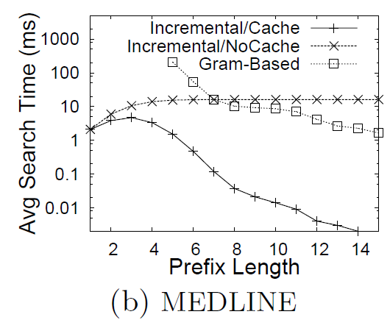
Experimental Results
Computing similar prefixes

Slide 24
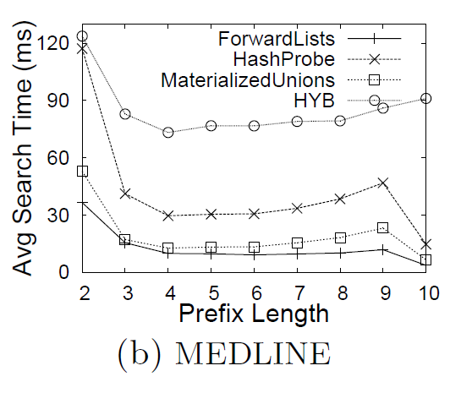
Multi-prefix intersection

Slide 25
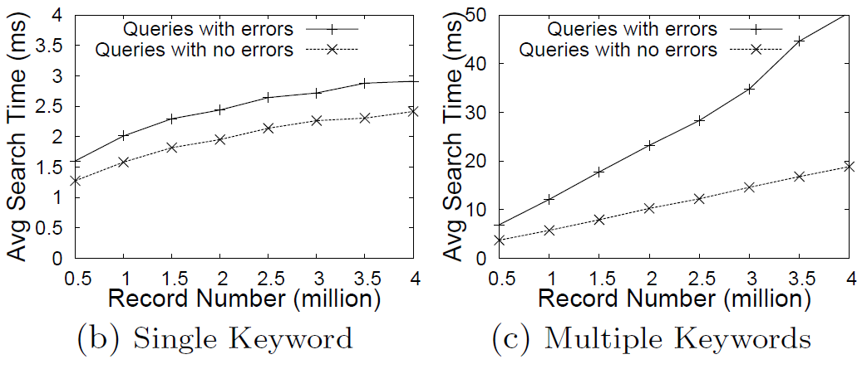
Time Scalability

Slide 26
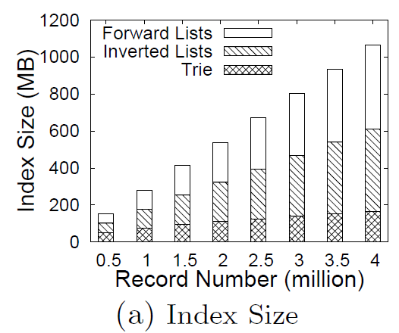
Index scalability

Slide 27
Other Features
Synonyms
Ranking

Slide 28
Conclusions
New data-access paradigm: Search as you type
Many interesting and challenging problems.
http://tastier.ics.uci.edu/

