Slide 1
Scaling Out Without Partitioning
A Novel Transactional Record Manager
for Shared Raw Flash
Phil Bernstein & Colin Reid
Microsoft Corporation
Jan. 16, 2010
© 2010 Microsoft Corporation

Slide 2
What is Hyder?
It’s a research project.
A software stack for transactional record management
Stores [key, value] pairs, which are accessed within transactions
It’s a standard interface that underlies all database systems
Functionality
Records: Stored [key, value] pairs
Record operations: Insert, Delete, Update,
Get record where field = X; Get next
Transactions: Start, Commit, Abort
Why build another one?
Make it easier to scale out for large-scale web services
Exploit technology trends: flash memory, high-speed networks

Slide 3
Scaling Out with Partitioning
Internet
Database is partitioned across multiple servers
For scalability, avoid distributed transactions
Several layers of caching
App is responsible for
  cache coherence
  consistency of cross-partition queries
Must carefully configure to balance the load
Web Server
Web Server
Web Server
App
$
App
$
App
$
Network
$
$
$
$
$
Database
Partition
Database
Partition
Database
Partition
Database
Partition
App
App
App
App
$
$
$
$
Data
Data
Data
Data
Log
Log
Log
Log

Slide 4
The Problem of Many-to-Many Relationships
FriendStatus( UserId, FriendId, Status, Updated )
The status of each user, U, is duplicated with all of U’s friends
If you partition FriendStatus by UserId, then retrieving the status of a user’s friends is now efficient.
But every user’s status is duplicated in many partitions.
Can be optimized using stateless distributed caches,
with the “truth” in a separate Status(UserId) table
But every status update of a user must be fanned out
  This is inefficient
  It can also cause update anomalies, because fanout is not atomic
  The application maintains consistency manually, where necessary
So maybe a centralized cache of Status(UserId) is better
  If you can make it fault tolerant ….

Slide 5
Hyder Scales Out Without Partitioning
Internet
The log is the database
No partitioning is required
  Servers share a reliable, distributed log
Database is multi-versioned, so server caches are trivially coherent
  Servers can fetch pages from the log or other servers’ caches
Web
Server
Web
Server
Web
Server
App
App
App
Hyder Log
Network
Hyder
Hyder
Hyder
$
$
$

Slide 6
Hyder Runs in the Application Process
Internet
Simple programming model
No need for client and server caches, plus a cache server
Avoids the expense of RPC’s to a database server
Web
Server
Web
Server
Web
Server
App
App
App
Hyder Log
Network
Hyder
Hyder
Hyder
$
$
$

Slide 7
Enabling Hardware Assumptions
I/O operations are now cheap and abundant
  Raw flash offers at least 10⁴ more IOPS/GB than HDD
  With 4K pages, ~100µs to write and ~200µs to write, per chip
  Can spread the database across a log, with less physical contiguity
Cheap high-performance data center networks
  1Gbps broadcast, with 10Gbps coming soon
  Round-trip latencies already under 25 μs on 10 GigE
  Many servers can share storage, with high performance
Large, cheap, 64-bit addressable memories
  Commodity web servers can maintain huge in-memory caches
  Reduces the rate that Hyder needs to access the log
Many-core web servers
  Computation can be squandered
  Hyder uses it to maintain consistent views of the database….

Slide 8
Issues with Flash
Flash cannot be destructively updated
  A block of 64 pages must be erased before programming (writing) each page once
  Erases are slow (~2ms) and block the chip
Flash has limited erase durability
  MLC can be erased ~10K times. SLC is ~100K times
  Needs wear-leveling
  SLC is ~3x the price of MLC
  Dec. 2009: 4GB MLC is $8.50; 1GB SLC is $6.00
Flash densities can double only 2 or 3 more times.
  But there are other nonvolatile technologies coming,
  e.g., phase-change memory (PCM)

Slide 9
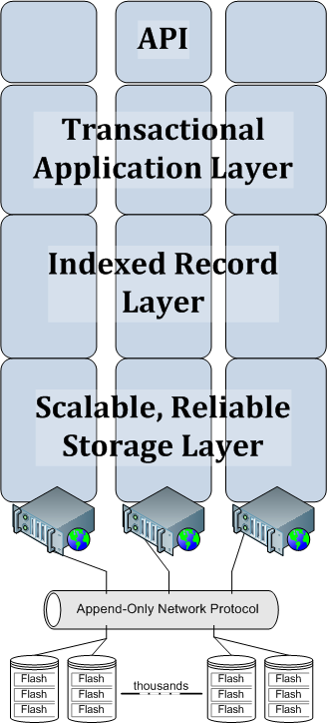
The Hyder Stack
Persistent programming language
LINQ or SQL layered on Hyder
Optimistic transaction protocol
Supports standard isolation levels
Multi-versioned binary search tree
Mapped to log-structured storage
Segments, stripes and streams
Highly available, load balanced and
self-managing log structured storage
Custom controller interface
Flash units are append-only

Slide 10

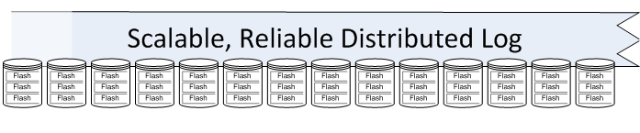
Hyder Stores its Database in a Log
Log uses RAID erasure coding for reliability
Notes:
This is oversimplified, since there is also a BLOB store. All BLOBs are referenced by records in the log-resident database.

Slide 11
Database is a Binary Search Tree
G
B
H
Binary
Search
Tree
A
C
I
D
Tree is marshaled into the log
A
D
C
B
I
H
G
Notes:
Binary search trees give us better storage density than B-trees.

Slide 12
Binary Tree is Multi-versioned
Copy on write
To update a node, replace nodes up to the root
G
G′
B
H
B′
A
C
I
C′
D
D′
Update
D’s value
Notes:
So the state that’s referenced by a root is immutable.

Slide 13
Transaction Execution
  Each server has a cache of the last committed database state
A transaction reads a snapshot and generates an intention log record
DB cache
Transaction execution
Get pointer to snapshot
Generate updates locally
Append intention log record
G
G′
B
H
B′
A
C
I
C′
D
D′
last committed
A
D
C
B
I
H
G
D′
C′
B′
G′
Snapshot

Slide 14
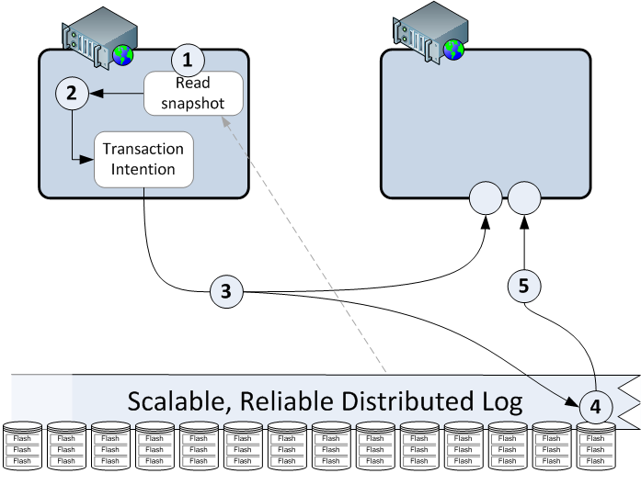
Log Updates are Broadcast
Broadcast intention
Broadcast ack
Notes:
The ack says that the intention log record is stable and indicates its location (and hence its order relative to other log records)

Slide 15
Transaction Commit
Every server executes a roll-forward of the log
When it processes an intention log record,
  it checks whether the transaction experienced a conflict
  if not, the transaction committed and the server merges the intention into its last committed state
All servers make the same commit/abort decisions
Did a committed transaction write into T’s readset or writeset here?
transaction T
A
D
C
B
I
H
G
D′
C′
B′
G′
Snapshot
Notes:
Supports all degrees of isolation, depending on definition of conflict

Slide 16
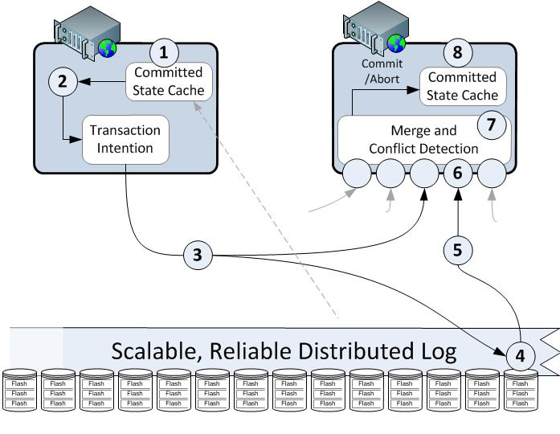

Hyder Transaction Flow
Optimistic concurrency
violation causes transaction to
abort and optionally retry
Each server
sequentially
merges each
intention into
the committed
state cache
Transaction starts with a
recent consistent snapshot
Transaction
executes on
application
server
Messages
are received
over UDP
and parsed
in parallel
Transaction “intention”
is appended to the log
and partially broadcast
to other servers
Intention
log sequence
is broadcast
to all servers
Intention
is durably
stored in
the log
Notes:
Where are the bottlenecks? Broadcast, append-to-log, and conflict detection and merge

Slide 17
Performance
The system scales out without partitioning
System-wide throughput of update transactions is bounded by
the slowed step in the update pipeline
  15K update transactions per second possible over 1 Gigabit Ethernet
  150K update transactions per second expected on 10 Gigabit Ethernet
  Conflict detection & merge can do about 300K update transactions per second
Abort rate on write-hot data is bounded by txn’s conflict zone
  Which is determined by end-to-end transaction latency.
  About 200 μs in our prototype ⇒ ~ 1500 update TPS if all txns conflict
Minimize the length of the conflict zone
A
D
C
B
I
H
G
D′
C′
B′
G′

Slide 18
Major Technologies
Flash is append-only. Custom controller has mechanisms for synchronization & fault tolerance
Storage is striped, with a self-adaptive algorithm for storage allocation and load balancing
Fault-tolerant protocol for a totally ordered log
Fast algorithm for conflict detection and merging of intention records into last-committed state

Slide 19
Status
Most parts have been prototyped.
  But there’s a long way to go.
We’re working on papers
  There’s a short abstract on the HPTS 2009 website

