Slide 1
Towards an Understanding of the Limits of Map-Reduce Computation
  Foto Afrati — National Technical University of Athens
  Anish Das Sarma — Google Research
  Semih Salihoglu — Stanford University
  Jeff Ullman — Stanford University

Slide 2
Tradeoff Between Per-Reducer-Memory and Communication Cost
q = Per-Reducer-
Memory-Cost
Map
Reduce
key | values
drugs_{<1,2>} | Patients_{1,} Patients₂
drugs_{<1,3>} | Patients_{1,} Patients₃
… | …
drugs_{<1,n>} | Patients_{1,} Patients_{n}
… | …
drugs_{<n, n-1>} | Patients_{n}, Patients_{n-1}
<drug₁, Patients₁>
<drug₂, Patients₂>
…
<drug_{i}, Patients_{i}>
…
<drug_{n}, Patients_{n}>
…
r = Communication
Cost
6500 drugs
6500*6499 > 40M reduce keys

Slide 3
Possible Per-Reducer-Memory/
Communication Cost Tradeoffs
100TB
10TB
r =communication-
cost
1TB
1GB
4GB
7GB
60GB
(EC2 small inst.)
(EC2 med inst.)
(EC2 large inst.)
(EC2 x-large inst.)
q = per-reducer-
memory

Slide 4
Example (1)
Similarity Join
  Input R(A, B), Domain(B) = [1, 10]
  Compute <t, u> s.t |t[B]-u[B]| · 1
Input
Output
A | B
a₁ | 5
a₂ | 2
a₃ | 6
a₄ | 2
a₅ | 7
<(a₁, 5), (a₃, 6)>
<(a₂, 2), (a₄, 2)>
<(a₃, 6), (a₅, 7)>

Slide 5
Example (2)
Hashing Algorithm [ADMPU ICDE ’12]
Split Domain(B) into k ranges of values => (k reducers)
k = 2
(a₁, 5)
(a₂, 2)
(a₃, 6)
(a₄, 2)
(a₅, 7)
[1, 5]
Reducer₁
[6, 10]
Reducer₂
Replicate tuples on the boundary (if t.B = 5)
Per-Reducer-Memory Cost = 3, Communication Cost = 6

Slide 6
Example (3)
k = 5 => Replicate if t.B = 2, 4, 6 or 8
[1, 2]
Reducer₁
(a₁, 5)
(a₂, 2)
(a₃, 6)
(a₄, 2)
(a₅, 7)
[3, 4]
Reducer₂
[5, 6]
Reducer₃
[7, 8]
Reducer₄
[9, 10]
Reducer₅
Per-Reducer-Memory Cost = 2, Communication Cost = 8

Slide 7
Same Tradeoff in Other Algorithms
Finding subgraphs ([SV] WWW ’11, [AFU] Tech Report ’12)
Computing Minimum Spanning Tree (KSV SODA ’10)
Other similarity joins:
  Set similarity joins ([VCL] SIGMOD ’10)
  Hamming Distance (ADMPU ICDE ’12 and later in the talk)

Slide 8
Our Goals
General framework for studying memory/communication tradeoff, applicable to a variety of problems
Question 1: What is the minimum communication for any MR algorithm, if each reducer uses · q memory?
Question 2: Are there algorithms that achieve this lower bound?

Slide 9
Remainder of Talk
Input-Output Model
Mapping Schemas & Replication Rate
Hamming Distance 1
Other Results

Slide 10
Input-Output Model
Input Data
Elements
I: {i₁, i₂, …, i_{n}}
Output Elements
O: {o₁, o₂, …, o_{m}}
Dependency = Provenance

Slide 11
⋈
Example 1: R(A, B) S(B, C)
|Domain(A)| = 10, |Domain(B)| = 20, |Domain(C)| = 40
(a_{1,} b₁)
…
(a_{1,} b₂₀)
…
(a_{10,} b₂₀)
(a_{1,} b₁, c₁)
…
(a_{1,} b_{1,} c₄₀)
…
(a_{1,} b₂₀, c₄₀)
(a_{2,} b₁, c₁)
…
(a_{2,} b₂₀, c₄₀)
…
(a_{10,} b₂₀, c₄₀)
R(A,B)
(b_{1,} c₁)
…
(b_{1,} c₄₀)
…
(b_{20,} c₄₀)
S(B,C)
10*20 + 20*40 =
1000 input elements
10*20*40 =
8000 output elements

Slide 12
Example 2: Finding Triangles
Graphs G(V, E) of n vertices {v₁, …, v_{n}}
(v_{1,} v₂)
(v₁, v₃)
…
(v_{1,} v_{n})
…
(v_{2,} v₃)
…
(v_{2,} v_{n})
…
(v_{n-1,} v_{n})
(v_{1,} v₂, v₃)
…
(v_{1,} v_{2,} v_{n})
…
(v_{1,} v_{n}, v_{n-1})
…
(v_{2,} v₃, v₄)
…
…
(v_{n-2,} v_{n-1}, v_{n})
n-choose-2
input data elements
n-choose-3
output elements

Slide 13
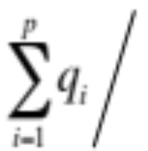

Mapping Schema & Replication Rate
p reducer: {R_{1,} R₂, …, R_{p}}
q max # inputs sent to any reducer R_{i}
Def (Mapping Schema): M : I → {R_{1,} R₂, …, R_{p}} s.t
  R_{i} receives at most q_{i} · q inputs
  Every output is covered by some reducer:
Def (Replication Rate):
  r =
q captures memory, r captures communication cost

Slide 14
Our Questions Again
Question 1: What is the minimum replication rate of any mapping schema as a function of q (maximum # inputs sent to any reducer)?
Question 2: Are there mapping schemas that match this lower bound?

Slide 15
Hamming Distance = 1
each input contributes to b outputs
each output depends on 2 inputs
<00…00, 00…01>
<00…00, 00…10>
…
<00…00, 10…00>
…
<11…11, 11…01>
<11…11, 11…10>
00…00
00…01
00…10
…
11…01
11…10
11…11
bit strings of
length b
…
|I| = 2^{b}
|O| = b2^{b}/2

Slide 16

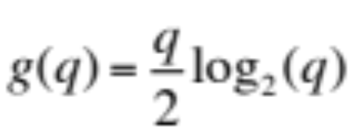
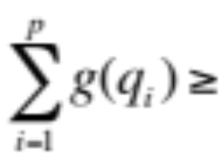
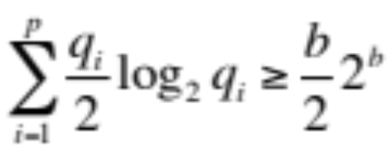
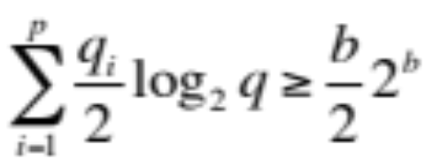



Lower Bound on Replication Rate (HD=1)
Key is upper bound : max outputs a reducer can cover with · q inputs
Claim: (proof by induction on b)
All outputs must be covered:
Recall: r = r =
r ¸ b/log₂(q)

Slide 17
Memory/Communication Cost Tradeoff (HD=1)
How about other points?
b
One reducer
for each output
r ¸ b/log₂(q)
r = replication
rate
All inputs
to one
reducer
2
1
2¹
2^{b/2}
2^{b}
q = max # inputs
to each reducer

Slide 18
Splitting Algorithm for HD 1 (q=2^{b/2})
first b/2 bits (Prefix)
last b/2 bits (Suffix)
P_{00..00}
P_{00..01}
00…00
00…00
…
11…11
…
11…11
00…00
00…01
…
00…00
…
11…11
Prefix
Reducers
…
P_{11..11}
S_{00..00}
S_{00..01}
Suffix
Reducers
…
S_{11..11}
r=2, q=2^{b/2}
2^{b/2} + 2^{b/2} Reducers

Slide 19
Where we stand for HD = 1
Generalized Splitting
b
One reducer
for each output
Splitting
r =replication
rate
All inputs
to one
reducer
2
1
2¹
2^{b/2}
2^{b}
q =max # inputs
to each reducer

Slide 20
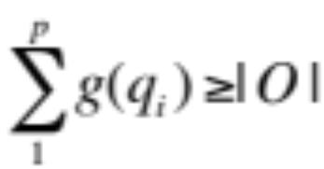
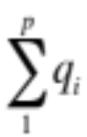

General Method for Using Our Framework
Represent problem P in terms of I, O, and dependencies
Lower bound for r as function of q:
  Upper bound on : max outputs covered by q inputs
  All outputs must be covered:
  Manipulate (ii) to get r = as a function of q
Demonstrate algorithms/mapping schemas that match the lower bound

Slide 21
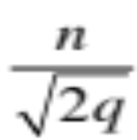
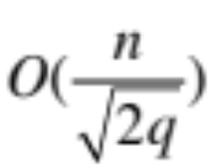
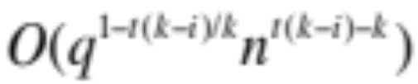
Other Results
Finding Triangles in G(V, E) with n vertices:
  Lower bound: r ¸
  Algorithms:
Multiway Self Joins:
  R(A₁₁,…,A_{1k}) R(A₂₁,…, A_{2k}) … R(A_{t1},…, A_{tk})
  k # columns, n = |A_{i}|, join t times on i columns
  Lower bound & Algorithms:
Hamming distance · d
  Algorithms: r · d + 1
⋈
⋈
⋈

Slide 22
Related Work
Efficient Parallel Set Similarity Joins Using MapReduce (Vernica, Carey, Li in SIGMOD ’10)
Processing Theta Joins Using MapReduce (Okcan, Riedewald in SIGMOD ’11)
Fuzzy Joins Using MapReduce (Afrati, Das Sarma, Menestrina, Parameswaran, Ullman in ICDE ’12)
Optimizing Joins in a MapReduce Environment (Afrati, Ullman in EDBT ’10)
Counting Triangles and the Curse of the Last Reducer (Suri, Vassilvitskii WWW ’11)
Enumerating Subgraph Instances Using MapReduce (Afrati, Fotakis, Ullman as Techreport 2011)
A Model of Computation for MapReduce (Karloff, Suri, Vassilvitskii in SODA ’10)

Slide 23
Future Work
Derive lower bounds on replication rate and match this lower bound with algorithms for many different problems.
Relate structure of input-output dependency graph to replication rate.
  How does min-cut size relate to replication rate?
  How does expansion rate relate to replication rate?

