Slide 1
CBLOCK:
An Automatic Blocking Mechanism for
Large-Scale Deduplication Tasks
Ashwin Machanavajjhala
Duke University
with Anish Das Sarma, Ankur Jain, Philip Bohannon

Slide 2
What is Deduplication?
Problem of identifying and linking/grouping different manifestations of the same real world object.
Examples of manifestations and objects:
Different ways of addressing (names, email addresses, FaceBook accounts) the same person in text.
Web pages with differing descriptions of the same business.
Different photos of the same object.
…

Slide 3
Deduplication Motivating Examples
Linking Census Records
Public Health
Web search
Comparison shopping
Counter-terrorism
Spam detection
Machine Reading
…

Slide 4
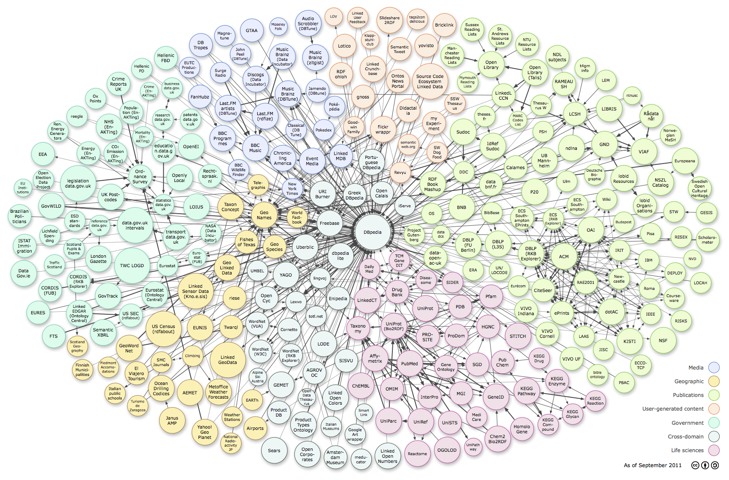
Big-Data & Deduplication

Slide 5
Blocking: Motivation
Naïve pairwise: |R|² pairwise comparisons
  100 business listings each from 10,000 different cities across the world
  1 trillion comparisons
  11.6 days (if each comparison is 1 μs)
Mentions from different cities are unlikely to be matches
  Blocking Criterion: City
  100 million comparisons
  100 seconds (if each comparison is 1 μs)
Notes:
1 micro second is a very optimistic estimate. Typical classifiers, like SVM or logistic regression, takes about 10-100 micro seconds per instance.

Slide 6
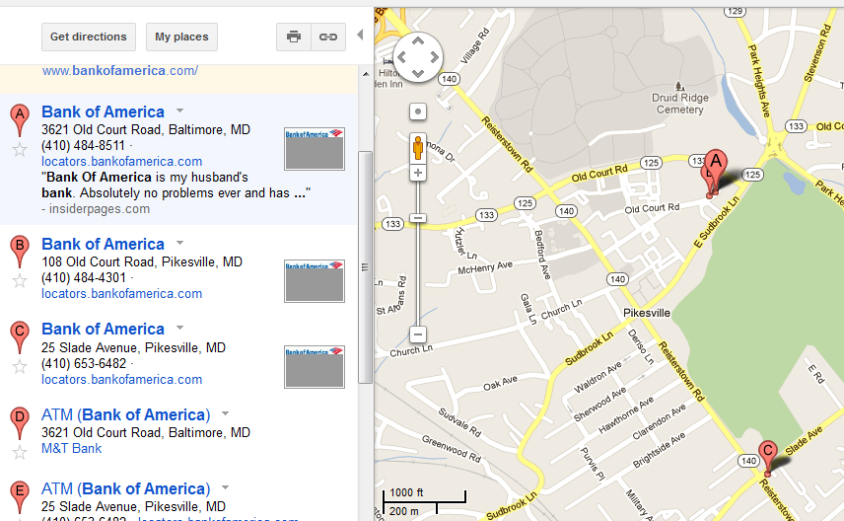
Blocking: Motivation
Mentions from different cities are unlikely to be matches
  May miss potential matches

Slide 7
Blocking: Motivation
Pairs of Records satisfying
Blocking criterion
Matching Pairs of Records
Set of all Pairs of Records

Slide 8
Focus of this talk
Need to scale de-duplication to very large datasets.
Need to perform de-duplication across a large number of domains.
Our Contribution:
CBLOCK: An automatic blocking strategy for scaling de-duplication tasks.

Slide 9
Next …
Blocking Problem Statement
CBLOCK
  Hierarchical Blocking Trees
    Structure
    Construction
  Rollup
  Drill-down
Experiments

Slide 10

Blocking Problem Definition
Input: Set of records R
Output: Set of blocks/canopies
Optimization Criteria:
Coverage: Most duplicates within some block
Efficiency: Blocks are small. When blocks evaluated in parallel, small ``largest block’’

Slide 11

Blocking Problem Definition
Coverage Estimator:
  Use a training set T⁺ of matching pairs of objects
  Maximize:
Efficiency Estimator:
  size of each block is bounded by S

Slide 12

Blocking Problem Definition
Input: Set of records R
Output: Set of blocks/canopies
Desiderata:
Need to efficiently compute which block a record belongs to.
Hash-based Blocking: Each block corresponds to objects that are hashed to the same key h_{i}
  Amenable to implementations on Map-Reduce
x is hashed to C_{i} if hash(x) = h_{i}.
Each hash function results in Disjoint Blocking:

Slide 13
Hash-based Blocking
Examples of hash keys:
  Last name
  First three characters of first name
  City + State + Zip
Using one (or a conjunction of) blocking keys may be insufficient
  Many objects may be hashed to a small number of hash keys.
  2,376,206 American’s shared the surname Smith in the 2000 US
  NULL values may create large blocks.
Solution: Construct blocking functions by combining simple functions

Slide 14
Next …
Blocking Problem Statement
CBLOCK
  Hierarchical Blocking Trees
    Structure
    Construction
  Rollup
  Drill-down
Experiments

Slide 15
CBLOCK Components
Training phase
Coverage Estimator
Execution phase
<R1, George Timothy Clooney, 50yrs,.. >
= <R2, G. Clooney, Age: 51, …..>
Block-generator
Drill-down Algorithm
Blocking function
Space of hash functions
Disjoint Blocking
- “first 3 chars of name”
- “last 4 digits of phone”
Blocks
Rollup Algorithm
Efficiency Constraints
Non-disjoint Algorithm
Input Data
- Disjointness
- Size Constraints
- Cost Objective

Slide 16
Hierarchical Blocking Trees
title
NULL
<A*
[T*,U*)
[A*,B*)
release-year
director

Slide 17
Hierarchical Blocking Tree
Tree of hash functions.
Each hash function is a root to leaf path.
Permits efficient implementation.

Slide 18
Blocking Tree Construction
Hardness:
Constructing an optimal blocking tree is NP-hard.
Greedy Heuristic:
Successively pick hash function for each partition having
size > S
Picking hash function at each node based on:
  Number of +ve examples that get split
  Sizes of remaining canopies

Slide 19
Extensions
Every block has size < S. But certain blocks may be very small, resulting in low recall.
  Rollup of blocks: Merging small blocks to improve recall.
A space of (manually generated) hash function is assumed as an input to CBLOCK.
  Drill-down: Automatically constructing a set of simple hash functions.
Allowing for non-disjoint blocking can increase recall
  Use multiple hierarchical blocking trees.

Slide 20
Rollup Problem
Input: Blocks C₁, …, C_{m} (each of size < S), and +ve examples T⁺
Output: Find canopies D₁, …, D_{m} such that
  D_{i}’s are disjoint
  Each D_{i} is a union of some C_{i}’s
  |D_{i}| < S
  Recall subject to above maximized
Results:
  Problem is NP-complete
  Greedy algorithm based on Dantzig’s 2-approximation for knapsack problem

Slide 21

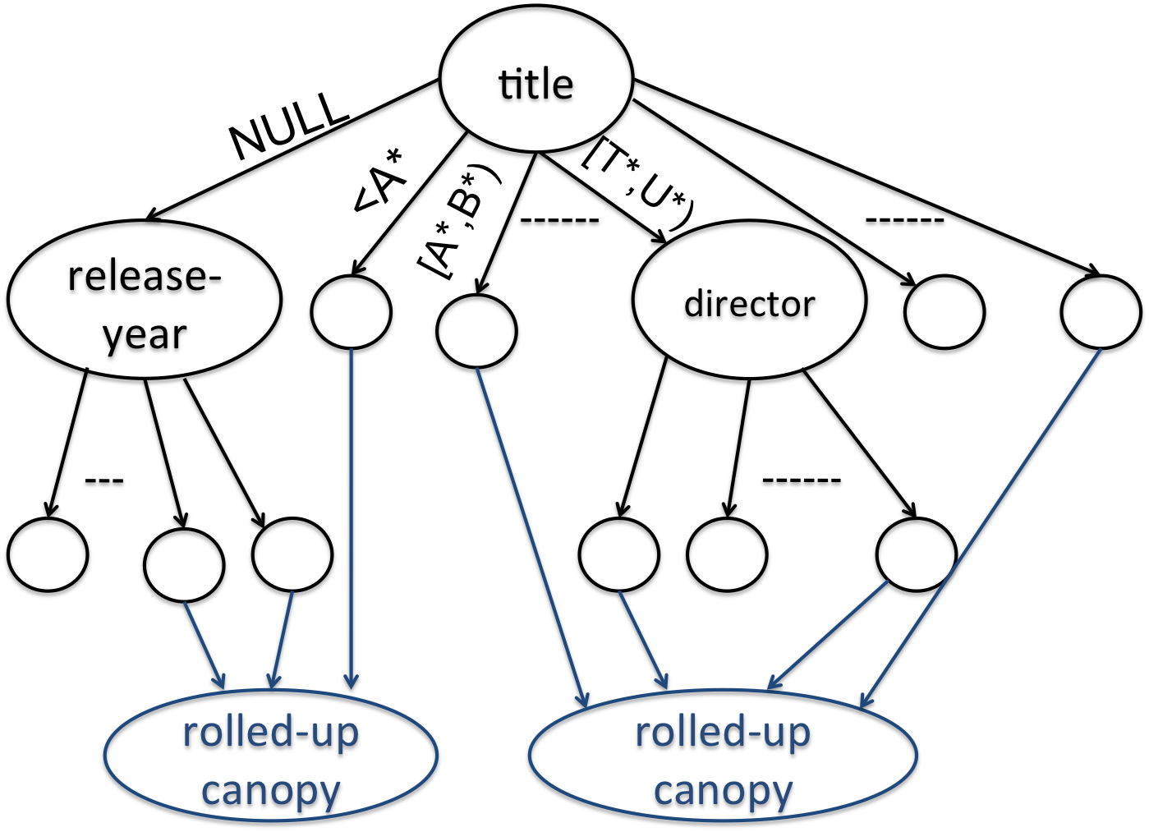
Rollup Algorithm
In each step find a pair of blocks D₁ and D₂ which maximize
where benefit(D₁, D₂) = number of new matching pairs in the training set that will be in the same block after merging D₁ and D₂.

Slide 22
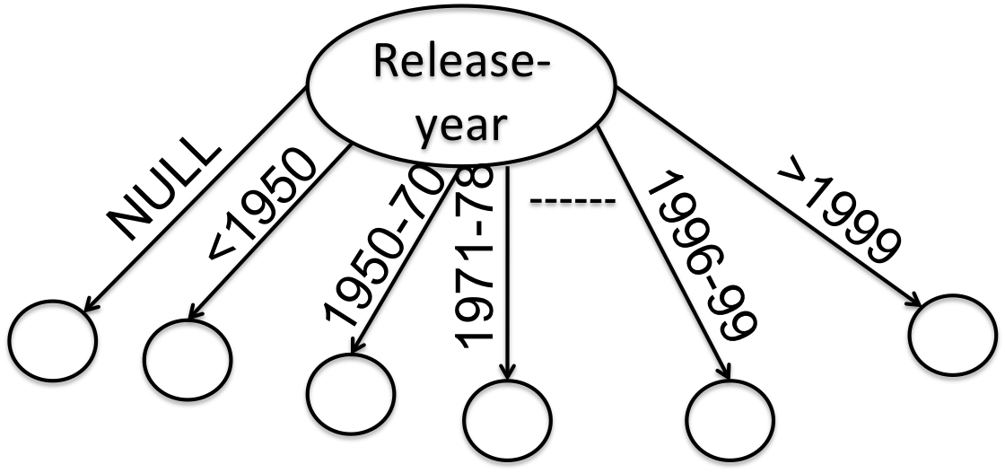
Drill-down Problem: Summary
Determining partitioning in an ordered domain:
  each partition gives canopy size < S
  recall maximized
Our result: Poly-time optimal algorithm based on dynamic programming

Slide 23
Next …
Blocking Problem Statement
CBLOCK
  Hierarchical Blocking Trees
    Structure
    Construction
  Rollup
  Drill-down
Experiments

Slide 24
Experiments
Datasets:
  Sample of Y! Movies dataset (140K entities)
  Sample of Y! Local dataset (40K entities)
Metrics:
  Recall: fraction of matching pairs in T+ which are in the same block
  Efficiency: computation cost.

Slide 25
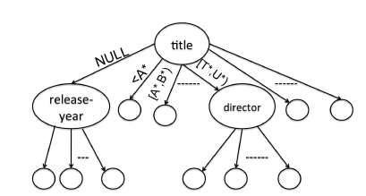
Experiments
Algorithms
  Random (R)
  Single-hash (SH)
  Chain (C): conjunctions of hash functions
    [Michelson & Knoblock AAAI ‘06], [Bilenko et al ICDM ‘06]
  Chain Tree (CT): Same hash function is used in all levels of the tree
  Hierarchical Blocking Tree (HBT)

Slide 26
Highlights
Significantly outperform all other approaches wrt recall.
Recall close to 1 using multiple rounds of HBT for movies data.
Next: a sample of results.

Slide 27
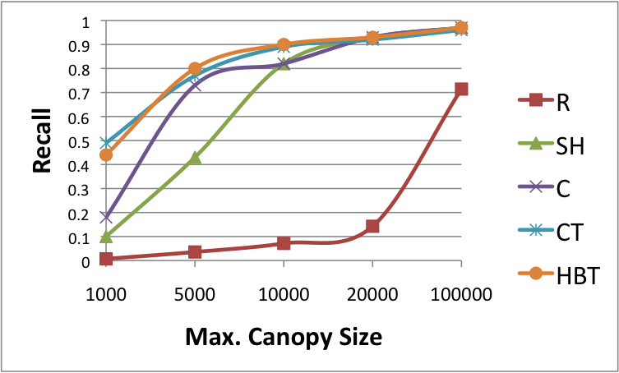
Recall vs Max Canopy Size (Disjoint)
Movies Dataset

Slide 28
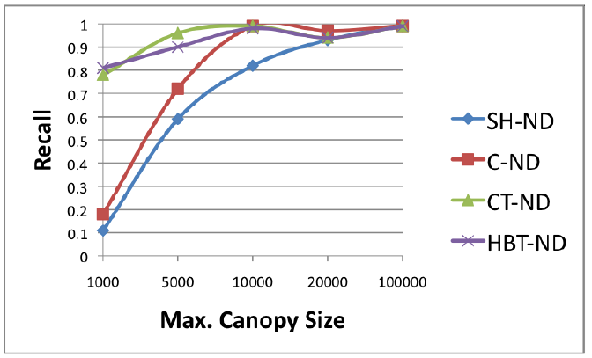
Recall vs Max Canopy Size (Non-disjoint)
Movies Dataset

Slide 29
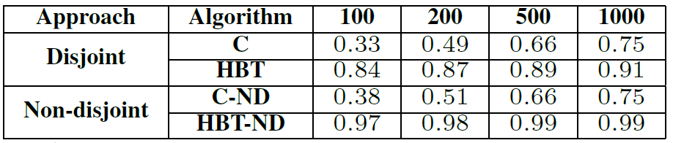
Summary of Recall on Restaurants

Slide 30
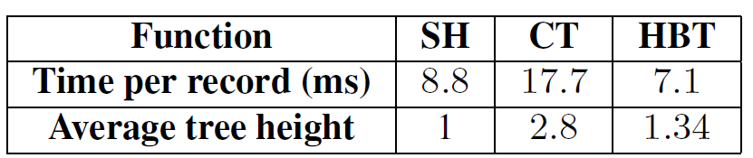
Time (μs), max size=10K

Slide 31
Summary
Presented CBLOCK, system for automatic blocking of large datasets
A novel hierarchical blocking tree structure for specifying disjoint blocking functions
Extensions of rollup, drilldown, and non-disjoint blocking
Experiments show performance improvement over state-of-the-art

Slide 32
Thank you! ☺

